Slide 1
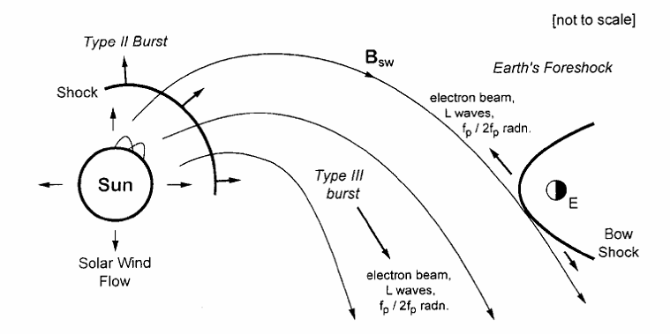
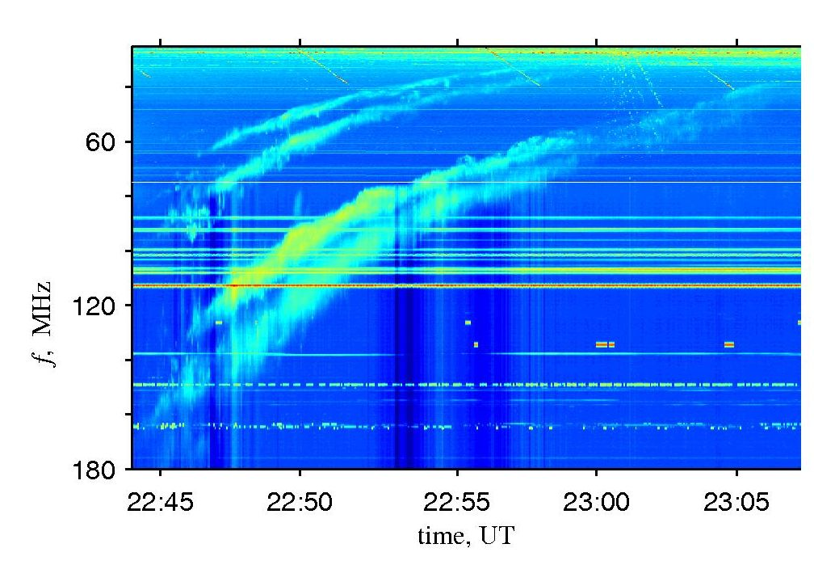
Solar Radio Bursts: Research Topics for SKA and Extensions to MWA (& other stars?)
Iver H. Cairns^{1,2}
¹ School of Physics, University of Sydney
² Also at CUAVA (ARC Training Centre for CubeSats, UAVs, & Their Applications) … interest in Space Weather and so Solar / Space Physics
ARDRA Workshop,
India 2019

Slide 2
Outline
Intro to CMEs and Type II & III Solar Radio Bursts
Topics: Some Illustrations with MWA data
  Density profiles
  Multiple source regions: type IIs, IIIs, & split-bands
  Scattering by density irregularities
  Polarization
  Weak radio emissions associated with CMEs
  Tests of theory
  Signatures of events likely to cause space weather at Earth
Summary

Slide 3
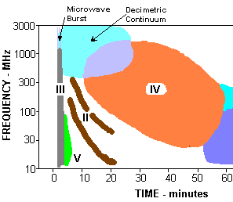
Type II & III Bursts and CMEs
[Wild & McCready, 1950; J.Kennewell, 2006]
Coronal and interplanetary type II bursts
Probe dynamic activity, fundamental physics (magnetic reconnection, wave processes, emission, shocks, CMEs...), n_{e}, T_{e}, Ti profiles, origin & heating of corona & solar wind.

Slide 4
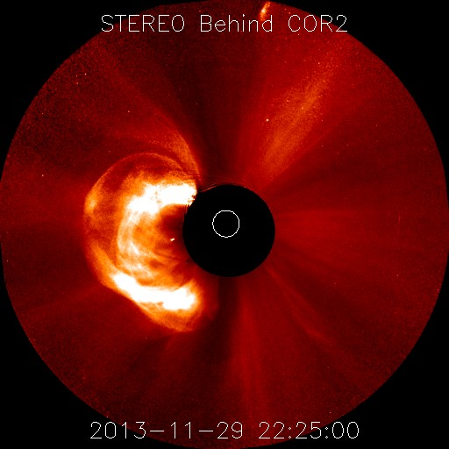
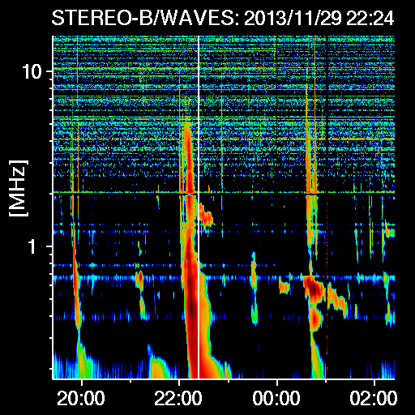
CMEs & Type II and III Solar Radio Bursts
arguably three of the most impressive forms of solar activity
[NASA / CDAW, courtesy N. Gopalswamy et al ]

Slide 5
CMEs, Type II Bursts, and Space Weather
Space weather = conditions in space that may affect human systems & activities on Earth & in space.
90% of large space weather events at Earth due to CMEs with southwards B_{z} & associated magnetic reconnection
[Richardson et al., 2010]

Slide 6
2. Issues & Illustrations with MWA
  Density profiles
  Multiple source regions: type IIs, IIIs, & split-bands
  Scattering by density irregularities
  Polarization
  Weak radio emissions associated with CMEs
  Tests of theory
  Signatures of events likely to cause space weather at Earth
  Other stars?

Slide 7
Density profiles: Offset Power-law fits well
Traditional density models are poor but Offset Power-Law fits well (r variation, solar wind acceleration)
➔ probe physics of corona & solar wind …. and radio bursts!
Is the power-law index different before and after flares? ➔ Ducting & scattering less important?
[Harding et al., ApJ, 2019]

Slide 8
Type IIIs: Multiple sources & connection to magnetic geometries and scattering
Sources splitting & moving at same and different f
➔ source physics, B(r) geometry, & probe of scattering ….
Do multiple, smaller sources exist?
[McCauley et al., ApJ, 2017]
Need better measurements.

Slide 9
Source location & scattering …. polarisation
Source location ⬅➔ Density model & scattering / ducting
Polarisation has information on wave physics, fundamental / harmonic, & scattering
Need better measurements.
[McCauley et al., 2017; Rahman et al., sub., 2019]

Slide 10
Type III source area & scattering?
Measured A = a f^{-2.4± 0.4}
Scattering theory ➔ A = a f ⁻⁴
➔ theoretical problem.
Magnetic field divergence with small amount of scattering?
Multiple sources?
Need better
measurements.
[M.M. Rahman, PhD thesis, sub., 2019]

Slide 11
Multiple source regions & theories for split-bands in Type II bursts?
Fundamental and harmonic bands split into 2 with a gap between.
3 theories proposed: Split-bands are
  from regions with different densities and so f_{p} and 2f_{p} [McLean, 1967].
  From upstream & downstream of shock, with frequency ratio giving the shock compression [Smerd et al., 1975].
  Due to two different emission mechanisms, with splitting of f_{ce} / 2 and f_{ce} for f_{p} & 2f_{p} radiation [Cairns, 1994].
Simulation code does not allow downstream emission and has 1 mechanism for each of f_{p} & 2f_{p} radiation.
Thus data-simulation comparisons ➔ strong test of all three theories.

Slide 12
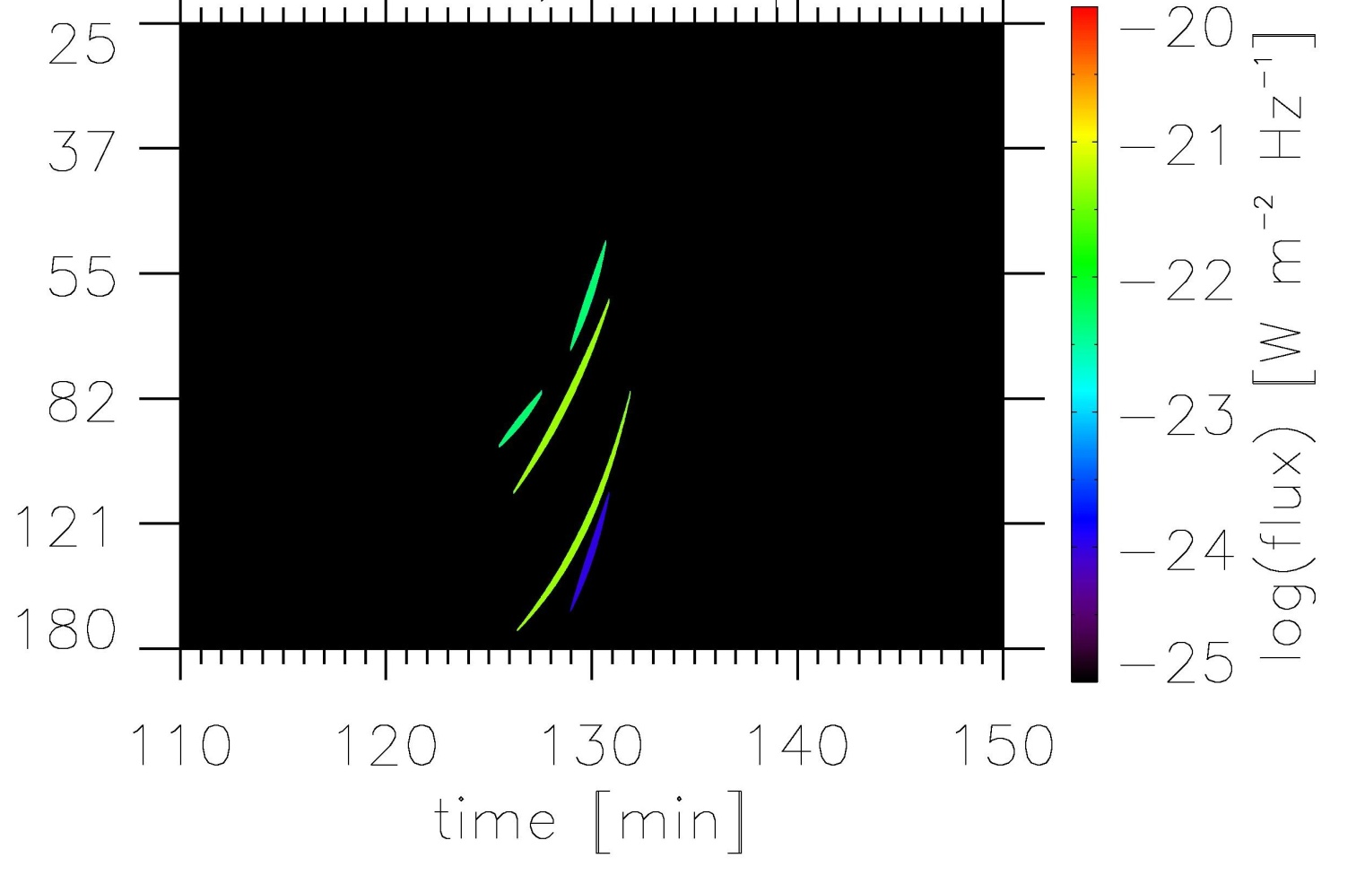
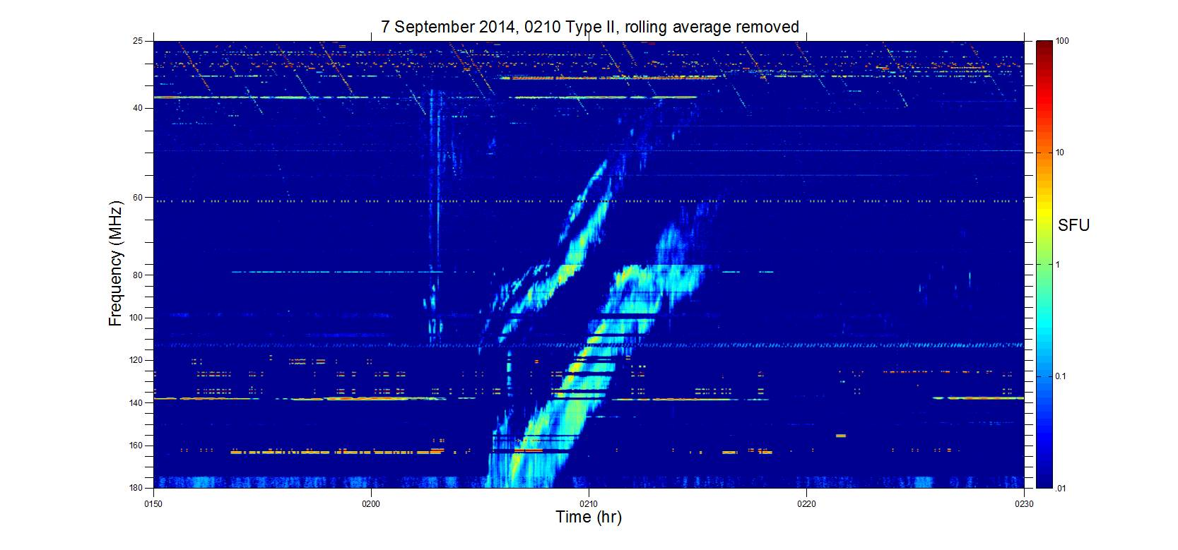
Theory / data
(Learmonth) comparison: same scales
10²
Flux
1
(SFU)
10⁻²
Frequency (MHz)
25
10²
Calibration by
J. Harding in 2014
40
10
60
Flux
(SFU)
7 Sept 2014
Type II Burst
80
1
100
10⁻¹
140
180
10⁻²
0150
0200
0210
0220
0230
[Cairns et al.,
in prep., 2019]
Time (HHMM)

Slide 13
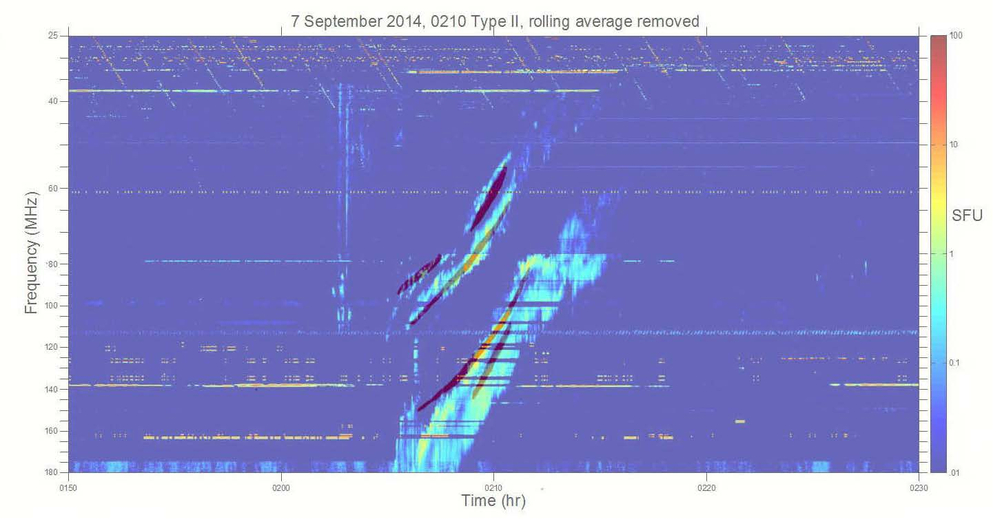
Data – Simulation Comparison: 7 September 2014 Split-band Event
Our simulations agree very well with the observations in frequency, intensity, & time.
Strong evidence for type II theory
Split-bands predicted & observed ➔ strong evidence for McLean [1967] theory.
[Cairns et al.,
in prep., 2019]

Slide 14
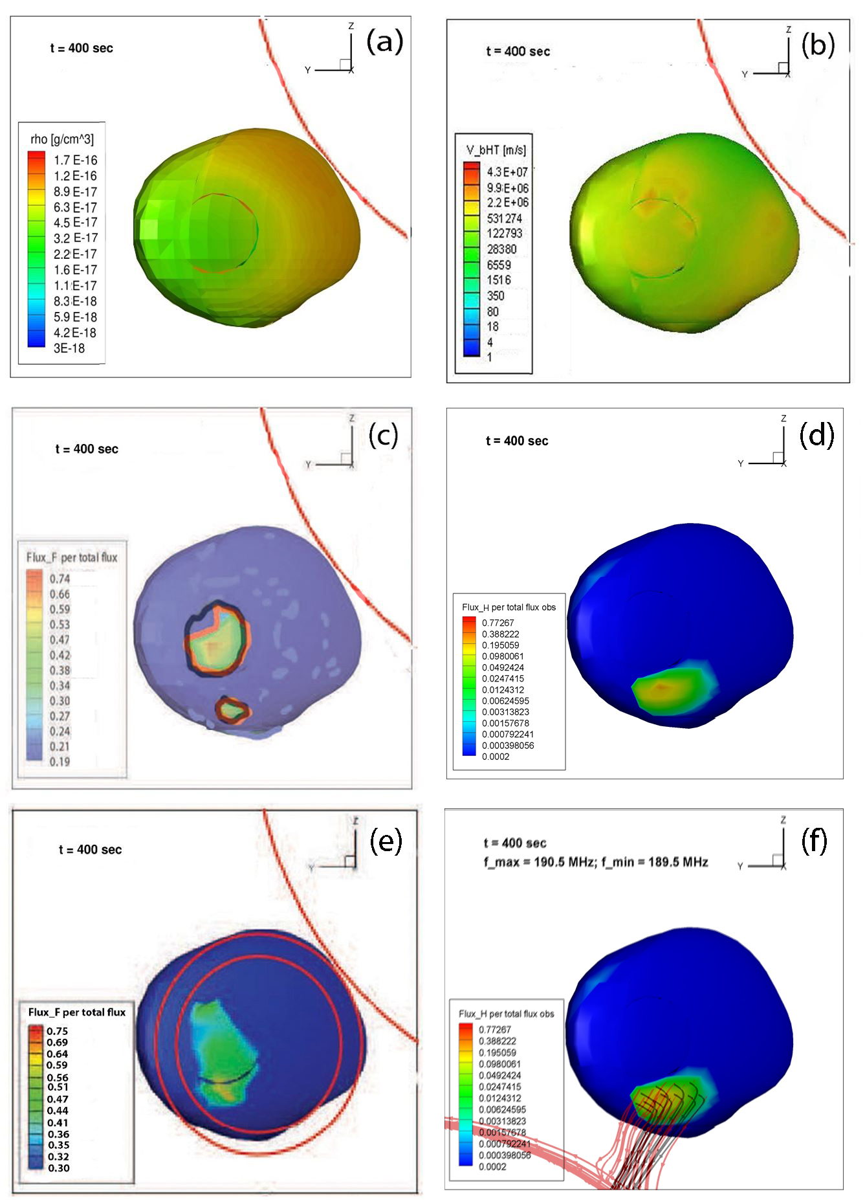
Predicted and MWA-Observed Source Locations
Sun’s limb
(a) Density and (b) de Hoffman – Teller speed over shock surface
➔ clear gradients in density
(c) Volume emissivity near shock surface for fundamental (red) & Harmonic (black) emission
  ➔ 2 sources with different frequencies
  split-bands have different source regions
  F & H sources overlie for this event.
(d) line-of-sight integrated source region of upper harmonic split-band
Density
variations
Two sources
Nose = lower
split-band
Flank = upper
split-bands
F (red) & H (black)
almost same sources
Need better measurements.
[Cairns et al., in prep., 2019]

Slide 15
Source Locations: Excellent MWA – Theory Agreement
Sun’s limb
Predicted and observed locations agree well for lower fundamental split-band (etc.)
  Larger observed source - due to scattering?
  Small role here for ducting, and propagation effects.
Is this usual?
Need better measurements.
Observed
MWA source
Predicted lower f_{p} split-band
convolved with MWA beam
B lines (black)
Shock normal (red)
[Cairns et al., ... in prep.]

Slide 16
4. Summary
Many important problems for SKA and MWA to solve in Solar Radiophysics
  Density profiles & their variations with solar activity
  Existence or not of multiple source regions for type II & III bursts and their fine structures (e.g., split-bands)
  How important are scattering & ducting by density irregularities?
  What are the polarization properties of type II and III bursts on short timescales and do their spatial variations show coherent patterns?
  Tests of theory for type II and III bursts etc
  Weak radio emissions associated with CMEs (not discussed)
  Can we use the radio emissions as harbingers of CMEs & space weather at Earth (“”)?
  Other stars?
  Need better measurements (esp. angular resolution) to resolve these questions observationally … ➔ SKA or MWA+?

Slide 18
3.1 Reminder of the Simulation and Theory Approach
[cf. Schmidt &
Gopalswamy, 2008]
We use the SWMF / BATS-R-US code (3D MHD + radiation – 2012 version)
  to model realistic corona for the time period.
  simulate CME initiation and propagation.
Kinetic type II theory
  Shock & plasma characteristics from BATS-R-US
  electron energization at shock
  Langmuir waves and radio emission.
Compare theory and observations.
[Roussev et al. 03, 04,
Toth et al., 2012]:
[Schmidt & Cairns,
JGR, 2012a,b]
For interplanetary type IIs [Schmidt et al., ApJL, 2013; Schmidt & Cairns, JGR, 2014a,b, 2016,2017 etc.]

Slide 19
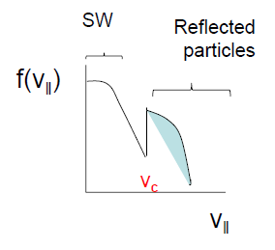
Type II Theory: shock + “plasma emission”
V_{c} = V_{sh} sec θ_{bn}
[Wild, 1952;
Nelson &
Melrose, 1985;
Cairns, 1986,
1988; …]
Semi-quantitative, analytic, macroscopic theory exists:
[Knock et al., 2001, 2003a,b; Cairns et al., 2003; Kuncic et al., 2002, Knock & Cairns, 2005; Schmidt & Gopalswamy, 2008; Schmidt & Cairns, 2012a,b]

Slide 20
3.3 Discussion … Solving the Type II Problem
Explain typical type II bursts quantitatively: corona to 1 AU
  Quantitative theory ✓
  Quantitative simulation capability: corona / solar wind and CME ✓
  Fluxes (frequency, time) ✓
  Appearance of dynamic spectrum (blobs / variability) ✓
  Source regions (frequency, time) & variability ✓
  In situ source region physics ✓ ?
  Propagation effects
  Corona (metric) versus interplanetary (10 MHz – 10 kHz) ✓
  Radio-loud / radio-quiet CMEs and shocks ✓
Explain fine structures:
  Split-bands ✓
  Multiple-lanes ✓?
  Herringbones

