Slide 1
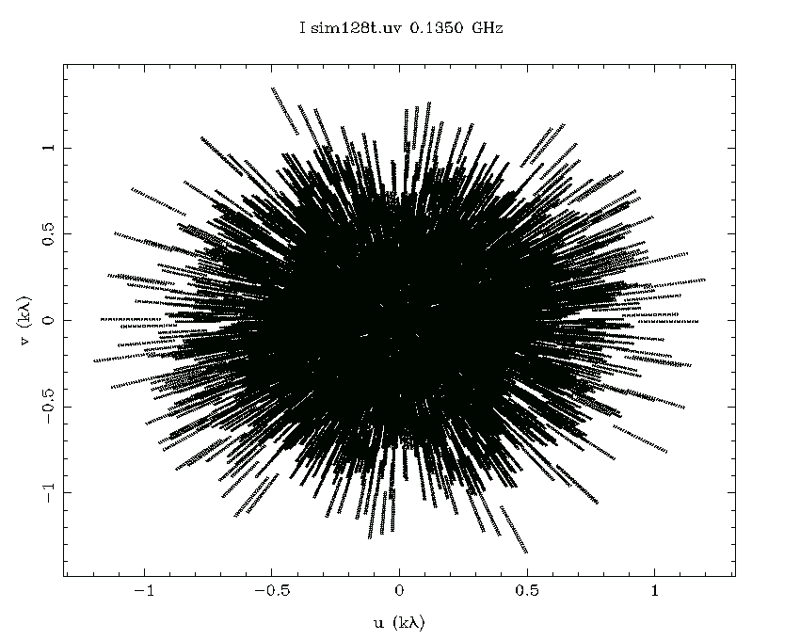
Interplanetary Scintillation with the
Murchison Widefield Array
John Morgan

Slide 2
IPS with the MWA
8˚×5˚ field; 1 minute of data (4×real time)

Slide 3
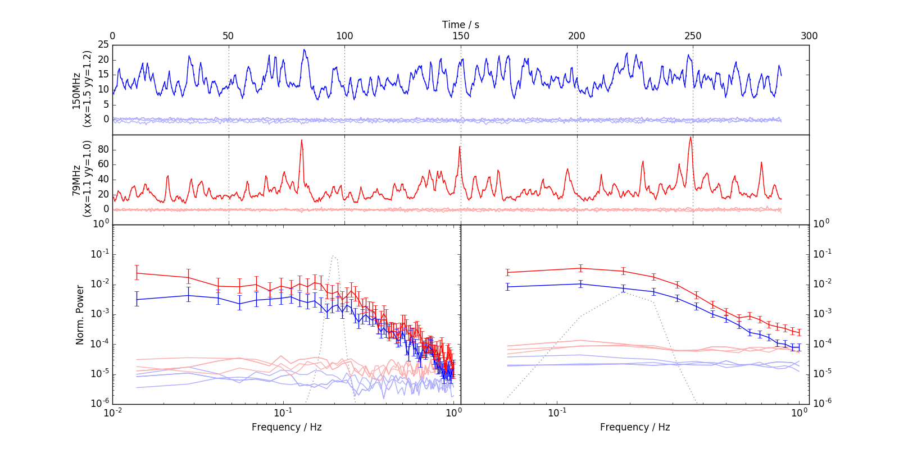
Lightcurve/Power spectrum On/Off source

Slide 4
Mean Image vs RMS Image

Slide 5
An overview of IPS
Observables
Scintillation Index
Power Spectrum / ACF
Distribution of Fluctuations
Multi-frequency
Cross spectrum
Cross correlation
Multi-station
Heliosphere Parameters
Solar Wind Density
Solar Wind Speed
Turbulence parameters
3D Anisotropy
Astrophysical Parameters
Source size
Source Structure
Source variability?

Slide 6
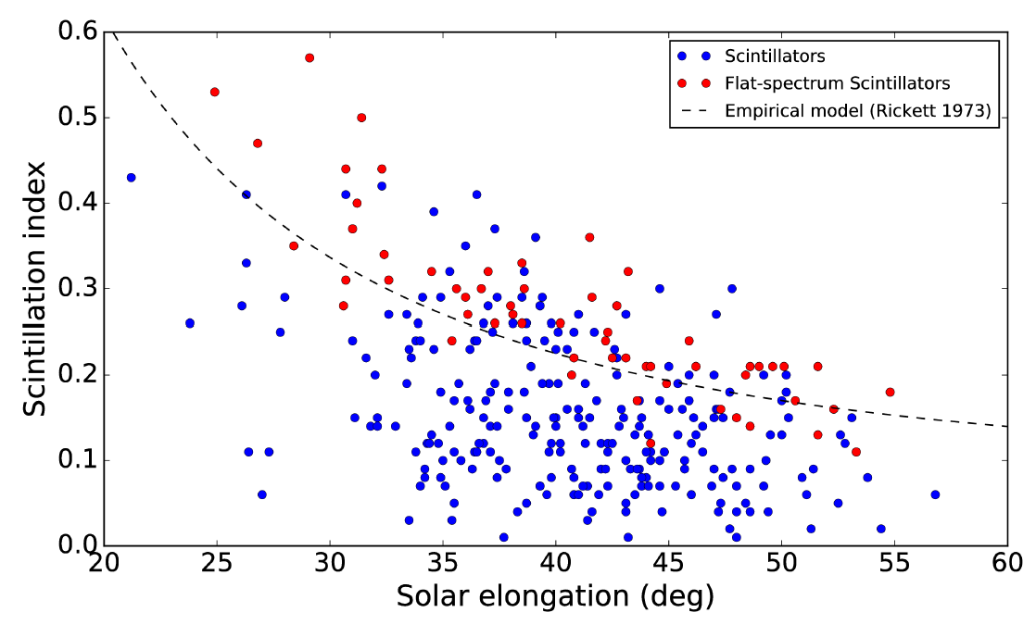
Expected Scintillation Index
Chhetri+ IPS with the MWA II
Notes:
Flat-spectrum sources, which we’d expect to be compact, sit towards the top of the range and trace the expected model. However flat-spectrum sources do not account for all of the IPS sources, or even for all of the most compact ones.

Slide 7
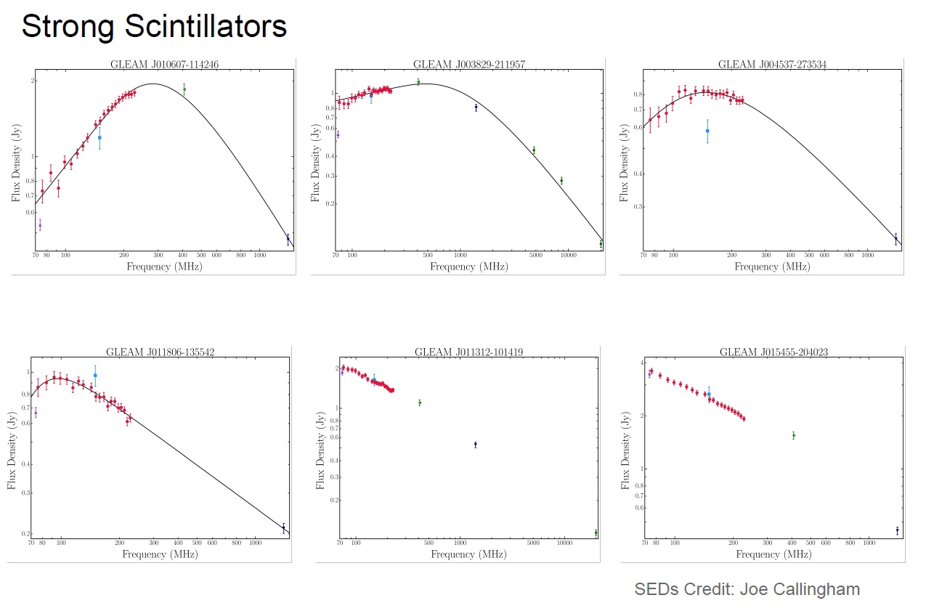
Large fraction of peaked sources
Stark contrast with:
General low-frequency source population
Compact source population at higher frequencies
Chhetri+ IPS with the MWA II

Slide 8
Compactness vs Spectral Index

Slide 9
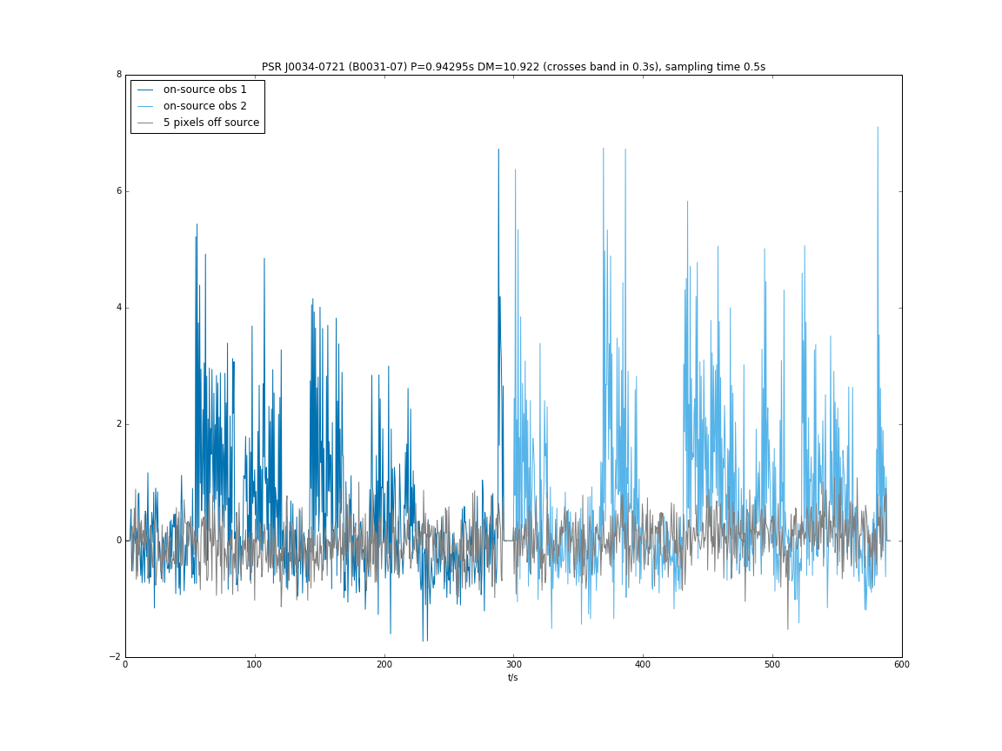
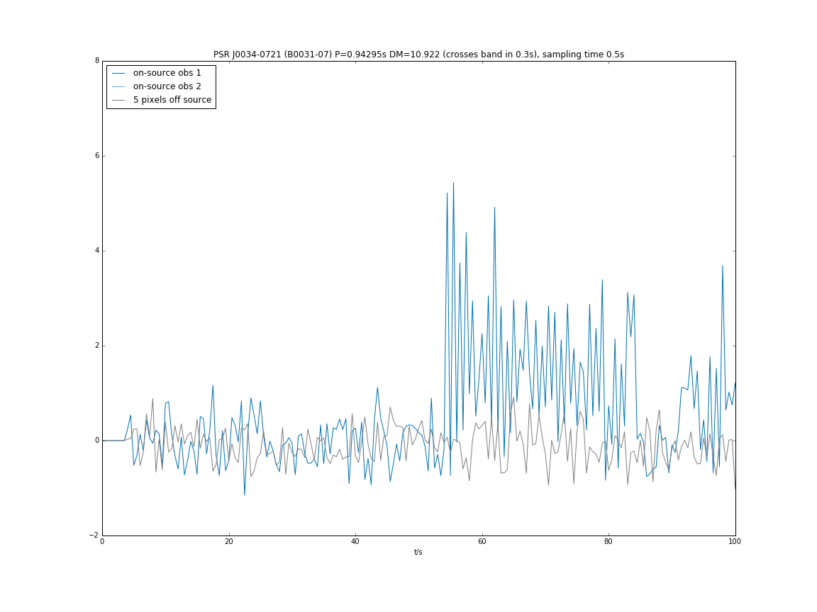
m-p curves for consecutive observations

Slide 10
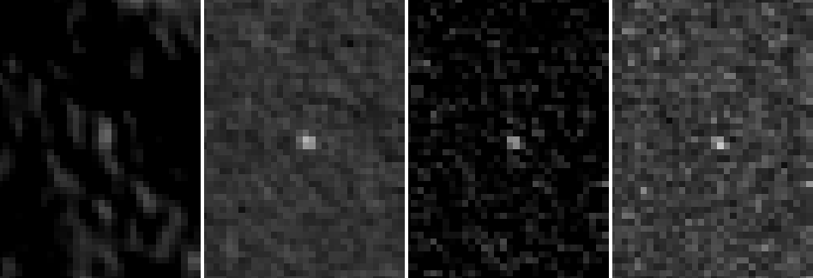
Going below the confusion limit
Continuum RMS Skew Kurtosis
2.5σ 17σ

Slide 11
J0034-0534 (millisecond pulsar)
Continuum RMS Skew Kurtosis
2.5σ 17σ

Slide 12
RMS vs Skew

Slide 13
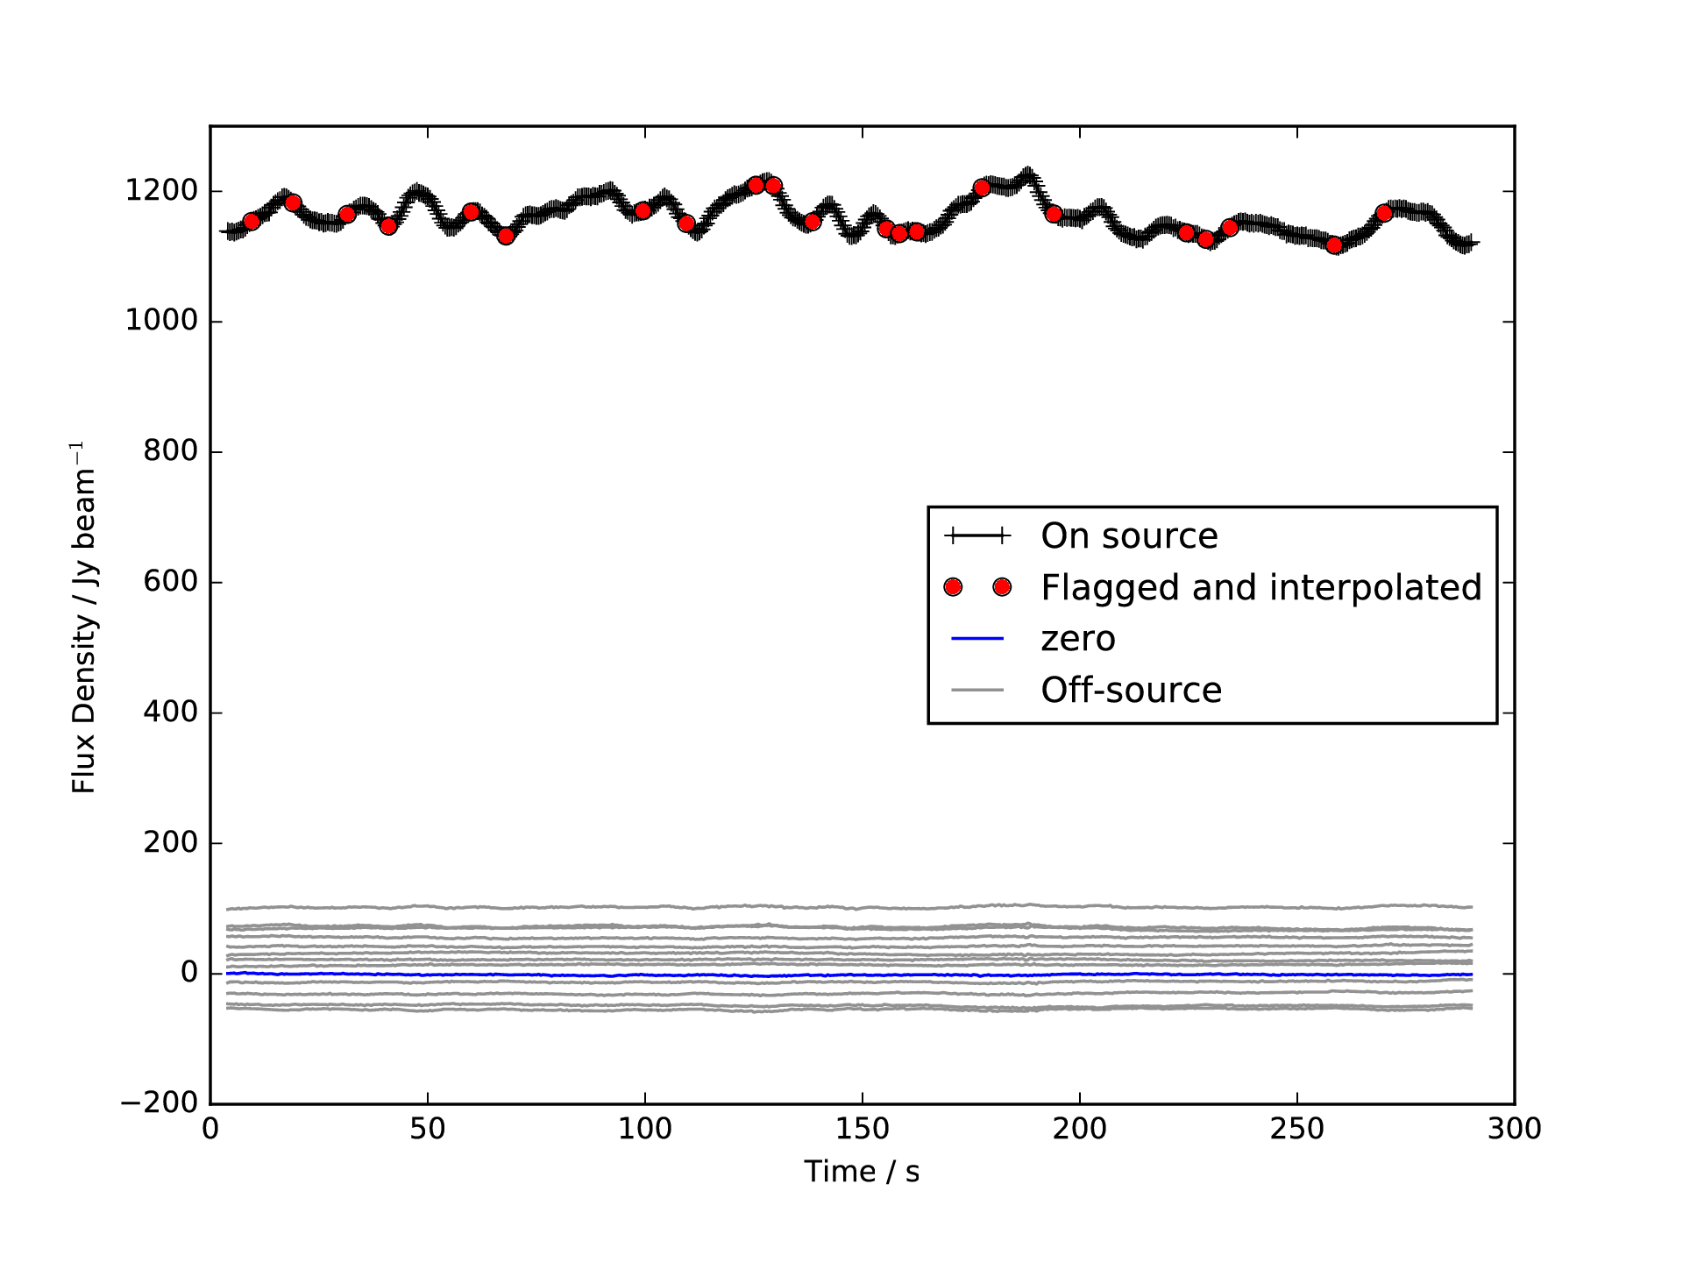
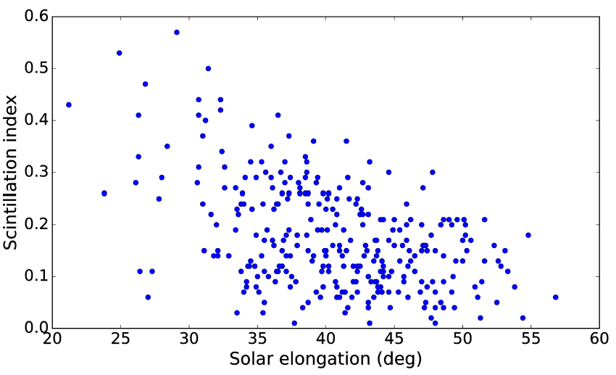
Ionospheric Scintillation 2.7%
Morgan & Ekers (in prep.)

Slide 14
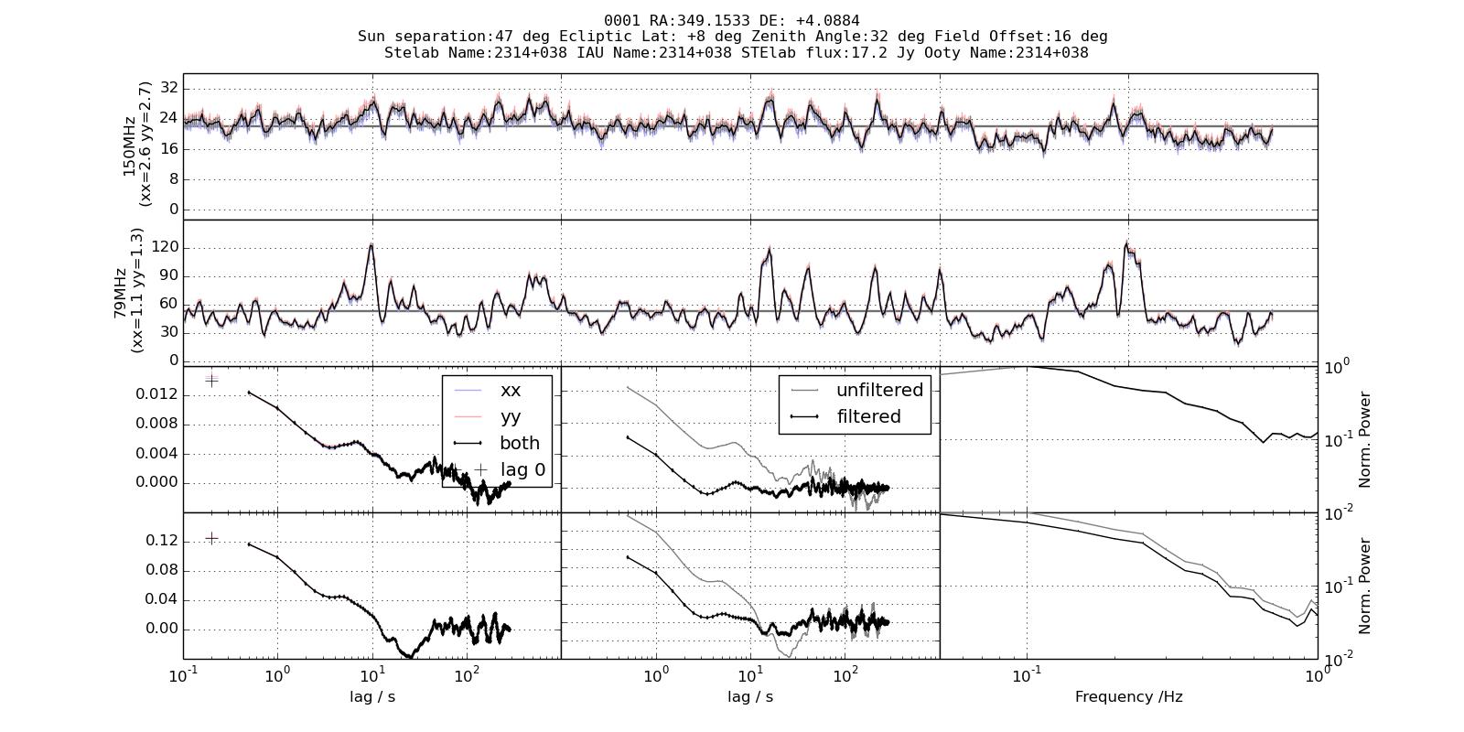
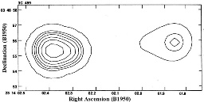
3C495
Distance to scattering screen: cos(47) AU = 1e8 km
Delay from ACF: 7 seconds
Implied solar wind velocity: 540km/s – Plausible
Arrow indicates direction of solar wind:
7.7 arcsec between components in solar wind direction

Slide 15
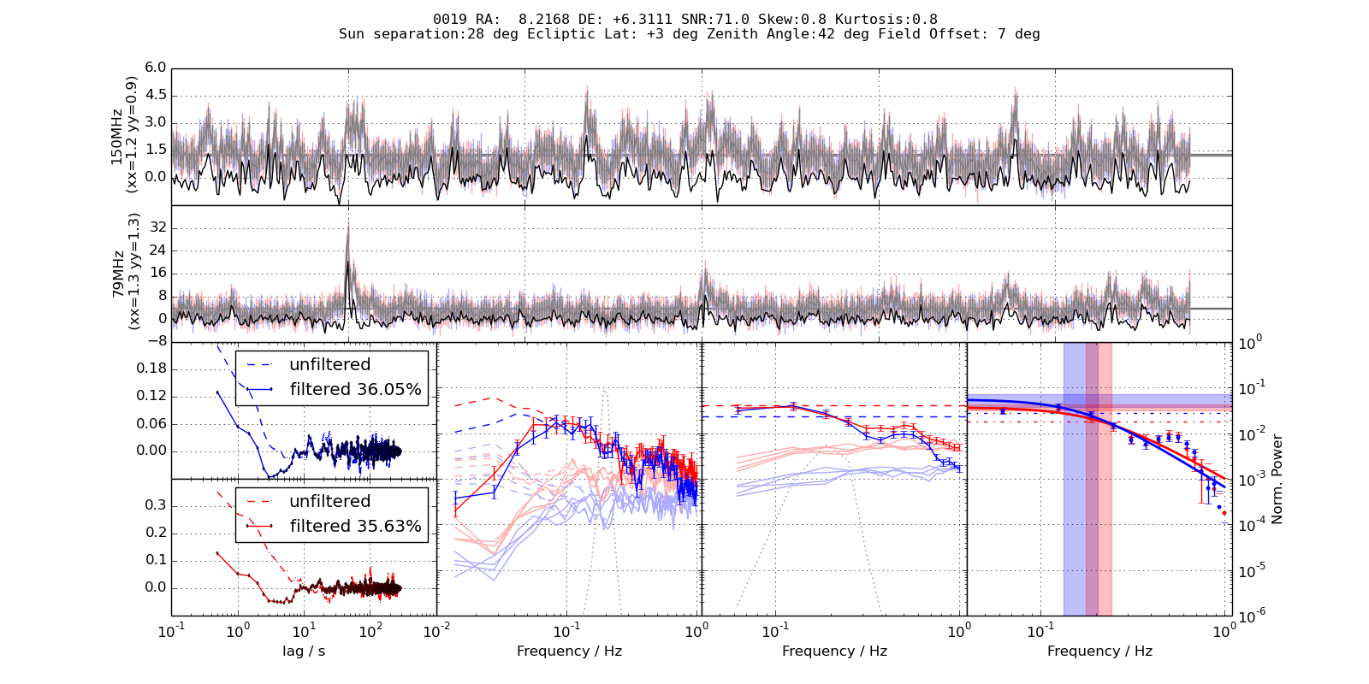
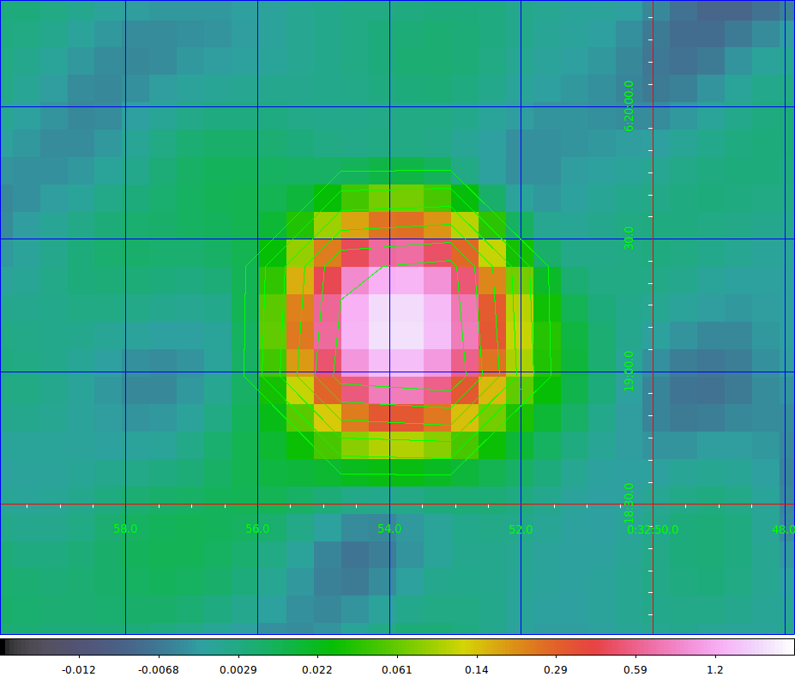
PMN J0032+0619
No high-resolution images to be found.
Much closer than the others: 400km/s wind speed implies 3.2” parallel with solar wind direction (almost perfectly E-W)
In all of the usual surveys (MRC, NVSS, VLSS etc.)
No sign of any extension in TGSS-ADR

Slide 17
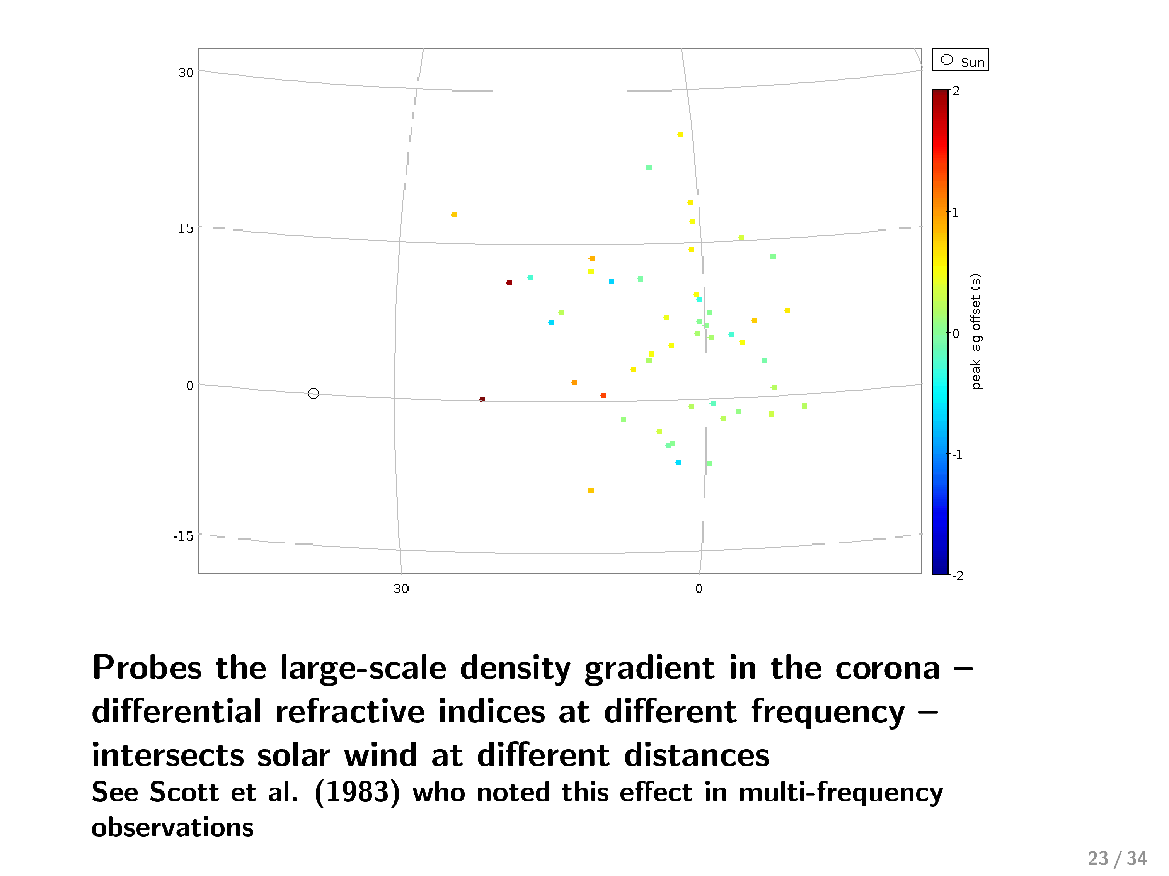

Slide 18
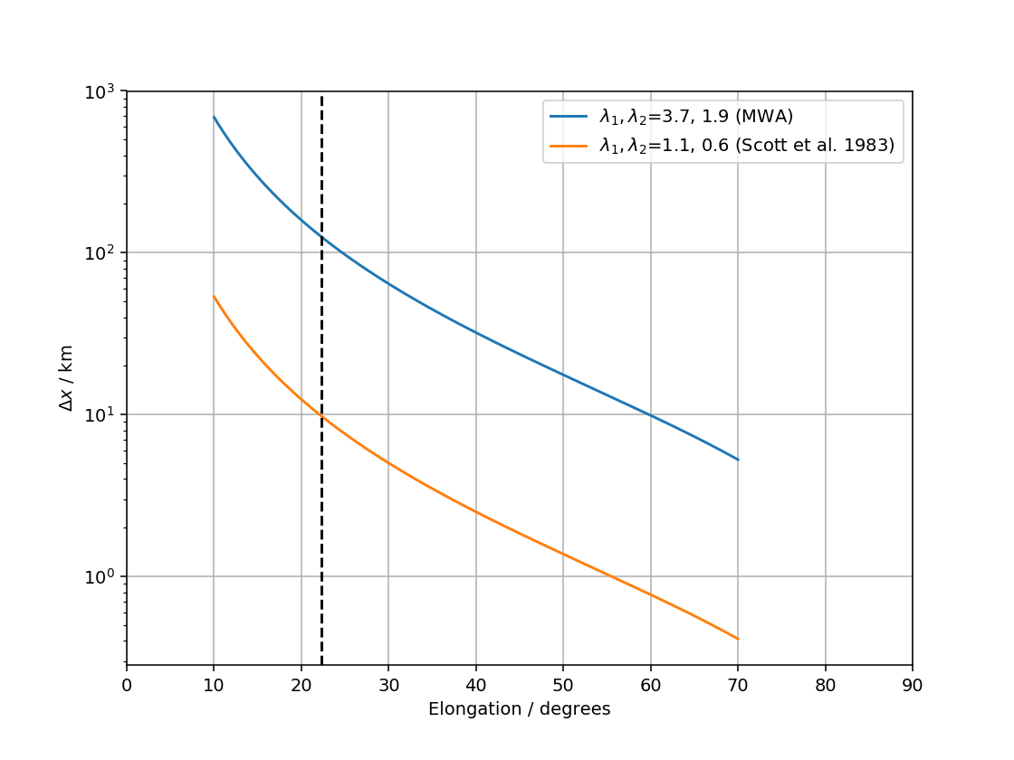

Slide 19
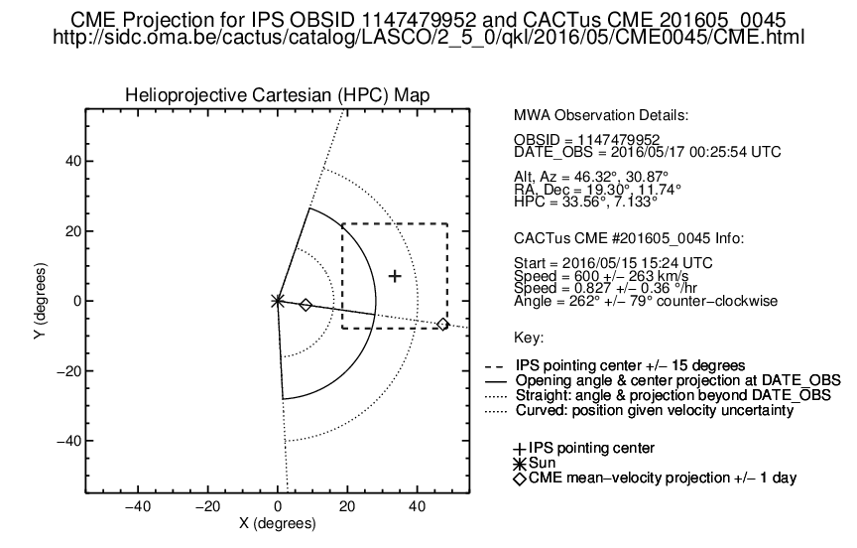
Mapping CMEs
Choose observations which we believe are likely to contain a CME
Analyse these along with a control sample
Patrick McCauley (USyd)

Slide 20
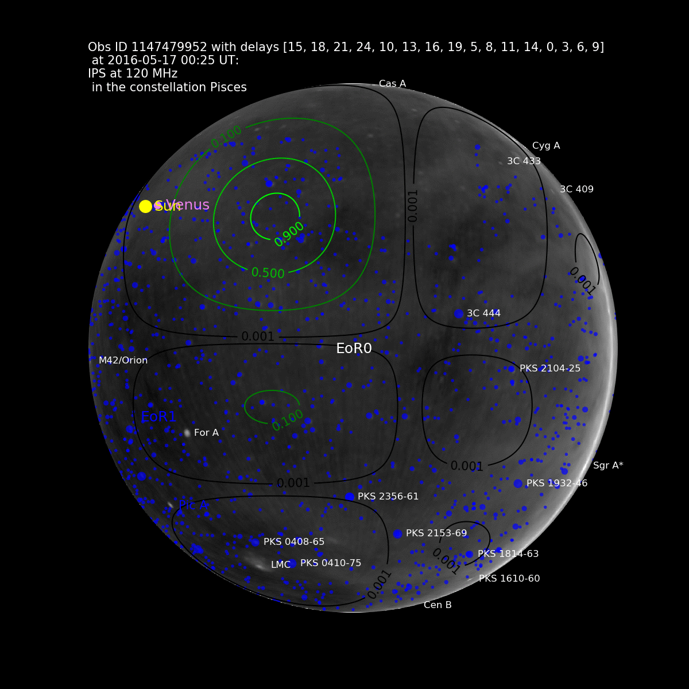

Slide 21
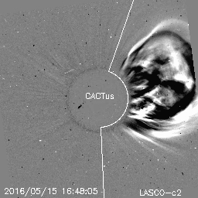
G-ratio
LASCO C2
Not to scale!

Slide 22
G-ratio
LASCO C2
Not to scale!
Enhancement 30˚
From Sun

Slide 23
G-ratio

Slide 24
G-ratio
Some evidence of extension to
the south
Notes:
2nd observation made an hour or so later

Slide 25
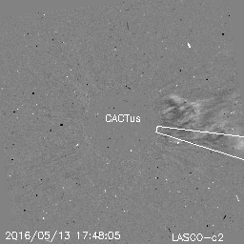
G-ratio
Notes:
Rarefaction in target observation or enhancement in reference observation? If the former, could plausibly be connected with a small CME launched two days previous to the last.

Slide 26
In Conclusion
The near-Earth environment and Heliosphere is the prism through which we see the rest of the Universe
Ionosphere (e.g. EoR and other precision measurements)
Pulsars (e.g. effect of heliosphere irregularities on pulsar timing)
IPS in particular is a technique which has applications across both Space Weather and Astrophysics
Track characterise CMEs
Identify HzRGs
Discover pulsars?
Solar/IPS observations are useful for precision tests of our instruments
Extremely high dynamic range imaging
Observing into the strong source regime (IPS)
Measuring ionospheric scintillation and identifying data errors in the time domain (IPS).
Case study in maximising science return by exploiting capabilities of the instrument
www.icrar.org/ips

