Slide 1


An Overview of Cluster Physics Research in Australia
Radio observations using MWA and ASKAP
Professor Melanie Johnston-Hollitt
Curtin Institute of Radio Astronomy

Slide 2

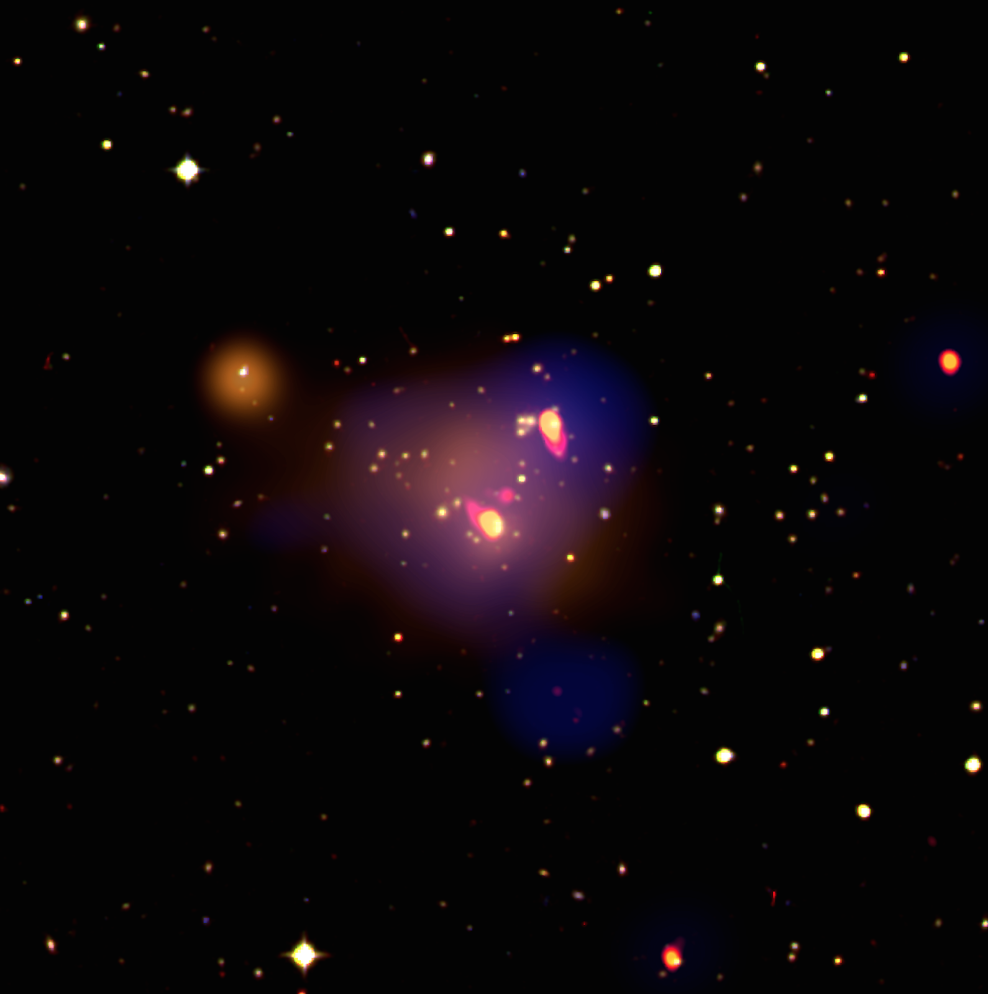
Partner Institutions
Cluster Physics in Australia
At present cluster physics is undertaken primarily using radio and optical observations, with X-ray analysis largely provided by international collaborators.
There are several groups in Australia pursuing research on galaxy clusters in the radio either observationally or with simulations:
  Clusters & Cosmic Web Group at Curtin (Johnston-Hollitt)
  EMU Team at CSIRO/ Western Sydney (Ray Norris)
  Radio Galaxy Group at UTas (Shas Shabala)
  Radio Galaxy Group at Curtin (Nick Seymour)
Abell 3888, Shakouri et al. (2016a, b). Blue = 200 MHz MWA, red = 1.4 GHz ATCA, orange = XMM, yellow = 2.4 GHz ATCA , background is a 3-colour optical image.

Slide 3
Partner Institutions
Cluster Physics in Australia
The instruments being used are: MWA, ASKAP, GMRT, LOFAR & ATCA. Plublished papers cover ATCA, GMRT & LOFAR, upcoming work is on MWA and ASKAP
Recent papers include:
  Radio Galaxy Zoo: The Distortion of Radio Galaxies by Galaxy Clusters (Avery et al. 2019, including Wong, Shabala & Norris) ATCA
  The spatial correlation of bent-tail galaxies and galaxy clusters (Obrien, Norris, Tothill & Filipovic 2019) ATCA
  Observability of intermittent radio sources in galaxy groups and clusters (Yates, Shabala, Krause 2019) Numerical
  Triggering active galactic nuclei in galaxy clusters (Marshall, Shabala et al. 2019) Numerical
  Detection of a double relic in the Torpedo cluster: SPT-CL J0245-5302 (Zheng, Johnston-Hollitt, Duchesne, Li 2018) ATCA + MWA
  ATCA observations of the MACS-Planck Radio Halo Cluster Project. II. Radio observations of an intermediate redshift cluster sample (Martinez-Aviles, Johnston-Hollitt et al. 2018) ATCA

Slide 4
O. Ivy Wong (UWA)
Role of env. on RGs
M. Johnston-Hollitt
Wilber
H. Intema
S. Duchesne
T. Hogdson
S. Keel
Diffuse emission in clusters, role of environment on RGs, cosmic web
R. Norris (CSIRO/ UWS)
O’Brien (CSIRO)
Role of environment on RGs in clusters
Photo from www.skatelescope.org
ASKAP – CSIRO
S. Shabala
R. Turner
Simulation of AGN in clusters

Slide 5
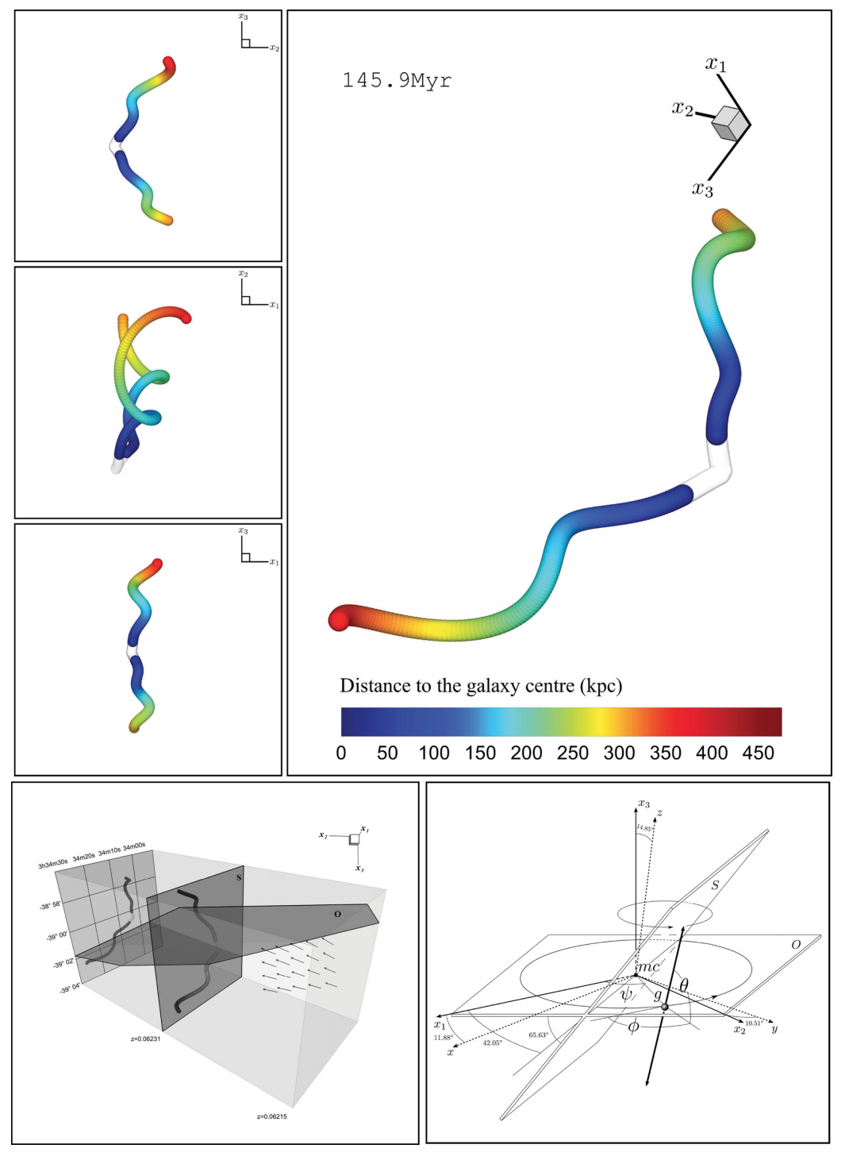
Partner Institutions
Role of Environment of RGs
Wide interest in how environment impacts RGs, using clusters as a probe.
New ASKAP observations are helping to uncover both complex shapes and old plasmas.
Both statistical studies and individual object research being undertaken. Plus simulations
Pratley et al. 2013

Slide 6
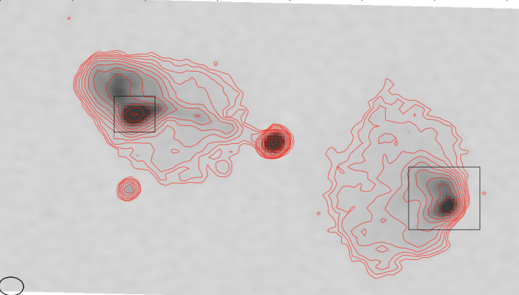
Partner Institutions
Role of Environment of RGs
Fields with large amounts of multi-wavelength coverage such as the GAMA survey field present opportunities to do detailed science on how environment plays a role in the generation of radio galaxies.
In the case of GAMA, MWA Phase II observations have been taken in the field with two current foci: 1) the prevalence of ‘relic’ or restarted radio galaxies, which are defined to be galaxies with obvious low frequency emission of an old electron population not seen at higher frequencies, and either a re-started or inactive host galaxy, and 2) Giant Radio Galaxies (GRGs) with asymmetries which are possibly the result of environmental over densities.
GRG associated with an Abell cluster in GAMA. The asymmetry of the lobes is possibly due to environmental density differences as traced by the optical galaxy positions. Seymour et al. (submitted). Note this is actually an ASKAP image at 888 MHz and 11’’ resolution. The MWA image in which the source was detected is much lower resolution.
Seymour et al. submitted

Slide 7
Partner Institutions
Diffuse Emission in Clusters
Detection of new diffuse sources in clusters up to z=1.
New MWA Phase II and ASKAP observations are being used.
Both statistical studies and individual object research being undertaken. In particular doing volume limited surveys with catalogues generated from SZ observations.
Diffuse source sensitivity of MWA is great, but the resolution is not sufficient, so we need to follow-up with GMRT or ASKAP to confirm emission type.

Slide 8
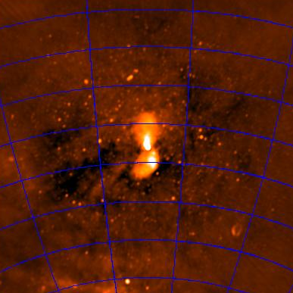
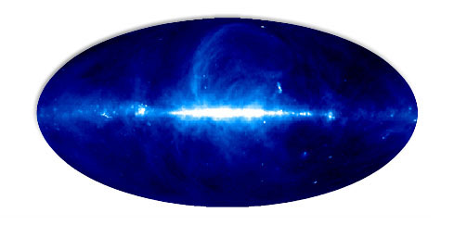
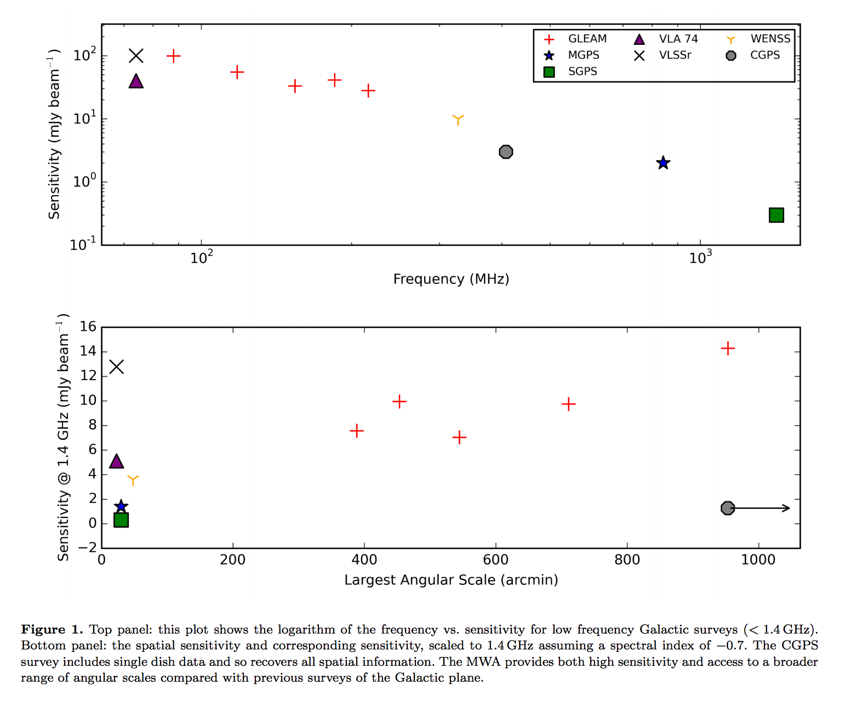
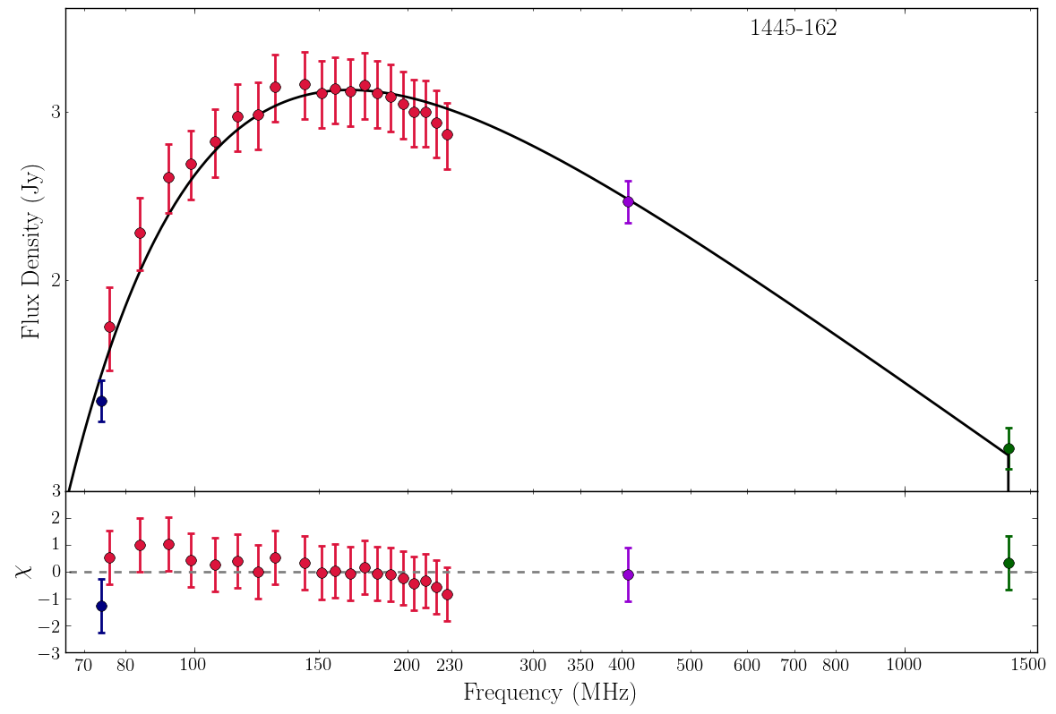
MWA Scientific Niches
30 degree FoV
McKinnley et al. 2014
Wide FoV
Diffuse Source Sensitivity
Spectral Coverage
Phase II
Centaurus A
MWA Phase I has the best sensitivity for diffuse source sources between 400 arcmin. (200 arcmin for Phase II).
In addition to the excellent diffuse source sensitivity, the MWA has unprecedented low frequency spectral resolution.
This makes it possible to distinguish between thermal and non-thermal emission using just MWA data!
Phase II
Callingham et al. (2017)
Hindson, Johnston-Hollitt et al. (2016)

Slide 9
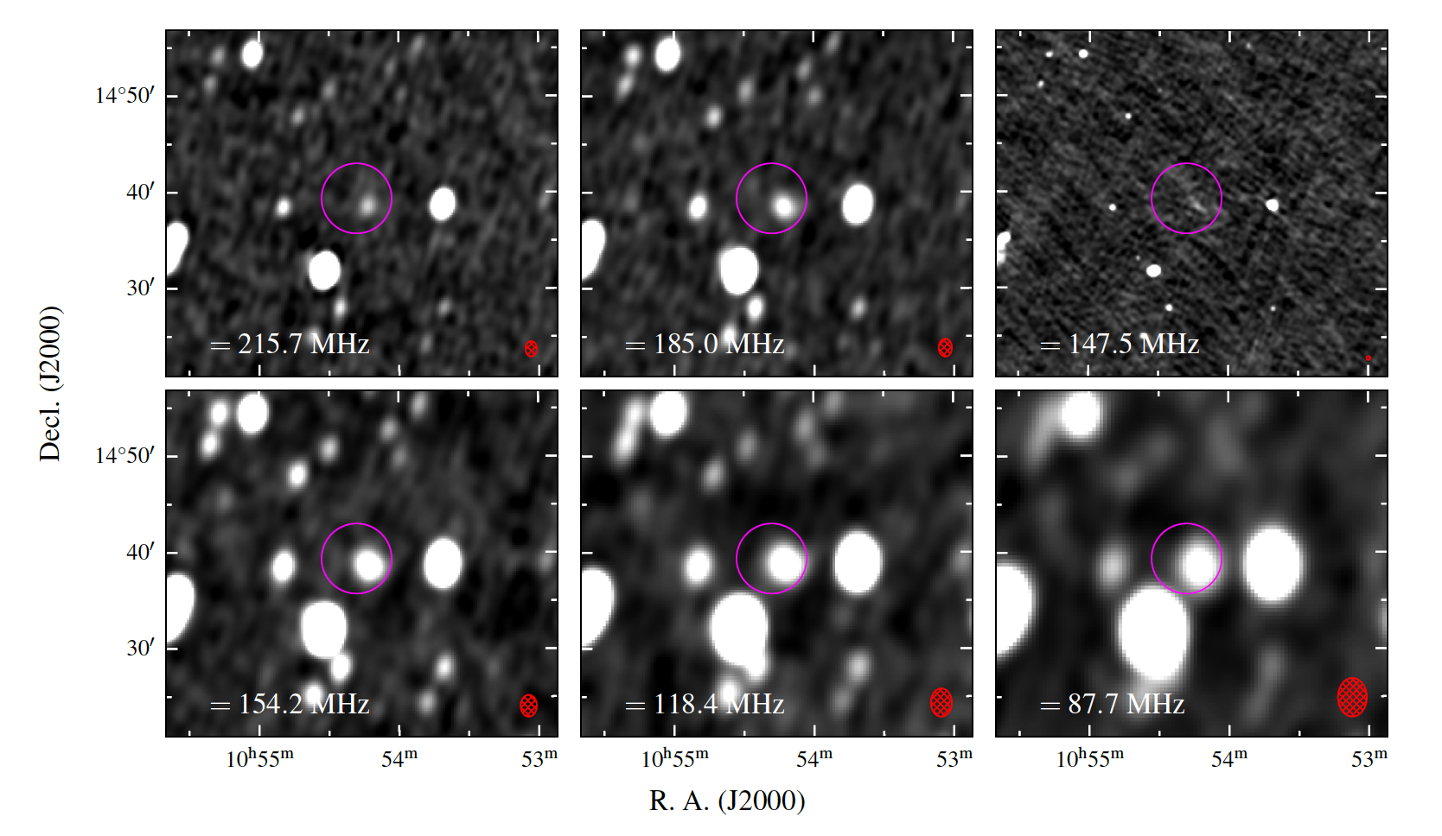
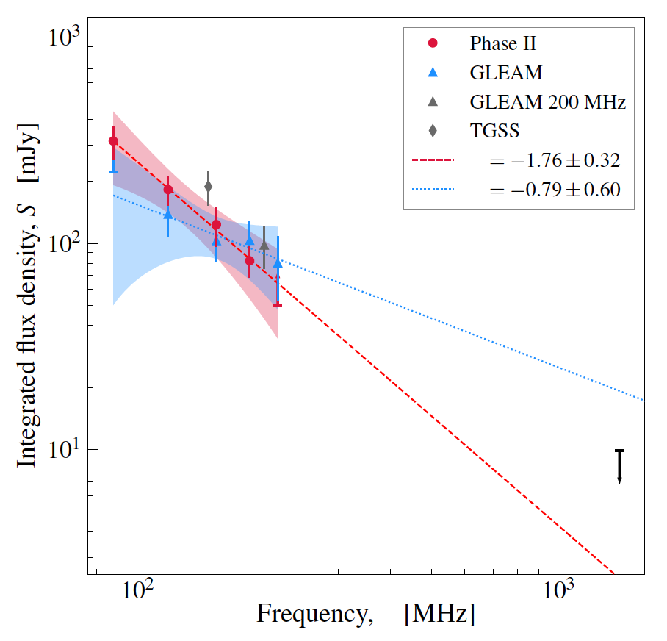
Partner Institutions
Diffuse Emission in Clusters
New diffuse emission in Abell 1127 by Duchesne et al. (in prep).
New diffuse source detected with MWA, but GMRT was needed to understand it.
Pratley et al. 2013

Slide 10
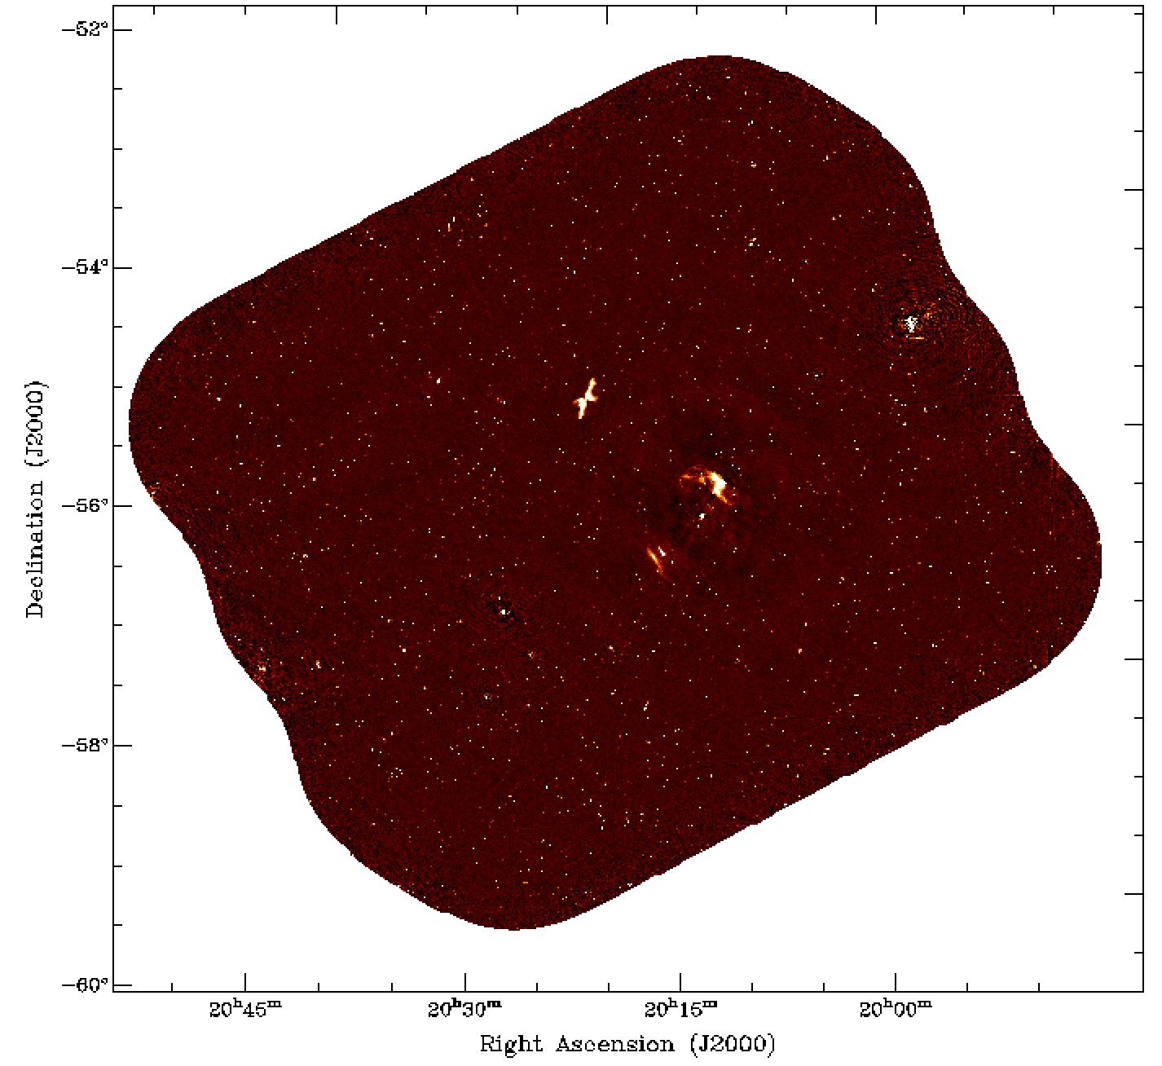
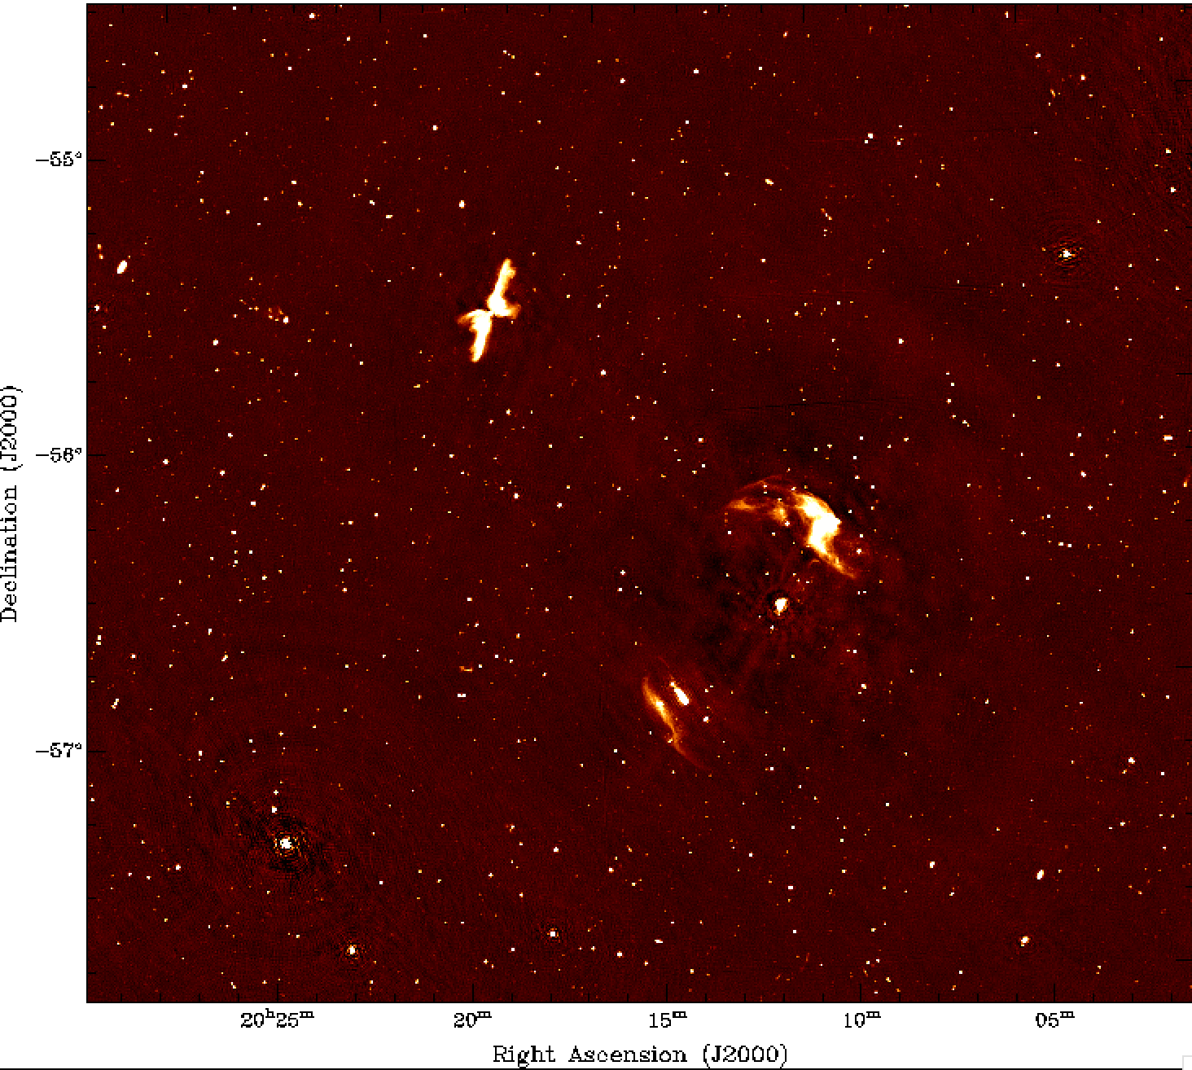
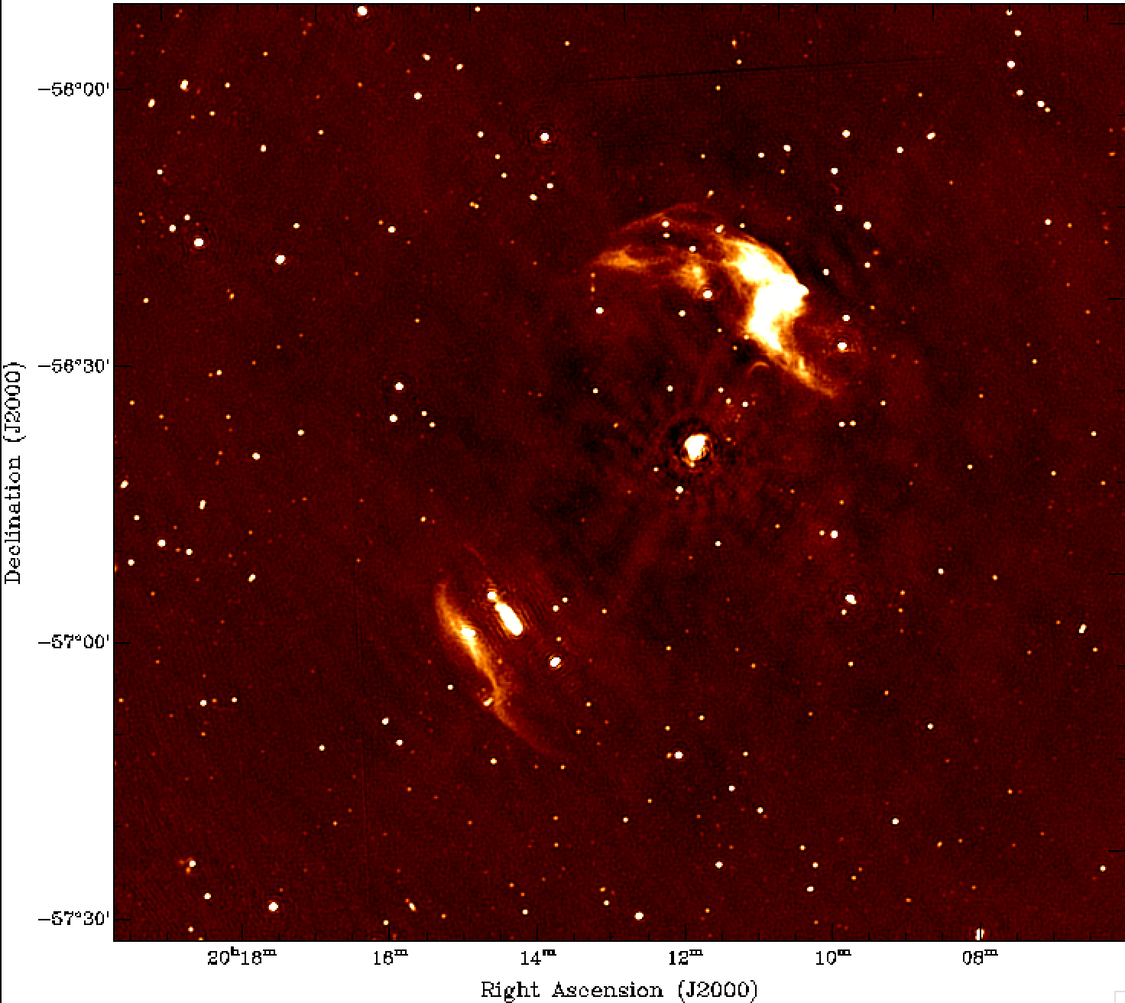
EMBARGOED!

Slide 11
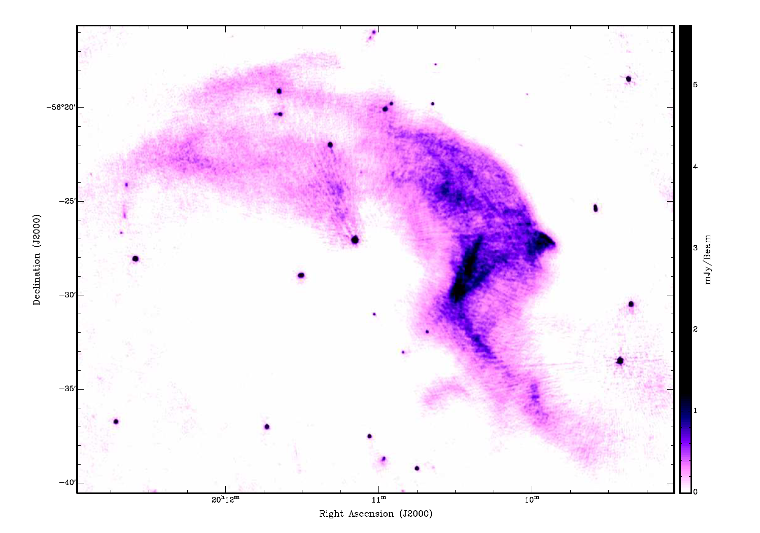
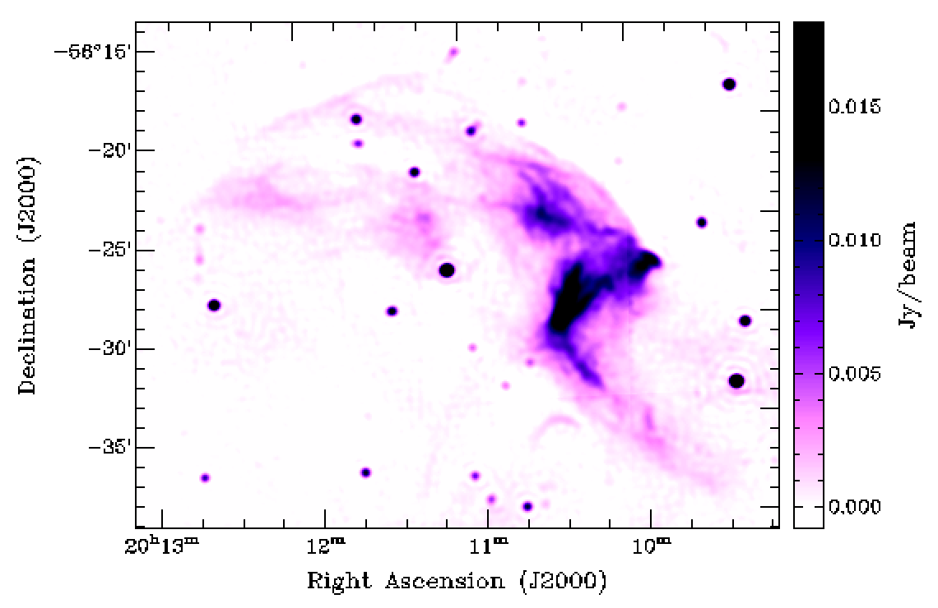
EMBARGOED!
ATCA: 1.4 GHz
Bandwidth: 256 MHz
Rms = 100 uJy
Beam = 6”
Integration time: 108 hours
Johnston-Hollitt 2003
ASKAP: 912 MHz
Bandwidth: 240 MHz
Rms = 100 uJy
Beam = 30”
Integration time: 9 hours
Johnston-Hollitt, Keel, Hotan et al. (in prep)

Slide 12
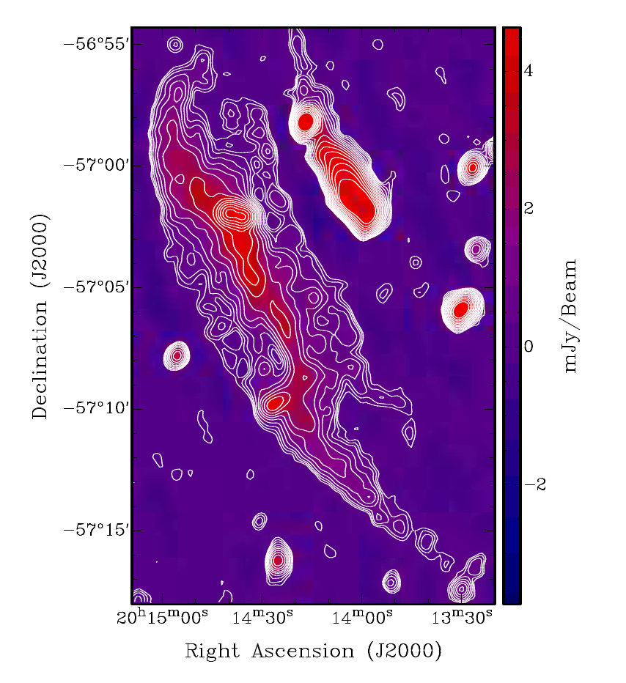
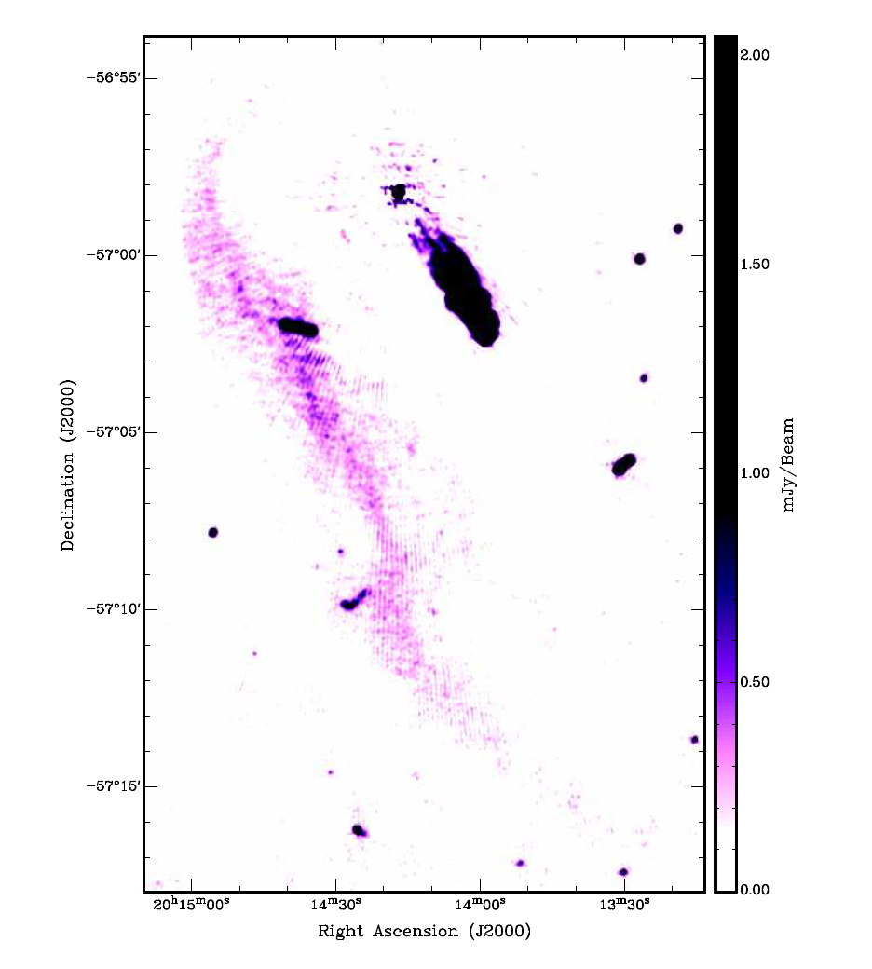
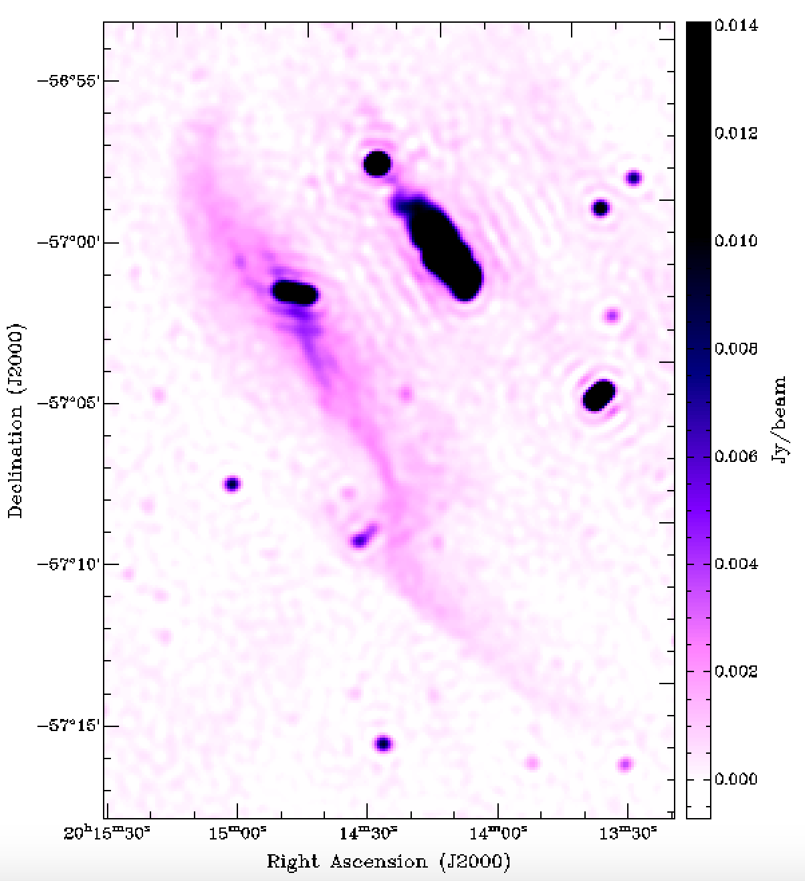
EMBARGOED!
ATCA: 1.4 GHz
Bandwidth: 256 MHz
Beam = 43”
Integration Time: 108 hours
Johnston-Hollitt 2003
ATCA: 1.4 GHz
Bandwidth: 256 MHz
Rms = 100 uJy
Beam = 6”
Integration time: 108 hours
Johnston-Hollitt 2003
ASKAP: 912 MHz
Bandwidth: 240 MHz
Rms = 100 uJy
Beam = 30”
Integration Time = 9 hours
Johnston-Hollitt, Keel, Hotan et al. (in prep)

Slide 13
Partner Institutions
Detection of the Cosmic Web
Using MWA and ASKAP to put limits on the diffuse radio cosmic web emission.

Slide 14
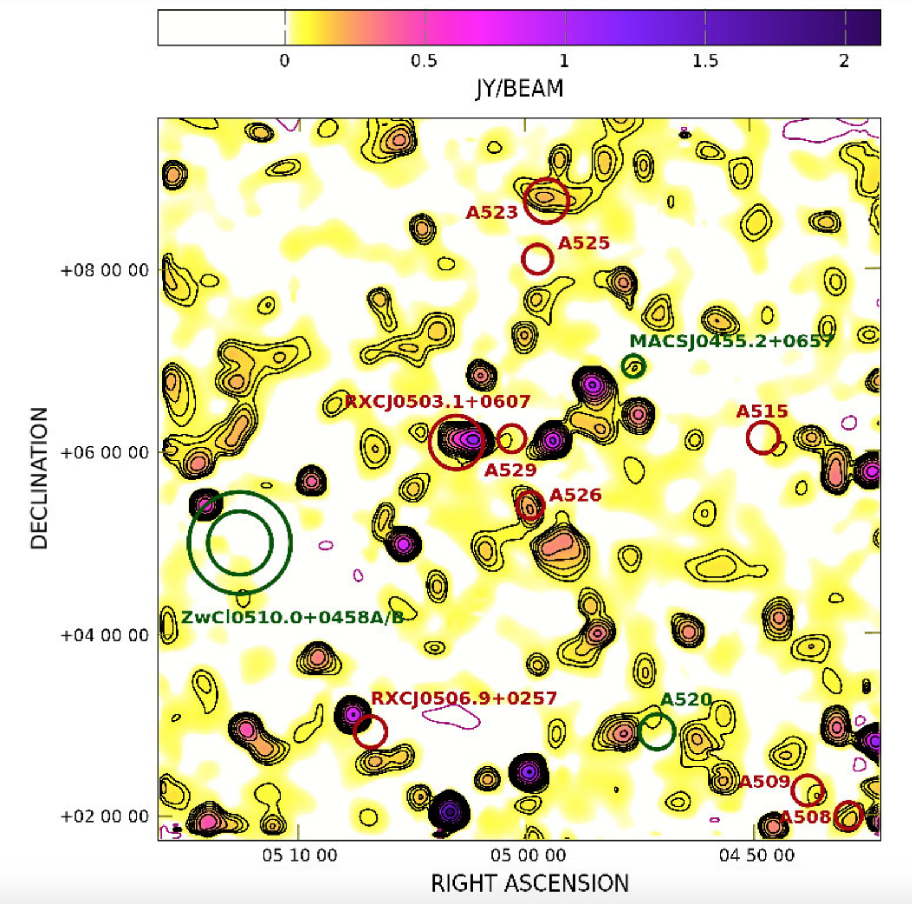
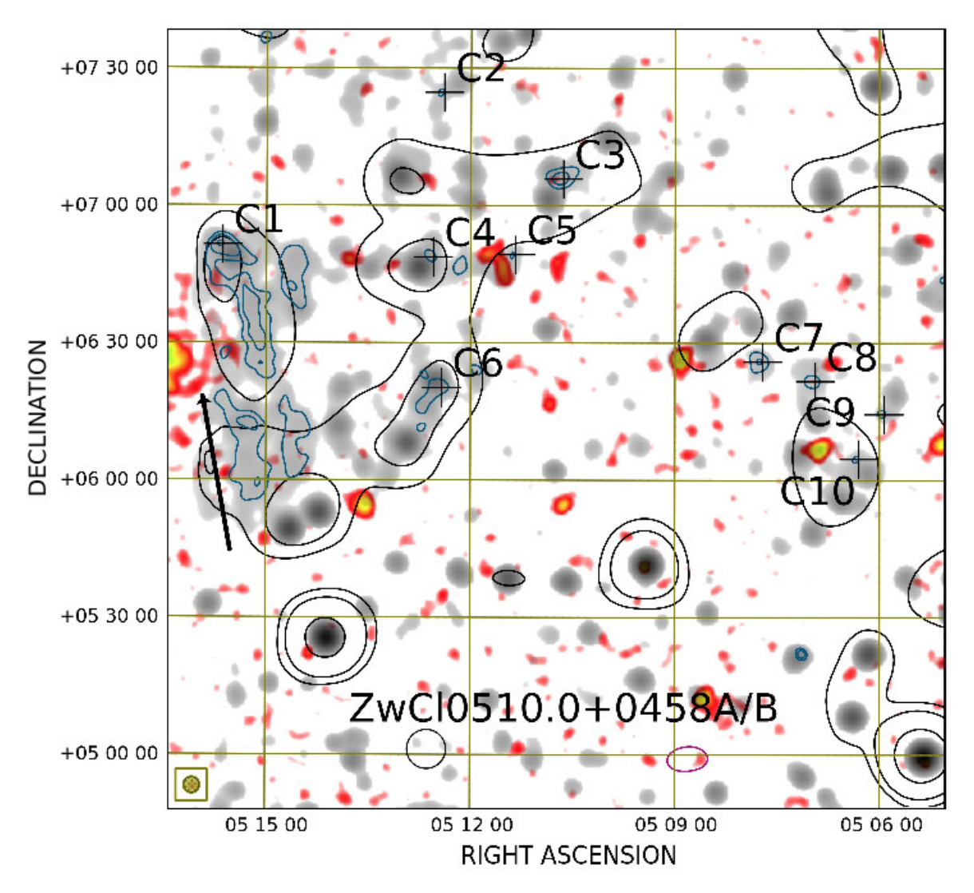
Partner Institutions
Detection of the Cosmic Web
Vacca et al. 2018 SRT and NVSS comparison at 1.4 GHz

Slide 15
Partner Institutions
Detection of the Cosmic Web
1.4 GHz SRT diffuse emission after point source subtraction (Vacca et al. 2018)
912 MHz ASKAP diffuse emission after point source subtraction (Hodgson et al. in prep)
Background H alpha -> will need SKA for cosmic web.

Slide 16
Partner Institutions
Opportunities & Summary
Several opportunities to engage in cluster physics:
  ASKAP Science Teams
  MWA Collaboration
  Large-scale survey exploitation between complimentary telescopes eg MWA + GMRT, MWA + ASKAP or even MWA+ASKAP+ GMRT
Happy to discuss further: Melanie.Johnston-Hollitt@curtin.edu.au.
Opportunities to engage with MWA – MWA is now seeking new partners for Phase III of the telescope which will be a 5-year phase from mid 2021. Very happy to engage with Indian colleagues on Indian membership of MWA in particular in support of future SKA opportunities
Notes:
The MWA has been fully operational since mid 2013, but the M&C software has evolved dramatically since then – paying back technical debt (rewriting thousands of lines of code), adding features, and supporting the end user with better metadata handling and access to data.

