Slide 1
Status Update of the LBA
Prepared: Chris Phillips
Presenter: Tasso Tzioumis
ARDRA. Lonavala India. 14/11/2019

Slide 2
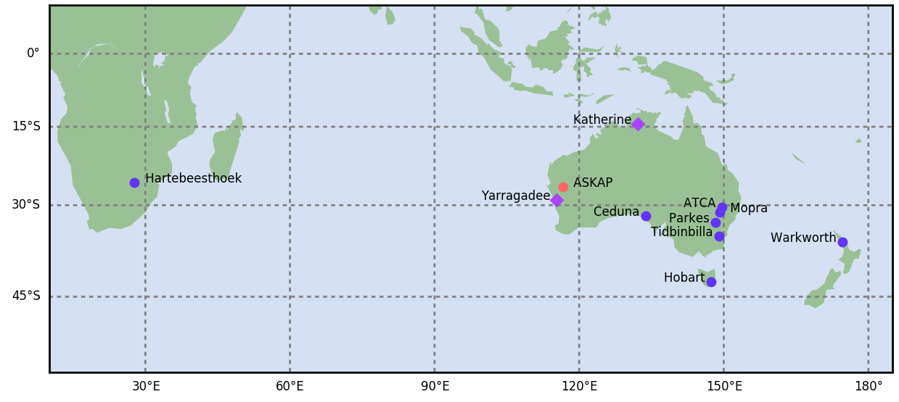
The Long Baseline Array (LBA)
Partnership between CSIRO, UTAS, AUT and SARAO
Ad hoc Asian telescope involvement, some joint EVN observations
~ 25 days VLBI, 2-4 sessions
Max rate 1 Gbps (128 MHz)
Wide range of Galactic and extragalactic science
Pulsars, masers, Galactic structure, stars, gamma-ray binaries, AGN, SNR, radio stars, radio galaxies
Astrometry pivotal
Notes:
External partners vital
Note that UTAS efforts bridge to geodesy, both science and funding.
72 hr continuous Global VLBI (EVN, VLBA, Asia, LBA) in Feb 2019
Oversubscription typically x2
Increasing number of NAPAs

Slide 3
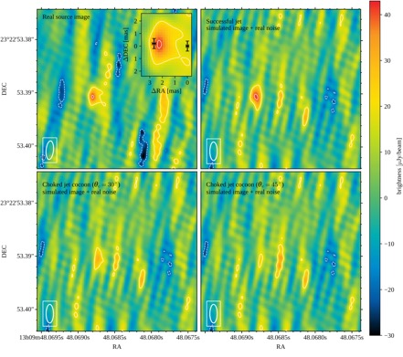
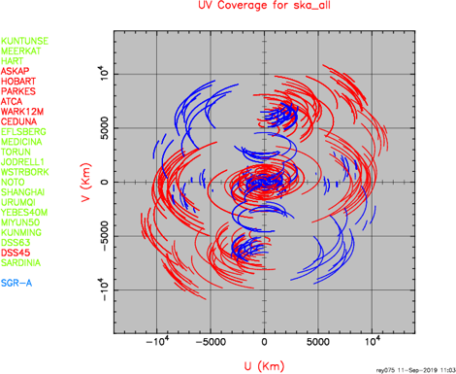
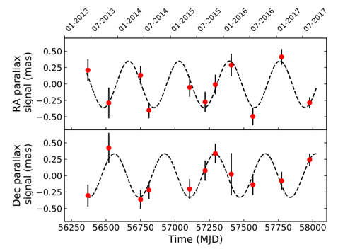
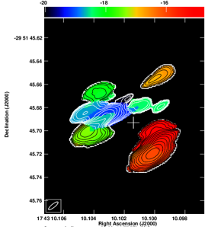
Science
Decadal Plan Alignment
GW events
Other transients
FRB Localisation
Parallax distances
ASKAP Follow-up
EMU, FLASH, VAST
Vital for SKA-VLBI
Ghirlanda et al. 2018
3. How do galaxies form and evolve across cosmic time?
6. What is the nature of matter and gravity at extreme densities?
4. How do stars and planets form?
Burns et al. 2019​
Miller-Jones et al. 2018
Notes:
GW image: follow-up of GW170817 Ghirlanda et al. (2018, Science). Constrain size and proper motion, proves successful Jet scenario.
Miller-Jones parallax: Astrometric uncertainties of 0.1 mas more or less routine.
U,v plot: note that 7 stations of SKA+LBA have better u,v coverage than 16 station SKA+EVN already at Dec of SAG-A (-29). Includes Ghana station of AVN only.
EVN+LBA+SKA maybe vital

Slide 4
Imaging Performance (1 GHz Bandwidth)
Frequency/MHz | Sensitivity/(microJy/beam) 1hr [+ Tid]
1400 | 16 [9]
2300 | 14 [7]
4800 | 23
8400 | 18 [9]
22000 | 81 [32]
43000 | [78]

Slide 5
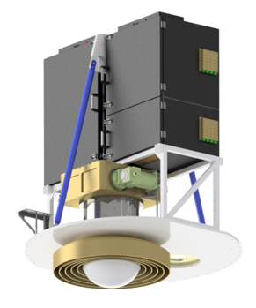
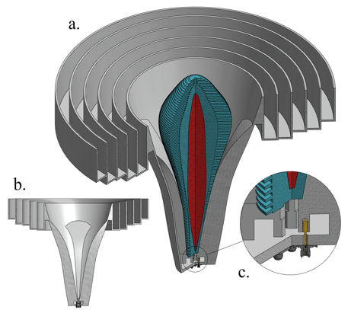
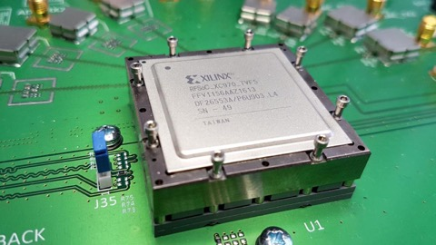
Current Upgrades
Fused Quartz
Aluminium
PTFE
Parkes UWB-Low
700 MHz - 4 GHz continuous
Initial VDIF voltage capture demonstrated
Parkes UWB-High planned
4-26 GHz (2 bands)? 16+ Gbps
Unfunded
ATCA “BIGCAT” upgrade
8 GHz bandwidth, GPU backend
Unfunded, LIEF proposal submitted

Slide 6
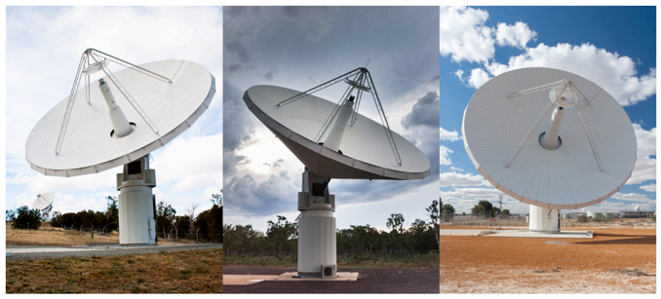
Current Upgrades (cont)
ASKAP Tied array planned
~2 year until work starts
Multiple beams across 30 sq deg field
AuScope wideband receiver
3-13.5 GHz, 8 Gbps capability
Stirling cycle cooling
Mopra still unfunded
Possible funding from KASI
Installed Octave and Mark6

Slide 7
Risks and Opportunities
Aging backend equipment
Nearing EOL, data rates trailing other arrays
Access to telescopes
Small array, all telescopes important contribution
Piggyback on ATCA/Parkes backend upgrades
Mopra? BIGCAT demonstrator
Enhanced sensitivity essential
More involvement with Asia (EAVN) – Thai National Radio Telescope
LBA vital for ASKAP and SKA follow-up
EMU, FLASH, VAST
Increase observing days
SKA-VLBI requires LBA for Southern Hemisphere observing
Notes:
Without increased data rates (Rx/digital backend and recorders) risk becoming obsolete)
Also MWA
Also MWA
Note EAVN ratified last year, opportunity for better engagement with observatories in Asia
Eastern Hemisphere Array?
Parkes/ASKAP/FAST/GMRT for high sensitivity low frequency array?
Potential new ESA dish in New Norcia.
More Tid time?

Slide 8
Universal Back-end & Compute Systems
Radio telescope signal flow block diagram
Universal backend
COTS systems
Antenna systems
(Drives,
Feeds)
RF
RF/IF
System
(LNAs,
Cryo,
RF,
LO/IF)
IF
ADC system
(Sampling,
Digitisation)
Data
streams
Digital system
(FPGAs)
Channels
Packets
Data
packets
Digital switch
Data
packets
Compute cluster
(CPUs,
GPUs)
.
.
.
.
.
.
.
.
.
.
.
.
.
.
.
Outputs
RFSOC
Timing systems
(H-maser; GPS; Freq references; UTC; ….)
NO need for Special VLBI h/w or Firmware !!

Slide 9
First fringe with UWL
Proof-of-concept
1600 MHz with ATCA
1 sec of data
Directly thru UWL
No special VLBI h/w
4 Nov 2019

Slide 10
SKA - Global
― EVN
― LBA
― SKA
― Cross array

Slide 11
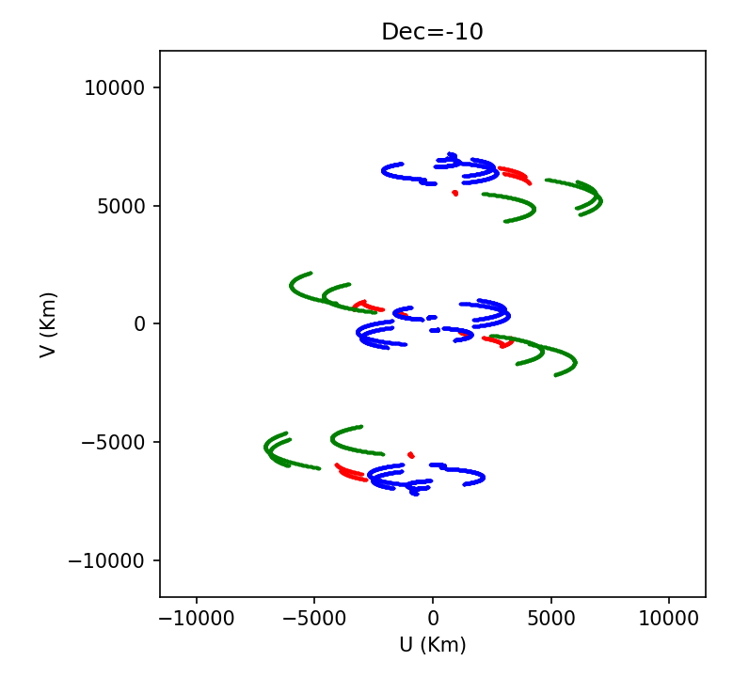
1 GHz High Sensitivity Array?
Potential low frequency array (~ 1 GHz)
FAST, GMRT, ASKAP, Parkes, ATCA, Usuda, Tianma
Eventually SKA/MeerKAT
Multibeam capability?
Notes:
QTT?

Slide 12
UV coverage LBA+GMRT
GMRT
LBA:
At,Mp,Pa,Ho,Cd,Yg,Ke,Wa,Hh

Slide 13
LBA-Low
MWA Style dipole
Bluering digital processing
RFSoC Sampler/FPGA
Channelisation+BeamForming
Locate at existing LBA observatories?
Saves on site costs (power, network etc)
Possibly near existing networks
Unfunded
→ LOW frequency High sensitivity VLBI array:
ASKAP/MWA, GMRT, FAST, Parkes, QTT, SKA1-LOW
Notes:
Rationale is mostly engineering test bed, but some science will be enabled. Scintellometry. Locating emission in exoplanetary systems. Resolving AGN. (Note: 0.3 arcsec @40 microjy rms with LOFAR @150 MHz). Needs fleshing out.
Any plan currently for number of stations? No - @LBA stations main idea so far, otherwise near AARNet presence
Bluering is custom board with 16 input RFSoc. BIGCAT, CryoPAF use 8 input version

Slide 14
Conclusion
A VLBI collaboration between the GMRT and the LBA, will offer a significant increase in scientific capabilities. In the era of SKA, GMRT+EAVN+LBA will be of great benefit to SKA science.
** Time to progress the VLBI collaboration is now **

Slide 15
Thank you
Tasso Tzioumis Program Director – Technologies for Radio Astronomy
+61 2 9372 4350
Tasso.Tzioumis@csiro.au
Astronomy and Space Science
Chris Phillips LBA Lead Scientist
+61 2 9372 4608
Chris.Phillips@csiro.au
csiro.au/atnf

