Slide 1
Software and Big Data Challenges in ASKAP
Eric Bastholm | on behalf of the CASS Science Data Processing team
ARDRA – 13-15 November 2019
CSIRO Astronomy and Space Science

Slide 2
Outline
Australian SKA Pathfinder (ASKAP)
Big data
Challenges
Software Engineering
What’s next?
Notes:
(very) brief intro to ASKAP
Then will outline some challenges we have had, most in data acquisition
Then lessons learned in the broader context of engineering rather than specifics

Slide 3
ASKAP:
Australian Square Kilometre Array Pathfinder

Slide 4
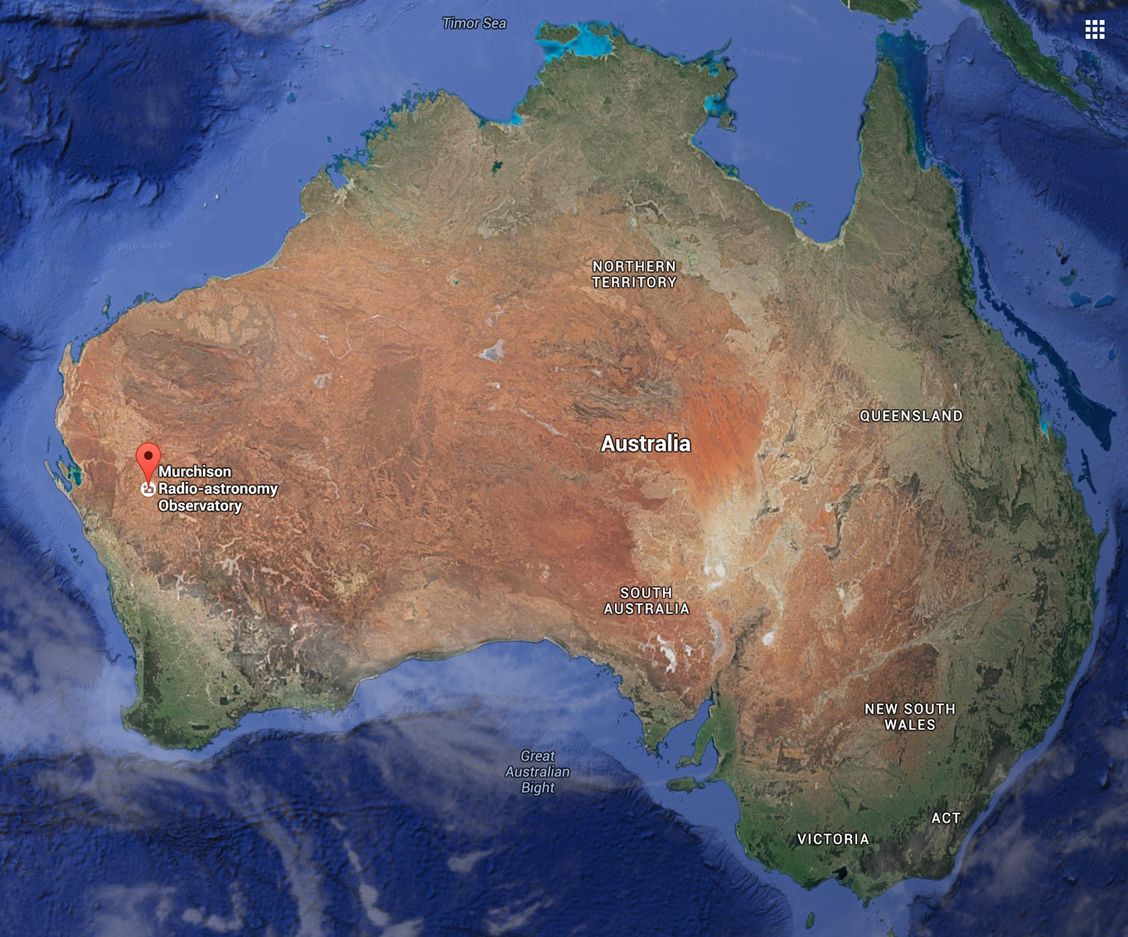
Outback!
Population: 10 +- 10
Murchison Radio Astronomy Observatory (MRO)
Geraldton
Perth
Sydney
(CSIRO ATNF)

Slide 5
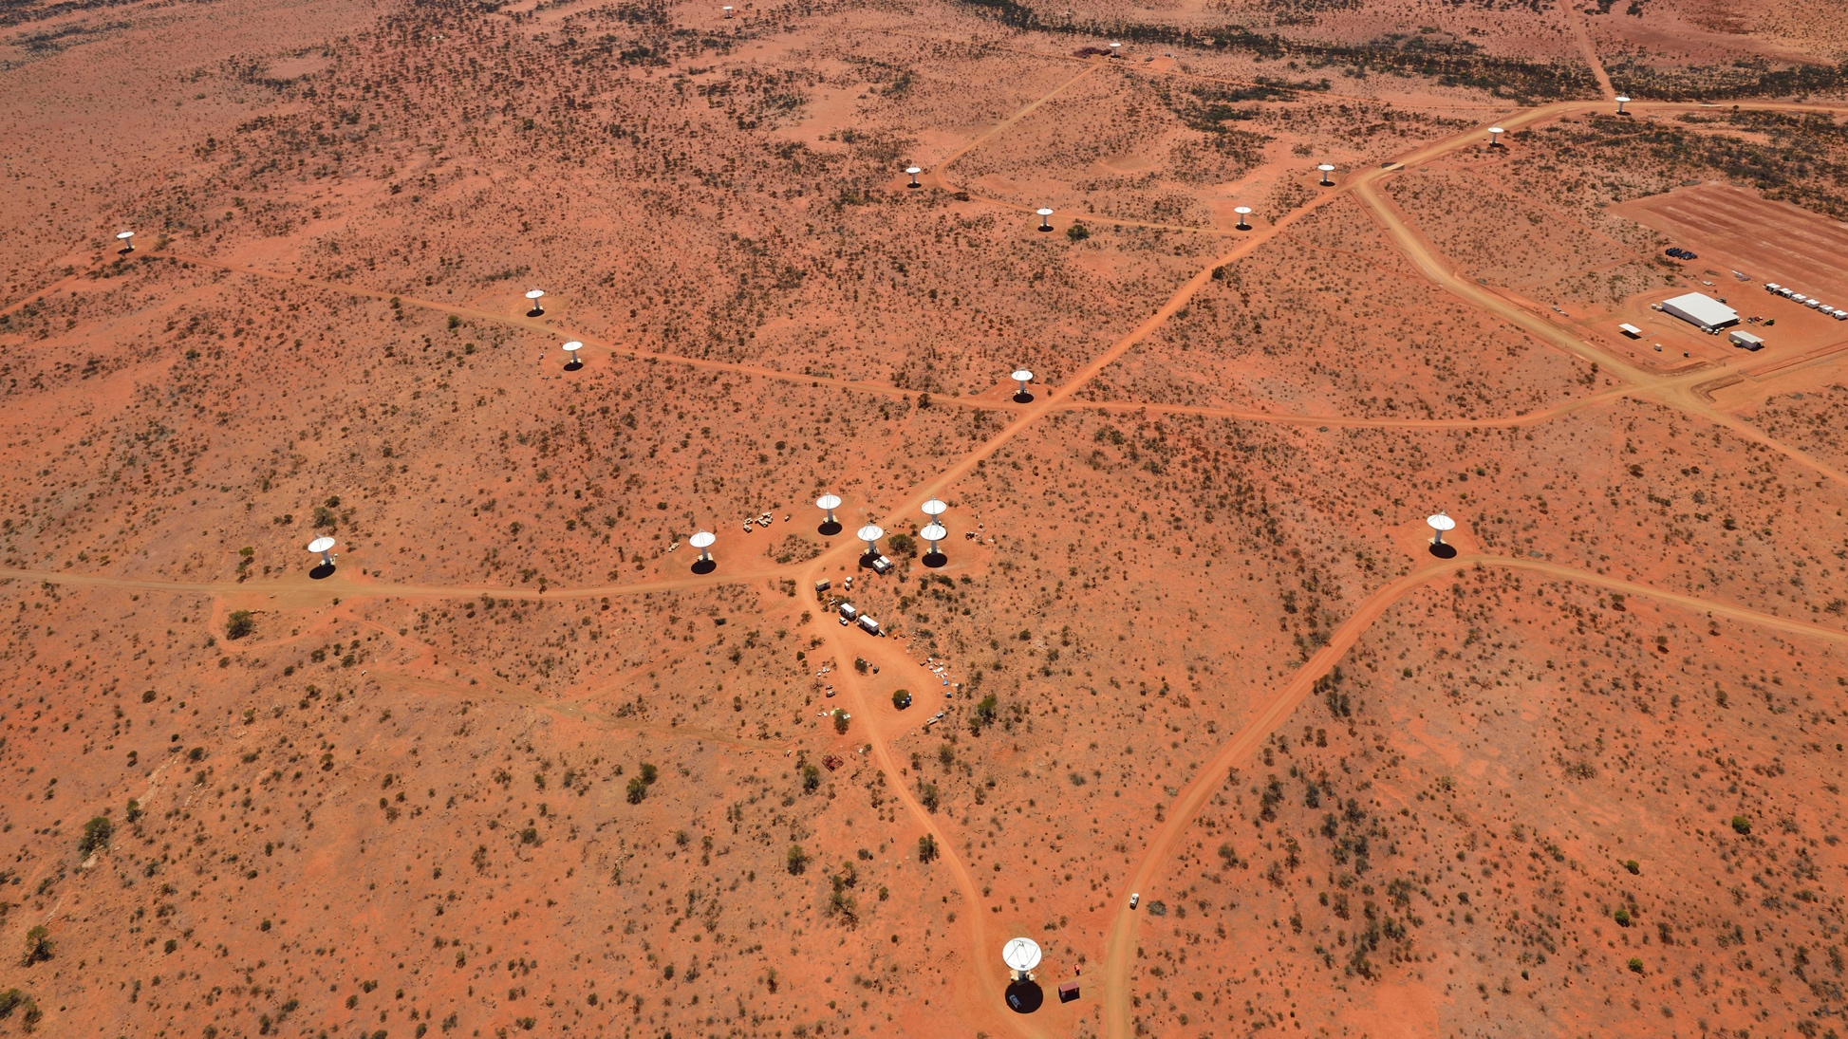
Image credit: CSIRO
Notes:
Murchison Radio-astronomy Observatory (MRO) - ASKAP core – there are more antenna out of the field
Control building top right is where the magic happens

Slide 6
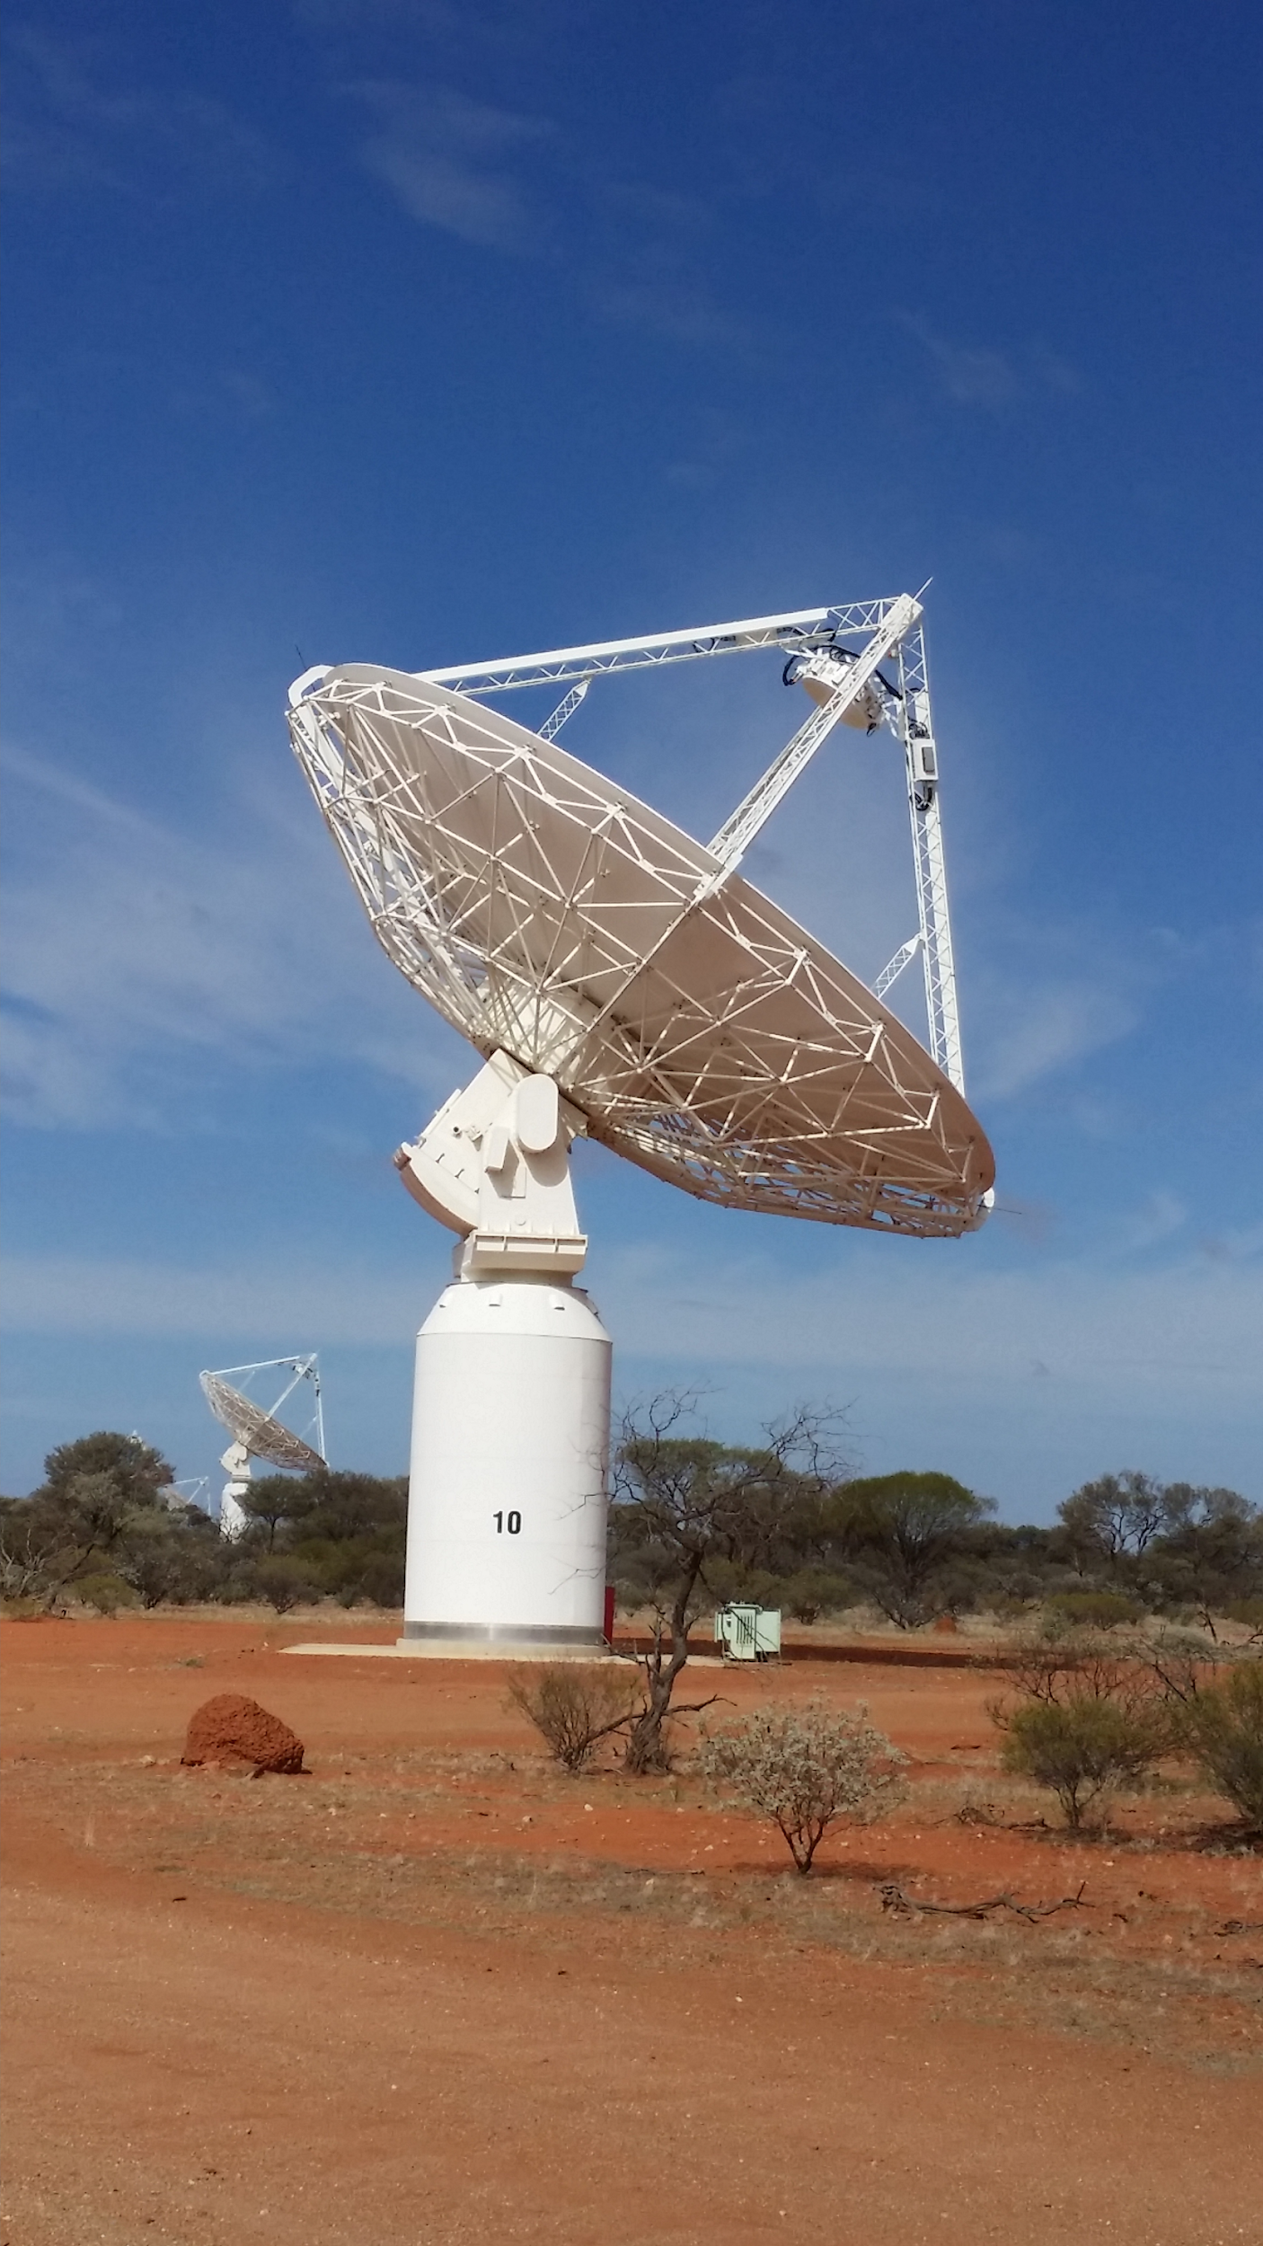
ASKAP
36-antenna interferometer
Operating frequency: 700-1800 MHz
Phased Array Feeds: Very Wide Field of view
36 beams
3 axis mount with roll-axis, the whole antenna can rotate fixing beams on the sky
High dynamic range imaging
Easier processing
Notes:
ASKAP is operated by CASS and it forms part of the Australian National Telescope Facility
Radio quiet is legislated – don’t know what the official penalties are but if an astronomer catches you using your phone there I imagine they are quite severe.
Cannot image radio emission directly like you can with optical
But like optical large is better however there is limit to how large you can build a single dish radio telescope – 100m (exception is the Arecibo and Five hundred meter Aperture Spherical Telescope, FAST)
One answer to this problem is radio interferometry using multiple dishes and electronically synchronise and correlate the signals.
Then process this digitised data to create images. HPC required due to the data rates and complex calculations.
HPC is very much considered an extension of the telescope – due to the real-time requirements for data acquisition
Disk buffer is 5 days - 1 PB – data products like images and catalogues – 5PB

Slide 7
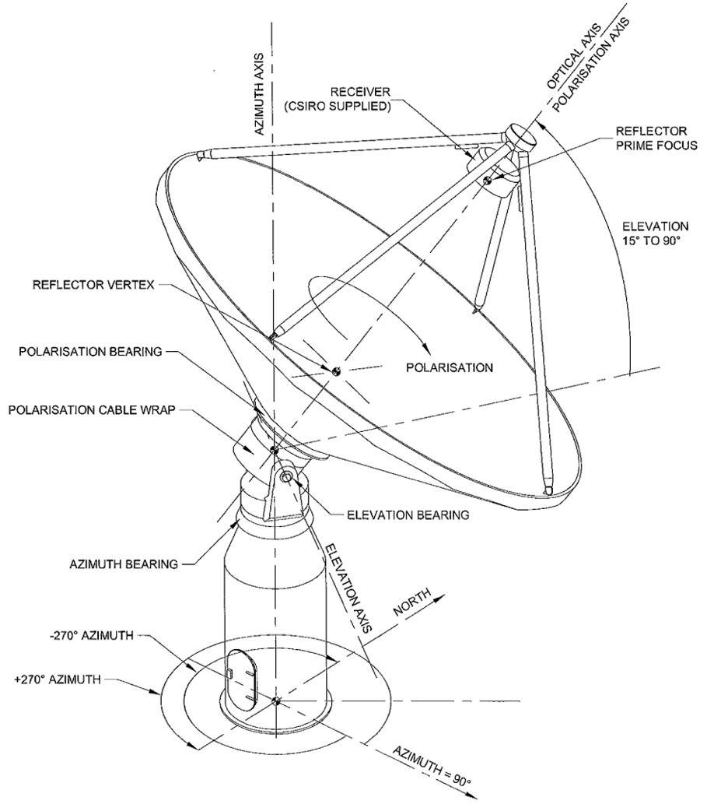
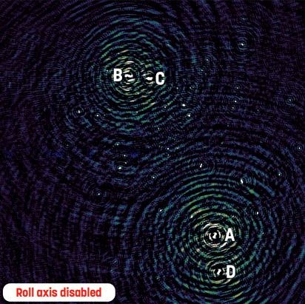
The Roll-axis allows high dynamic range imaging
Image Courtesy: Ian Heywood
Notes:
Novel features: Roll-axis

Slide 8
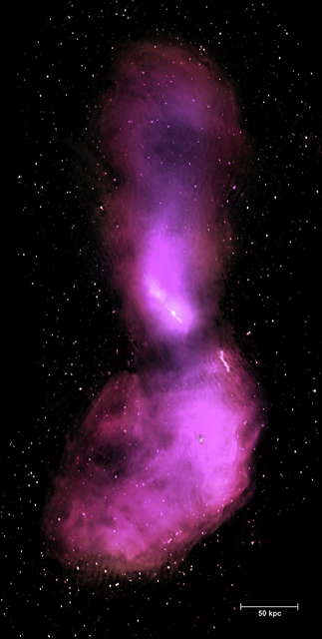
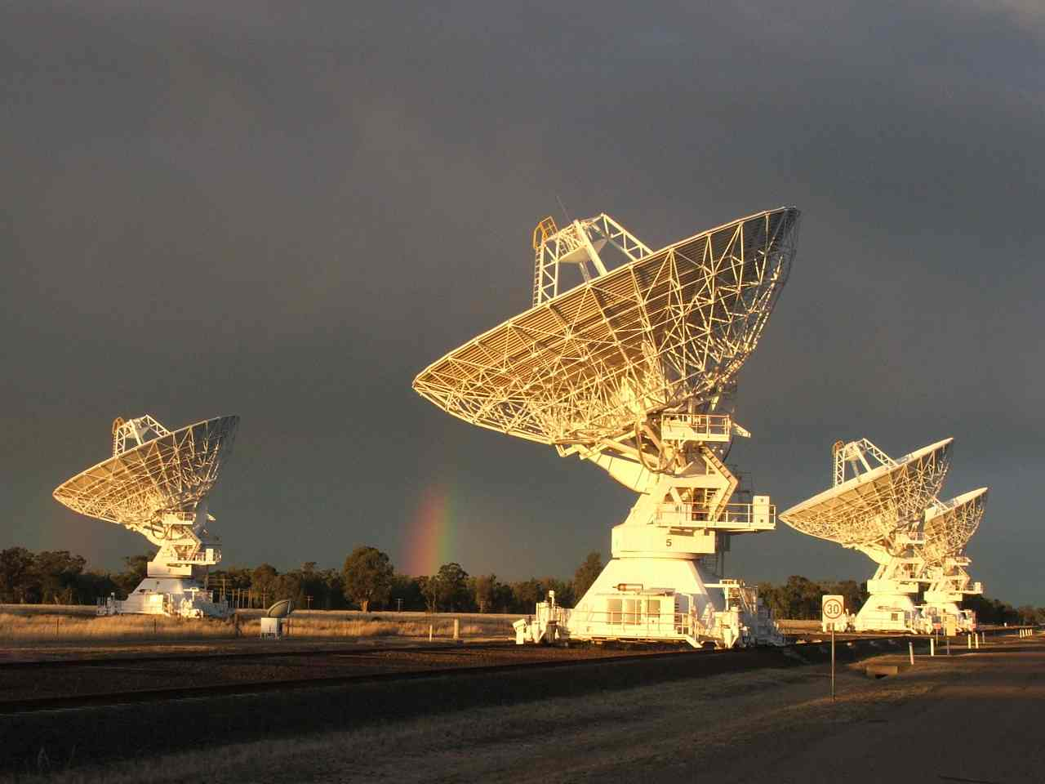
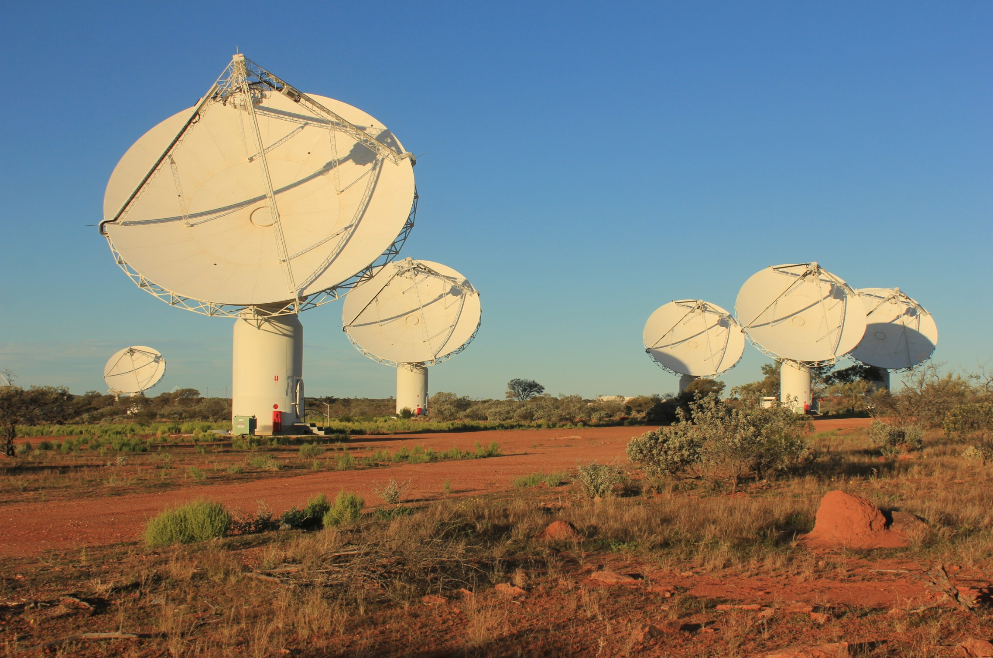
Wide Field of View
Required 1200 hours observing with the Australia Telescope Compact Array
ASKAP will take about 10 minutes
Cen A image credit: Tim Cornwell / Ilana Feain

Slide 9
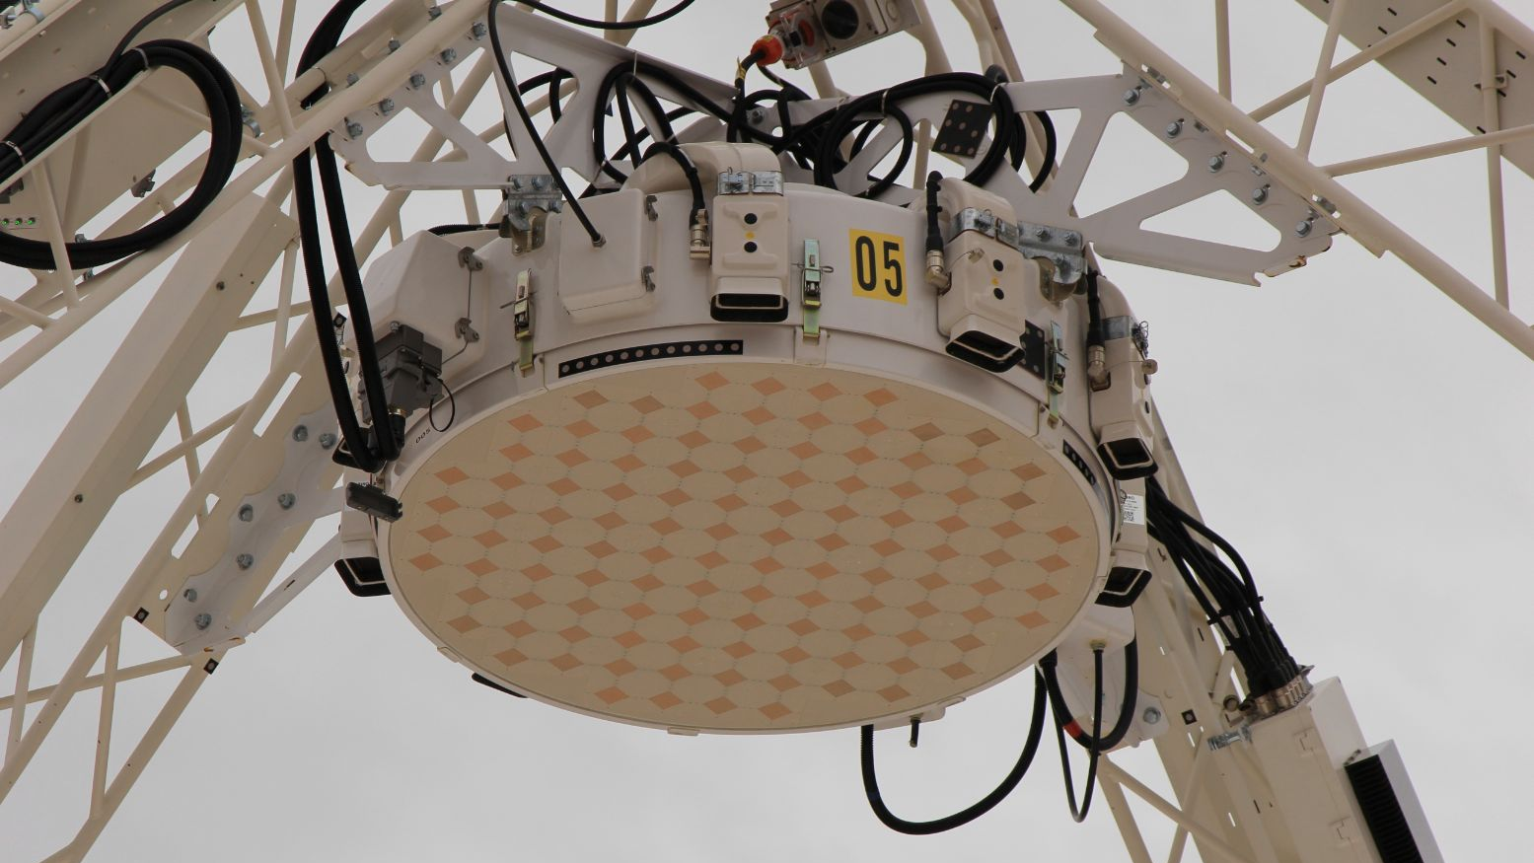
Image credit: CSIRO

Slide 10
ASKAP:
Big Data

Slide 11
Big Data
Data Ingest ~ 2.8 GB/s = ~ 10 TB/h full spectral resolution
Full FOV image 70 TB, 16K channels, 4 pols
1 PB of disk buffer + 3 PB for processing
Supercomputer, 10 000 cores, 4 GB/core, 200 TFLOPs Peak
5 PB data products per year
Paradigm shift

Slide 12
Image credit: Matt Whiting

Slide 13
ASKAP:
Challenges

Slide 14
Computing Challenges
Disk performance (space and speed)
Application performance (compute, memory and messaging)
Application complexity (parallelism and execution)
Subsystem isolation
Sensitive to
Multiple user environment and shared resources
Legacy non-parallel code
System parameters
Complexity of component interactions

Slide 17
Organisation Challenges
Multiple organisations
Multiple teams
Geographically distributed
Remote site
Synchronising effort and focus
Resourcing and project allocation
Form close working relationship with HPC provider

Slide 18
Complex interactions
HPC
Ops
Science
Dev
Pawsey
ASKAPsoft

Slide 19
ASKAP:
Software Engineering

Slide 20
YEARS!
10
A year
https://xkcd.com/1831/

Slide 21
Software Process
Multiple synchronised agile teams (SAFe)
Research software engineering (RSE)
Prototyping and exploratory process
Requires rigour in design and documentation
Requires significant effort in tests, simulation and emulation before implementation
Monitor everything
Automate [nearly] everything

Slide 22
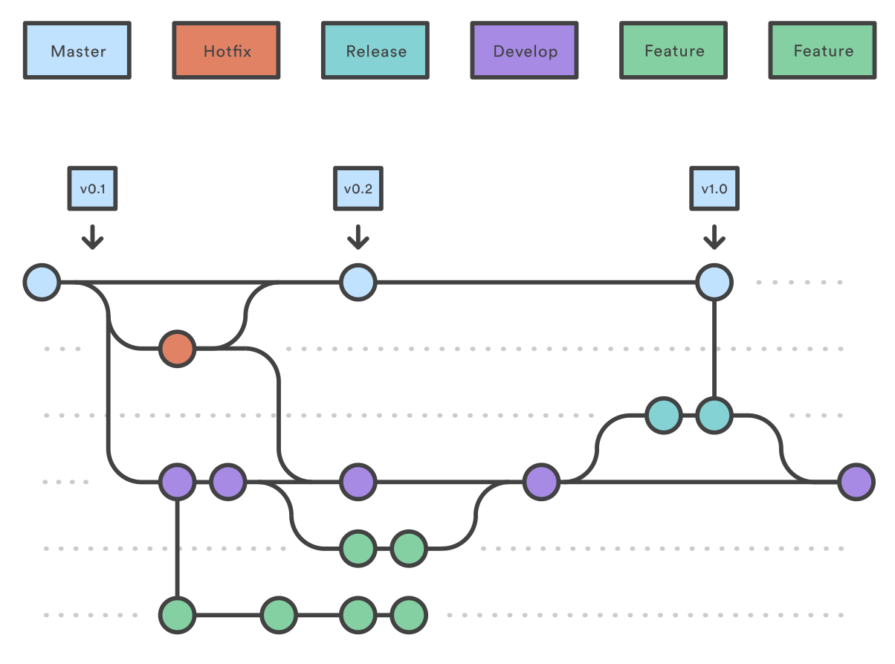

Slide 23
Agile for Researchers
Use a (formal) software process
Tolerate and accept the uncertainty
Allow solutions to grow organically, through exploration
Qualitative measures, not quantitative
Think “goals” rather than “tasks”
Measure goal satisfaction, not task completion
Goal definition and task breakdown intertwine across scale
Together they form a solution

Slide 24
ASKAP:
What’s next?

Slide 25
What’s next?
More automation in the workflow
Pawsey refresh
Increase external distribution of YANDAsoft
Look at streaming to reduce file I/O

Slide 26
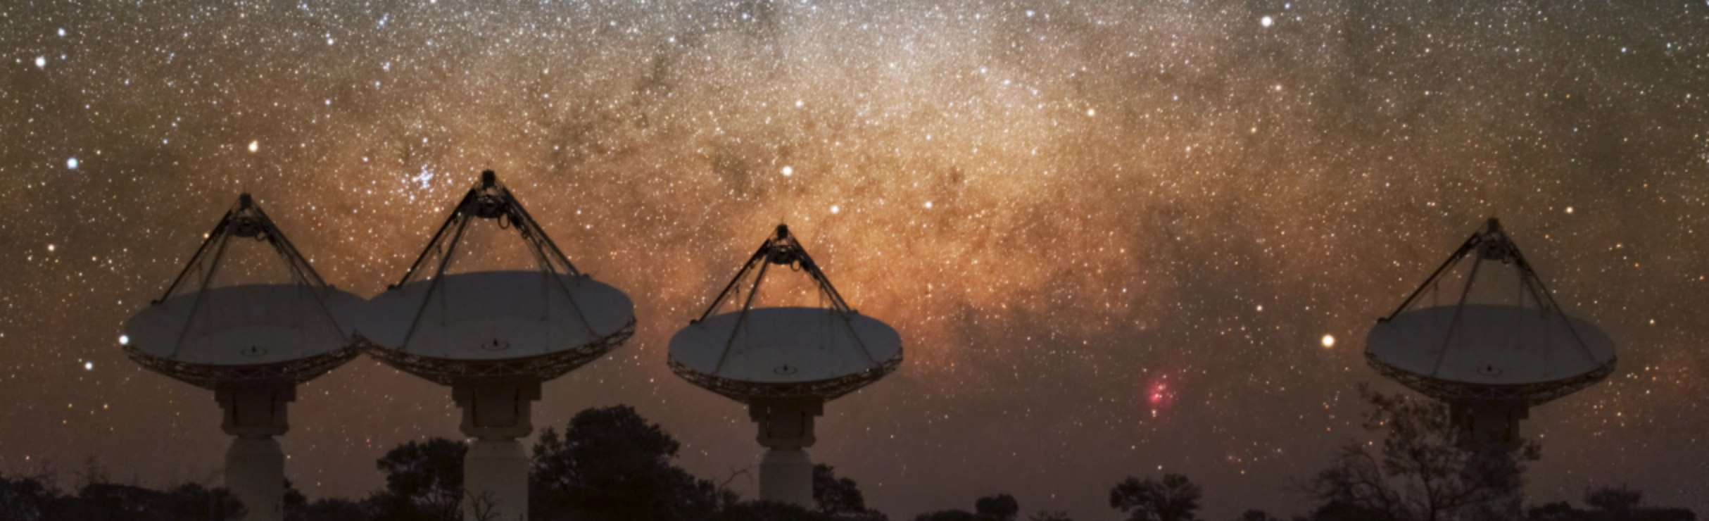
Take 3
Radio Astronomy is experiencing a paradigm shift
Research software engineering is not just IT
Tech + algorithms + process + dev culture -> success

Slide 27
Thank you
We acknowledge the Wajarri Yamatji people as
the traditional owners of the Observatory site.
CSIRO Astronomy and Space Science
Eric Bastholm Team Leader ASKAP SDP
t +61 8 6436 8505
e eric.bastholm@csiro.au
w www.csiro.au/Research/Astronomy
CSIRO Astronomy and Space Science
Slides by Eric Bastholm, Wasim Raja, Max Voronkov, Matt Whiting

