Slide 1
MWA Archive & Data flow
November 2019, ARDRA workshop, Lonavala
Presented by Greg Sleap, Curtin University/MWA

Slide 2
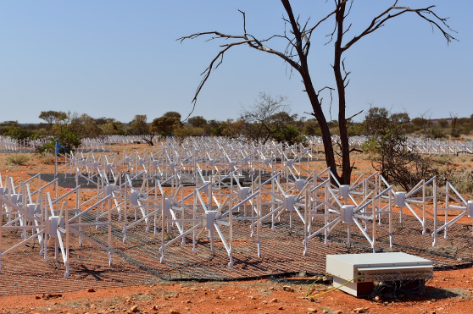
About the MWA
Operating since mid 2013
International collaboration led by Curtin University
One of four SKA Precursor telescopes
70-300 MHz, 30.72 MHz instantaneous b/w
256 tiles each w/ 16 “bowtie” dipole antennae
>33 PB of raw data
>170 published papers
>5,000 citations

Slide 3
MWA Partner Institutions
Notes:
Australia, USA, Japan China, NZ, Canada

Slide 4
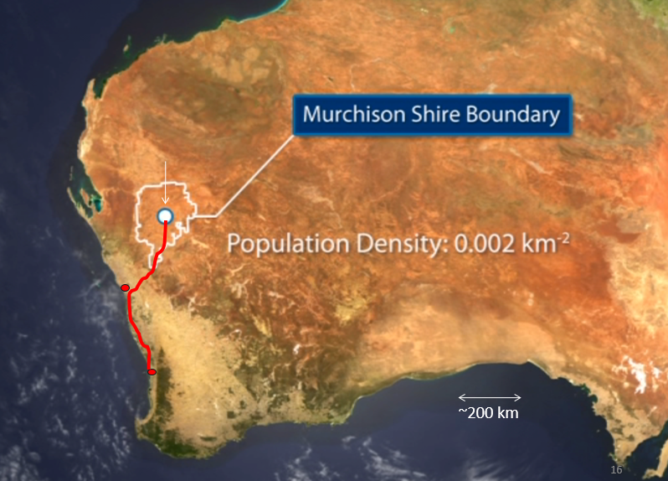
The Murchison Radio astronomy Observatory (MRO)
MRO (operated by CSIRO)
Geraldton
800 km fibre
Perth
Pawsey Centre
Notes:
ASKAP, SKA-Low, Edges

Slide 5
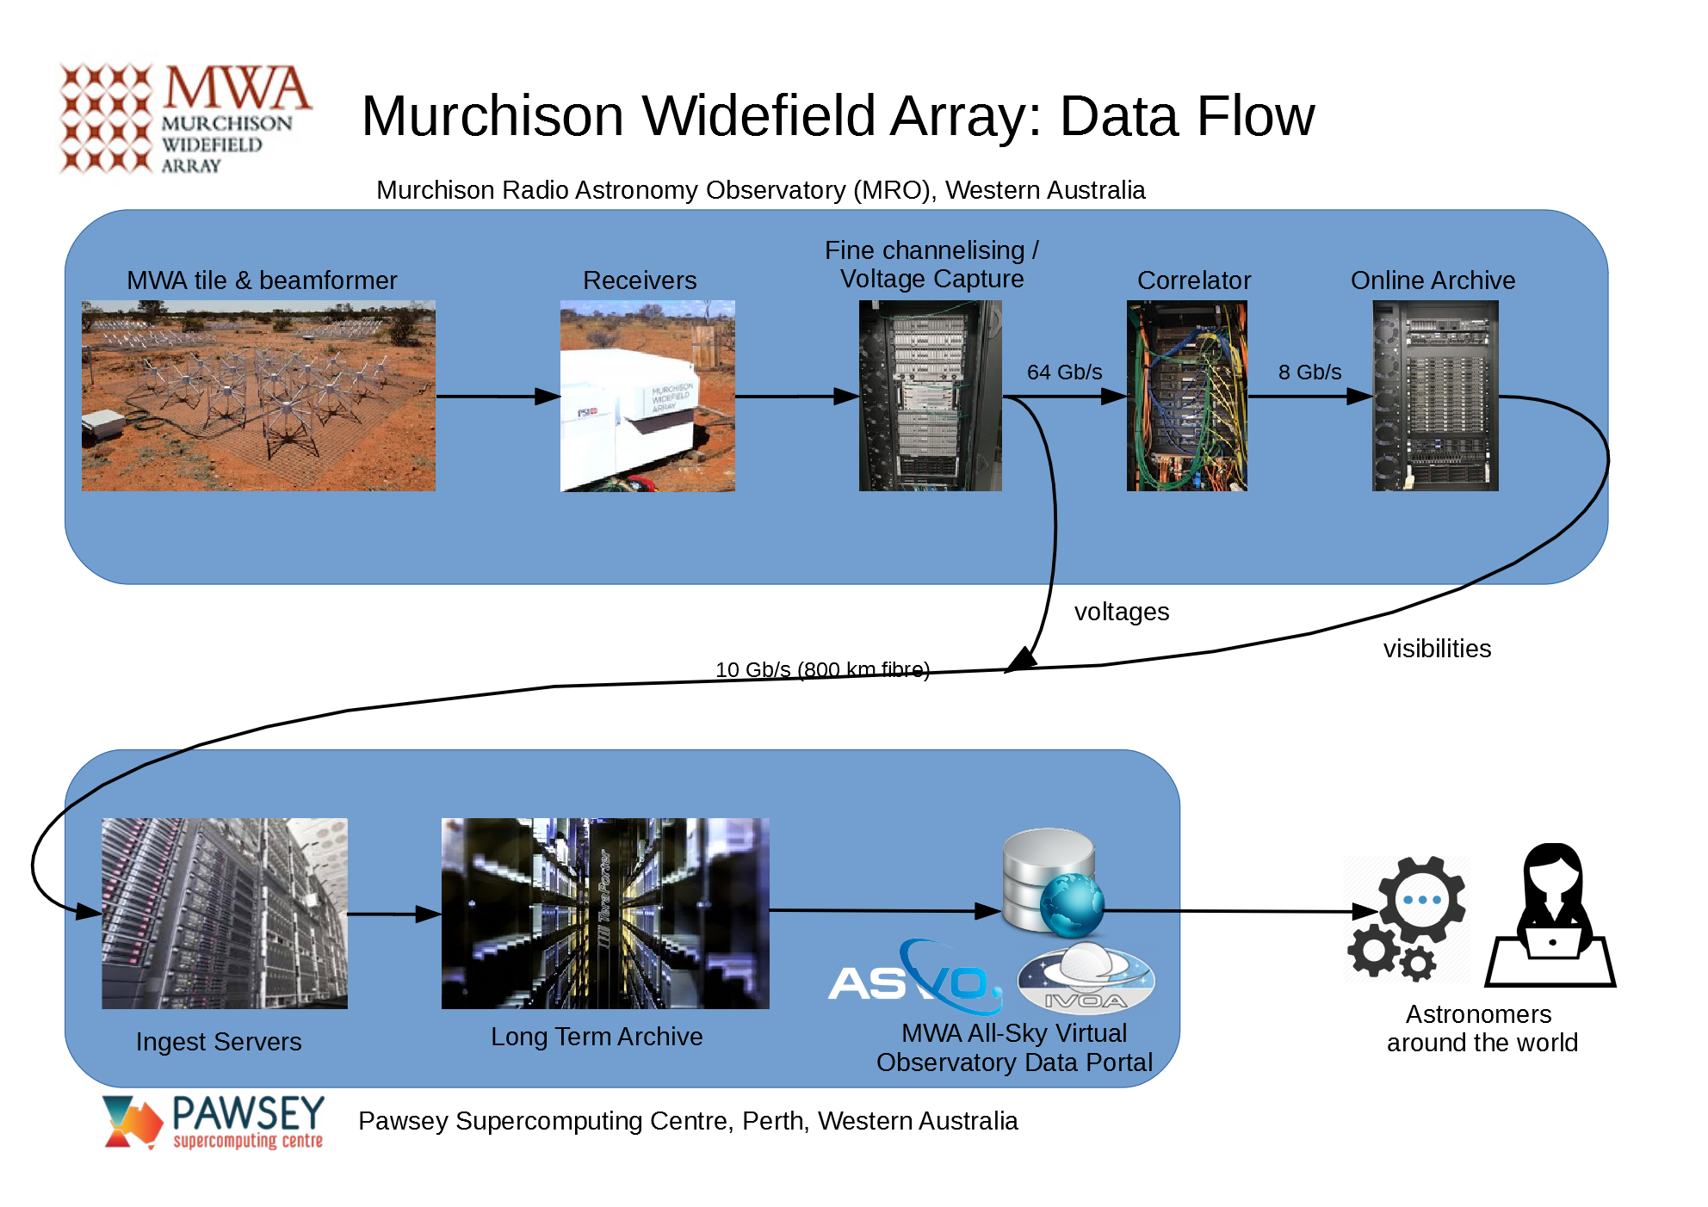
Notes:
Receivers take 8 tiles’ data each and channelize into 256 1.28MHz channels and we downselect 24
The Fine PFBs further channelizes the 24 channels down to 3072 10kHz channels
Correlator then cross multiplies and dumps data at 10kHz, 0.5 sec, but can average the data by frequency (20,40 kHz) or time (1,2 secs)

Slide 6
Data Archive
Raw data archive
33+ PB stored
34,000,000+ files
Hierarchical Storage Management
Ingest at up to 80 TB per day
POSIX-based archive software (NGAS)
1.5 PB disk cache
3 PB of “zero-watt” disk storage
40 PB out of 63 PB of robotic tape library 7 – 10 TB per tape
x2 –libraries for redundancy
Growth 3-8 PB/year
Notes:
We have 33 petabytes of data….which is over 7 million DVDs’ worth !

Slide 7
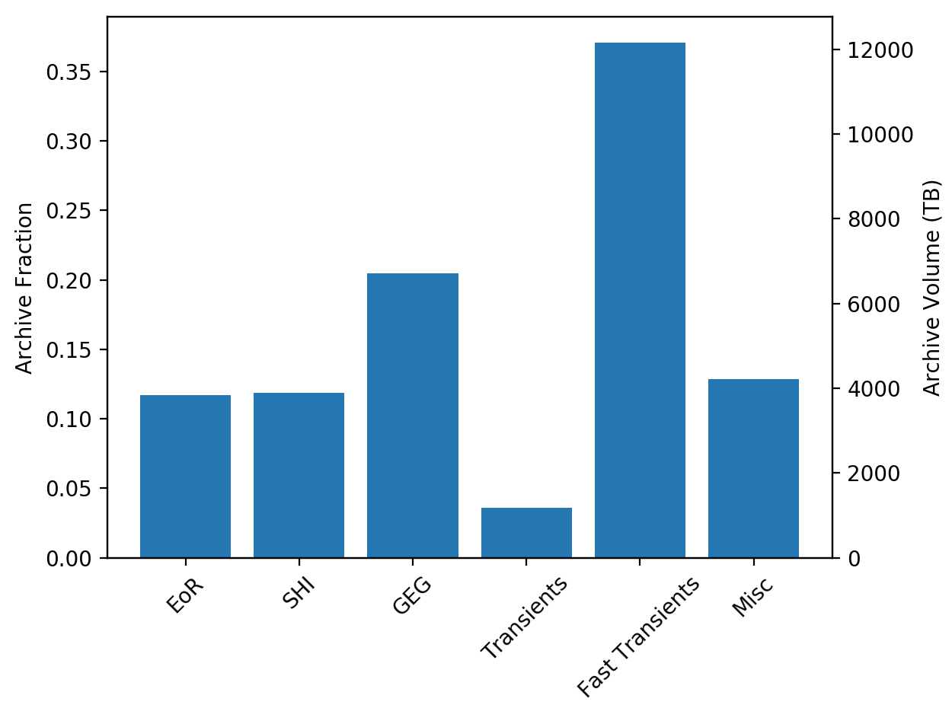
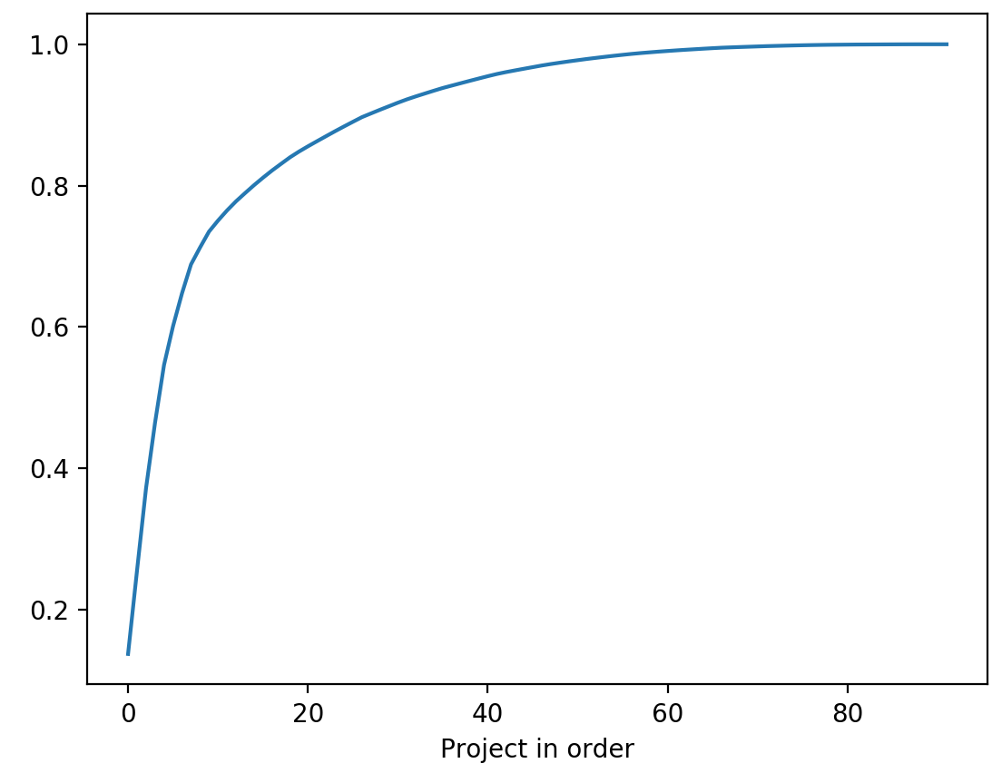
Archive Summary
Volume Fraction per Science Group
Cumulative Fraction of Volume

Slide 8
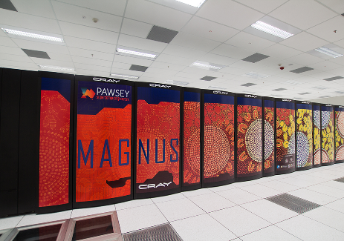
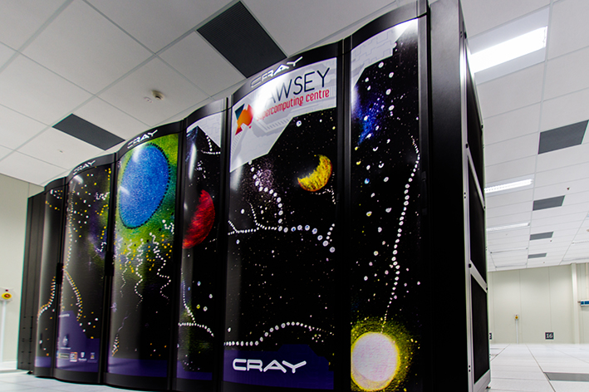
Pawsey Centre
Established 2010
Unique groundwater cooling system
PV array supplying 140 kW
Supercomputer Systems
Magnus (Cray XC40 cluster, 1,488 nodes)
Galaxy (Cray XC30 cluster,472 nodes+64 GPU)
Zeus (SGI GPU cluster, 189 nodes)
Nimbus Research Cloud (46 nodes)
Data & Visualisation
63 PB of HSM storage
Data Portal Service
20 remote visualisation nodes
AUD$70M upgrade in progress
See: www.pawsey.org.au for more info

Slide 9
Data Delivery
https://www.asvo.org.au
https://asvo.mwatelescope.org

Slide 10
Data Delivery: MWA ASVO
350+ users registered world wide (MWA+Public)
Raw or calibrated visibility data available in MWA, CASA or UVFITS formats
IVOA TAP & SCS service for metadata
Python client and API
>23 PB of data downloaded
Federated Identity system
Ability to mirror data to remote locations via NGAS

Slide 11
Data Delivery: Pawsey->NCRA
Image: Excerpt of map (AARnet 2018)
Notes:
Prototype SKARDC plan to transfer existing MWA SHI data from Pawsey to NCRA
Initially mirror 100TB of MWA raw visibilities
Essential to collaborate with national research infrastructure

Slide 12
Lessons Learnt & Challenges
Divide and conquer!
Managing limited data allocation
You get punished every time you read or write large data sets
Cost ($/TB) of tape vs disk
Cost in accessibility of tape vs disk
Instant download vs queue system
Power is by far biggest cost
Tape, zero watt disk, spinning disk balance

Slide 13
Lessons Learnt and Challenges
Reaching limits in many dimensions, disk write, memory, network
COTS vs Bespoke hardware vs cloud
Testing & tuning critical for throughput
Small multidisciplinary team
Collaboration is critical
Metadata is important for interoperability
IVOA standard interfaces
Raw data flexibility vs Reduced data sizes

Slide 14
Near Future: MWA Data Flow…
New “MWAX” correlator in development
Higher resolution up to 1kHz in f 0.2sec in t.
Fringe stopping correlator- longer int. times
Multicast voltages – allows many uses of data e.g. Breakthrough Listen, FRB detection, etc
Data rates will increase from 8 Gbps to up to 20+ Gbps and 128Gbps for voltages
MWA ASVO: improve metadata, AWS for processing, more Pawsey nodes, bigger cache, better download speeds

Slide 15
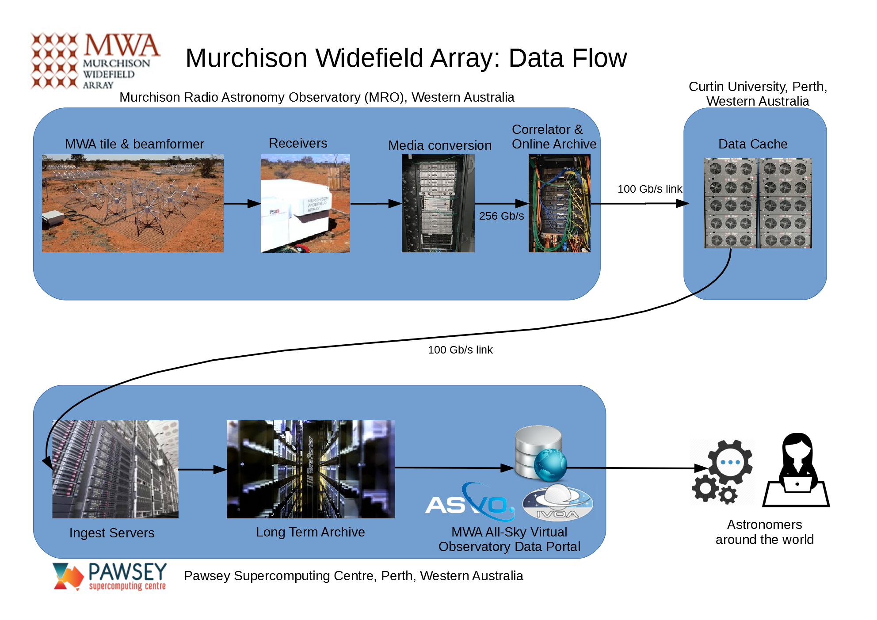

Slide 16
Thank you
Greg Sleap
MWA Data Manager
greg.sleap@curtin.edu.au
www.mwatelescope.org
@mwatelescope
Murchison Widefield Array
We acknowledge the Wajarri people as the traditional owners of the MRO site.

