Slide 1
Contributions to Astronomy domain : The Virtual Observatory, GMRT and SKA

Slide 2
Content
About Persistent Systems
Partnership with Astronomy projects
Offerings cutting across an Observatory life cycle
The Virtual Observatory
GMRT Proposal submission & data archive system
SKA – Telescope Manager, Observation Mgt & SaDT
SKA – Involvement in Scaled Agile – SAFe approach
Future plans- areas of collaboration

Slide 3
Persistent at a glance
Product Development
Enabling those in the business of software and those building software driven business
Technologies
AI, ML and Data
Cloud Services
Identity, Access and Security
Software Product Engineering
Industries
Banking, Financial Services and Insurance
Healthcare and Life Sciences
Industrial
Software and Technology
In Numbers
$480.97M FY’19 revenues
10000+ employees
15+ countries

Slide 4
Global footprint
Canada
The Netherlands
UK
Germany
Ireland
Switzerland
Austria
USA
France
Japan
Israel
Mexico
India
Malaysia
Sri Lanka
Singapore
South Africa
Australia

Slide 5
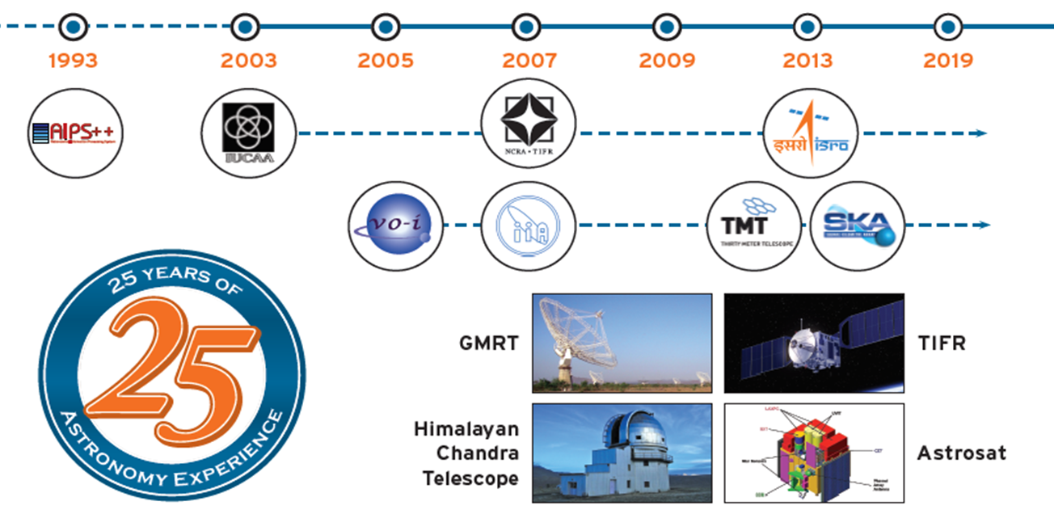
Nearly 25 years of working with Astronomers !
Notes:
Strong long term partnership with the astronomy domain. Our experiences dates back to the early days of AIPS++ development moving on to being actively involved in VOI project for 10 _ years and then getting involved on various projects for GMRT, AstroSat, TMT and SKA …I will be talking about it shortly

Slide 6
Our offerings cut across the entire life-cycle of an observatory
Science Data Processing
LFAA and other software
Observatory Science Operations (OSO)
SaDT
Agile Project Management
MCCS software
(Worked on proposal Management for GMRT, IGO, Astrosat, SKA)
Participate in TANGO and UI prototyping, development and testing
Simulators(Involved in control System for IUCAA and NCRA)
Network Manager plug-ins, interfaces to TM
(Involved in SKA NMGR design)
Gold Partner to Scaled Agile
Software development, Web interfaces
Cloud and Distributed Databases
FPGA programming
Certified Product Owners and scrum masters in SKA’s solution management team
Hosting PI planning meting
Design thinking workshop for SKA
Telescope Monitor & Control
Performance Engineering
Validation of throughput, latency, pinch points in network, hardware and software
Messaging Platforms Performance Benchmarking for TMT, Performance Benchmarking prototype for SKA Proposal Handling Tool
Data Pipeline Management
Big Data and Machine Learning (Image classification)
Involved in GMRT Data Archive, Astrosat Pipeline Design
Analytics and visualization tools , Virtual Observatory Plotting Packages , Mosaic Services & FITS Utilities)

Slide 7
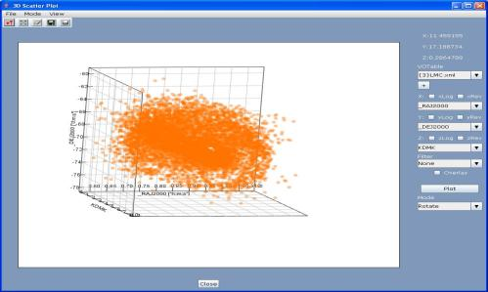
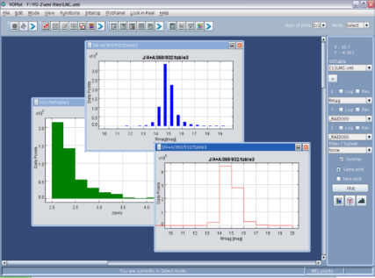
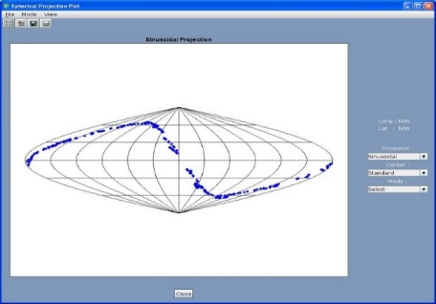
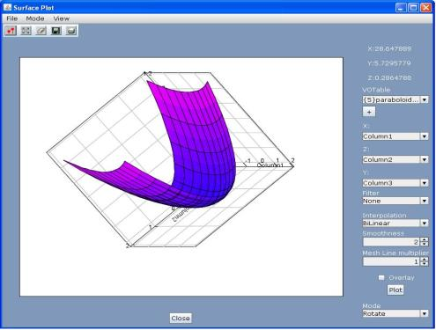
Post observation processing: Visualization tools built under VO
Tools for visualization of astronomy data
Engagement Highlights:
Rich and interactive tools for web-based version as well as a standalone desktop application.
Data support for VOTable, FITS or ASCII format
Scatter Plot (2D, 3D)
Histogram, Spherical projection plots
Statistics and Cone Search directly on plots
Interoperability using SAMP
Notes:
These are some snapshots of the visualization tools that we developed as part of VO-I project. Data in various formats like VOTable FTS and ASCII was loaded into these tools and user could view it in different plots . Interoperability within the VO word was achieved using SAMP

Slide 8
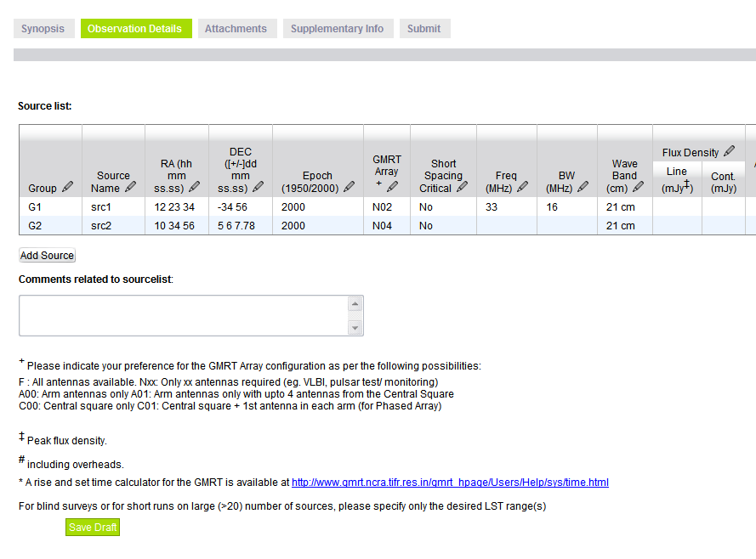
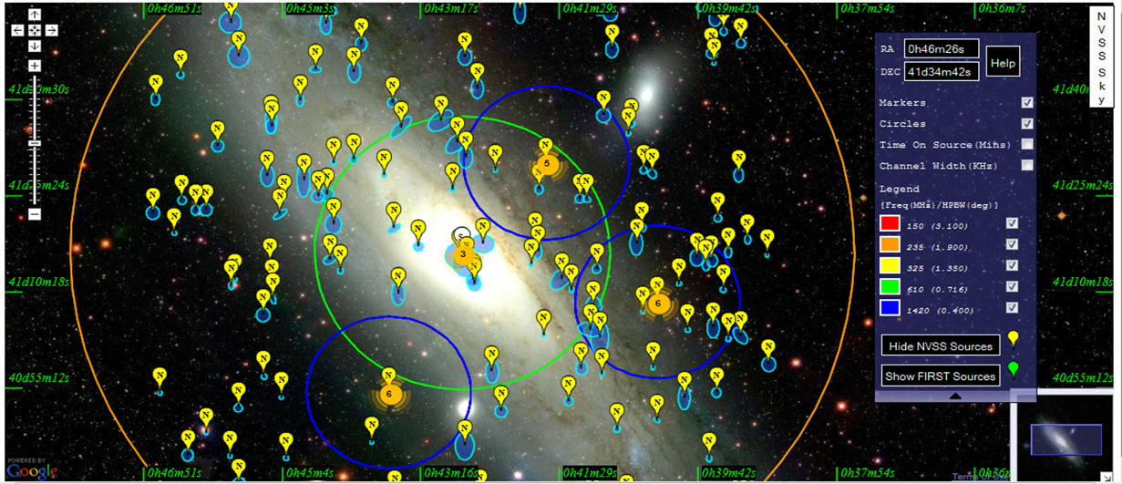
NAPS – GMRT Proposal Submission Tool and Online Data Archive
Developed web based system for automating proposal submission ,review and management process of GMRT
Workflows for Principal Investigators, Review committee, Time Allocation Committee members, Operation staff , Scheduler implemented as part of this system
Developed Data Archive system for GMRT observation files to archive, query and download the GMRT data in a virtual observatory compatible manner as per access policies
Releasing data products generated by SPAM data pipeline via GOA
Enhancing data pipeline for uGMRT
Notes:
In a conference held last year at ESO Garching, we realized that we are the pioneers in upgrading the technology stack and having polished automated workflows for proposal submission systems.
Currently, we are in the process of integrating sign in to this system using resrearcher’s OrcIds. For those who are not aware about OrcId, its a unique, personal, persistent identifier for researchers that distinguishes you from every other researcher and enables you to link your publications to your unique record, ensuring your work is recognized.
Got understanding …experience of observed raw data, processing, file formats, units, science goals workflows. this Helped in contributing to a much larger telescope - SKA

Slide 9
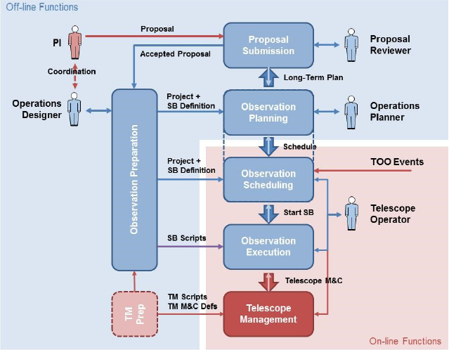
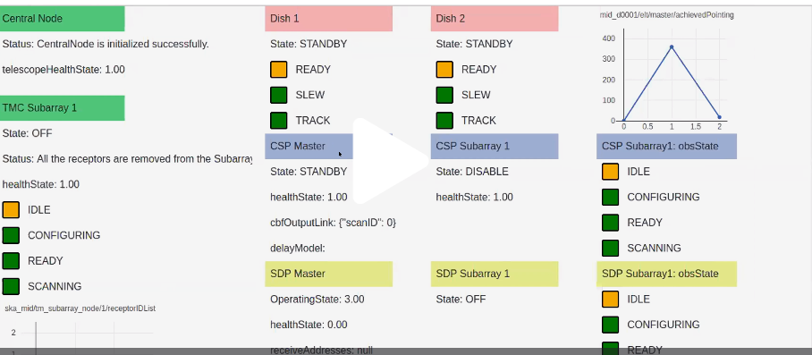
SKA Observation Management
Engagement Highlights
Design of Proposal Submission System and Proposal Management System
Prototyping activities
Technology down -selection
Performance benchmarking
Interfacing with databases and AAA systems
Designing Observation execution scripts and scheduling block definition
Engineering UI for telescope monitoring & control
Notes:
Involved in Telescope Manager (since Concept of Design Review), and Signal and Data Transport (since Preliminary Design Review).
Design involved identifying roles types of proposals (toO, joint proposals, shared propsals etc). Studied existing proposal submission tools – norh star, alma, hct, gemini
To keep up with the high rates of proposals submission during peak proposal deadline time, availably and scalability important.Tech downselction, prototyoing and performance benchmarking was carried to identify the performance bottlenecks in design.
Online function ,SB crucial input to telescope management, All packages like TM, Signal Data processing, Central signal processing interface with each other using the SB definition.
During the designn phas,e we also contributed to the Signal and Data transport package na dnetwork mamager package.

Slide 10
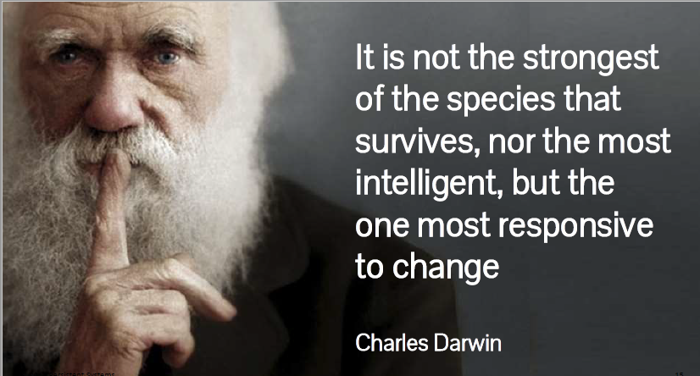
Notes:
To take care of what Charles Darwin said,KA has righly apodeted the approach of Scaled Agile for marching steadily towards the telescope construction.
Involving all stakeholders and meeting the end goal such a huge geographically distributed team structure is a big challenge…next slide

Slide 11
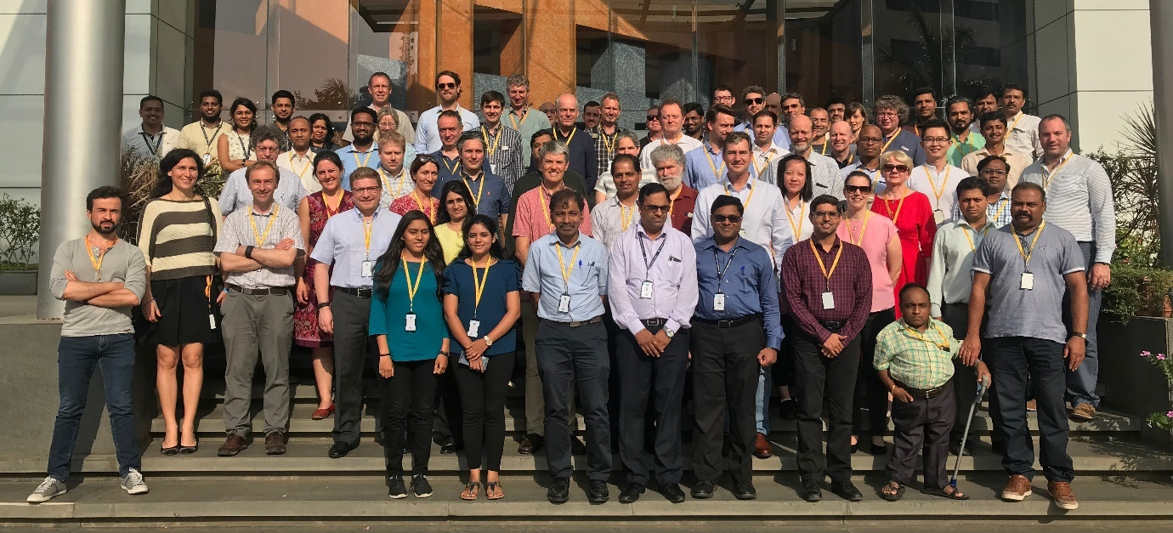
SKA - Scaling SAFely
Contributions to the Agile Development team
Persistent is a Gold partner to Scaled Agile Inc
Product Manager in the SKA SAFe solution management team
Roles of Scrum master and Release train engineer
Hosted and facilitated a Program Increment planning event
Organised Design thinking workshop
Notes:
We run 13 weeks program increments, divided in 5 2-weeks development sprints, and one 3-weeks innovation and planning sprint.
Each team plans and iterates on the same cadence every two weeks. We have our presence in the solution management team to contribute to the features, business value and drive the release train smoothly.
We as Indian team recently hosted PI planning in India.Be it a product, software or a telescope , its always for the end users. Its important to be in the boots of the end users and design the system.Design thinking teaches us this way. We have conducted workshops for SKA business owners, product managers and all stakeholders .

Slide 12
Possible collaboration areas :
Possible Collaboration Areas
Notes:
With our vast experience in this domain and technical expertise gained over all these years, we are keen to collaborate further on various areas like…

Slide 13
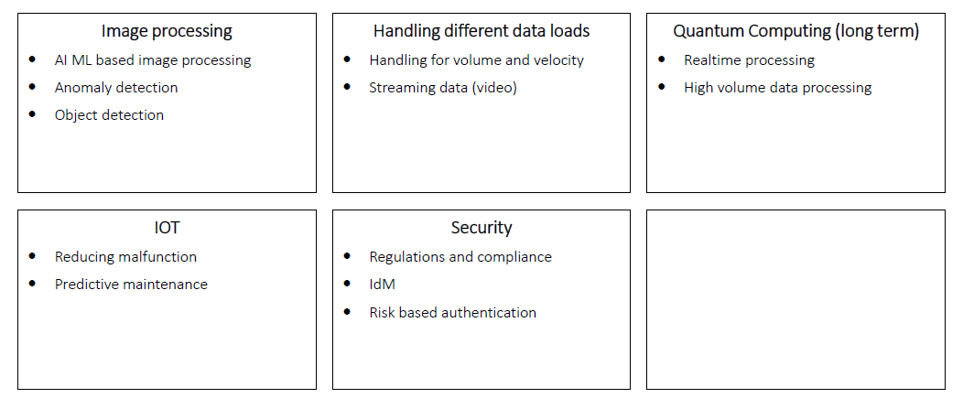
Possible collaboration areas :
Possible Collaboration Areas

Slide 14
Thank you!
Snehal Valame snehal_valame@persistent.com
Notes:
We are passionate about SKA and excited to grow our collaboration…

