Slide 1
AUSTRALIA-INDIA RESEARCH & DEVELOPMENT IN RADIO ASTRONOMY MEETING (ARDRA)
Challenges in the design of an antenna for the detection of Global 21cm EoR signal
A. Raghunathan
15-11-2019
Collaborators:
Somashekar.R, Girish B.S, Srivani K.S, Saurabh Singh,
Jishnu Nambissan T, Udaya Shankar, Ravi Subrahmanyan
Raman Research Institute - Bangalore – 80

Slide 2
Talk outline
  Global EoR signal and minimum system requirements for its detection
  Factors influencing adversely the detection process
  Methodology adopted to detect EoR signal
  Primary requirements of the antenna used as a detector
  Review of antennas built at the Raman Research Institute
  Current status

Slide 3
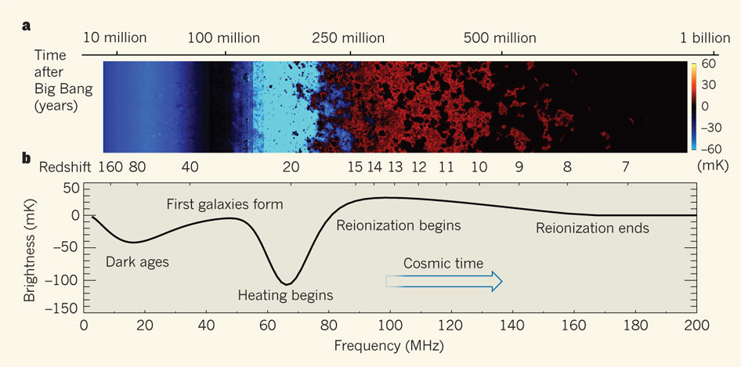
Typical Global EoR signal being detected
Evolution of Universe
EoR signal
  Typical magnitude ~ 26 mK in emission &
  ~ 150 mK under absorption

Slide 4
Minimum system requirements for
EoR detection
  If we have a receiver with Tsys = 100 K, then with a bandwidth of 1 MHz and an integration time of 300 Sec. we can reach the sensitivity of
  Δt = Tsys / √Bτ
  = 100 / √(1e6*300)
  Δt = 6 mK
  This is enough to have 4 – 5 sigma detection of EoR signal.
  But still we are struggling to detect it ---- WHY ??

Slide 5
  Factors influencing adversely the detection process
Requires @ mK level - Hard
Calibration
Error
Requires Galactic model at
mK level – Impossible
Difficult to model
Influence of
Real
Earth
Modeling
Strong Galactic
background
EoR
Not in our
hand
Freq. dependent
Characteristics
of Antenna
Difficult to
control
Local RFI
Additives of
Rx.
System
Partially controllable

Slide 6
We are optimistic about the detection because most of the contaminants are assumed to have smooth spectral response and not have frequency structures similar to EoR signal.
We are building the receiver system to have smooth spectral response so that EoR signal could be detected.

Slide 7
Antenna Characteristics
Impedance
characteristics
Radiation
Characteristics
Antenna
These characteristics should be smooth to an extent that when they are fitted using a low order polynomial, the residual left out must be in the range of 10⁻⁵ – 10⁻⁶

Slide 8
Primary Requirements of an antenna
  Return loss characteristics must be moderate to get acceptable sky signal
  Its response must be free from inflection point and smooth to within a few parts in 10⁵
  Gain variation with frequency also should be smooth to the same order.
  Operating bandwidth : 50 – 200 MHz (1:4)
  Radiation efficiency must be more than 50 % to get enough sky
  signal

Slide 9
How to make antenna radiation patterns (Gain) independent of frequency ?
Make the antenna electrically smaller
  A short antenna generally exhibits frequency independent radiation patterns
Disadvantage
  This seriously affects the impedance match.

Slide 10
How to improve the Impedance match (Return loss)
Profile the antenna structure to minimize the reactive part of its impedance
Based on this technique, several antennas have been designed like - Sinusoidal, Spherical, Conical, planar sinusoidal, antenna for space application…

Slide 11
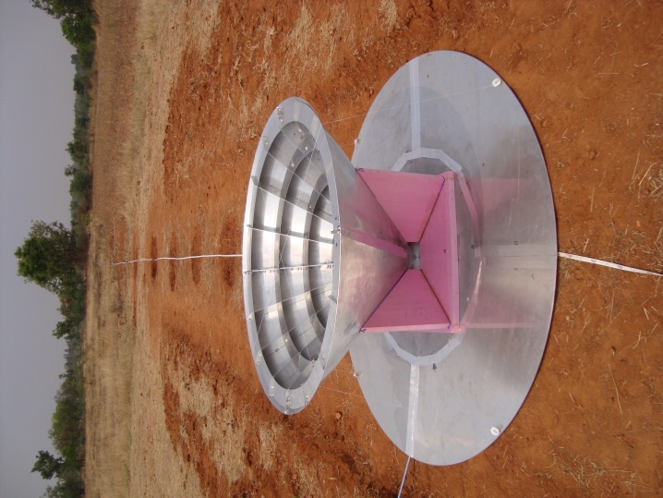
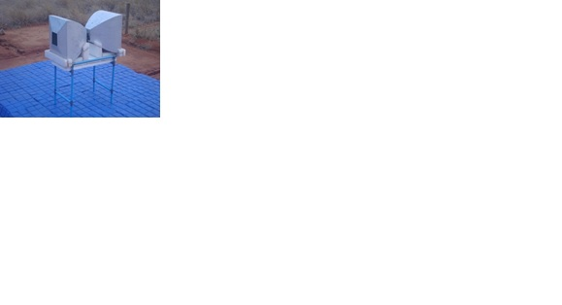
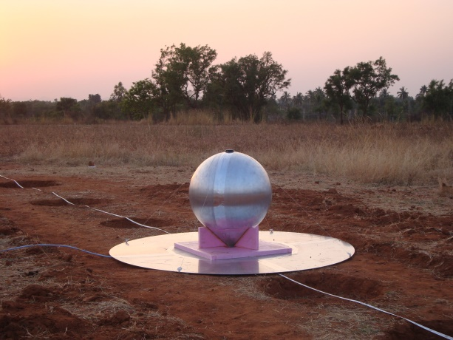
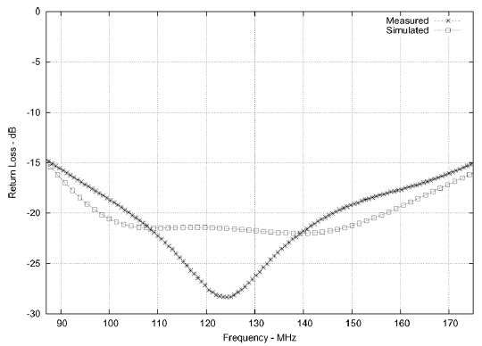
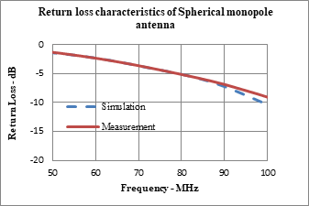
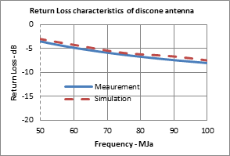
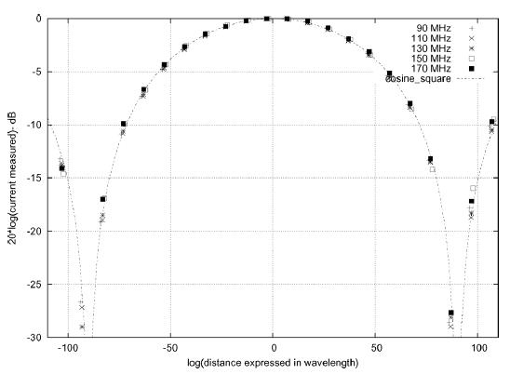
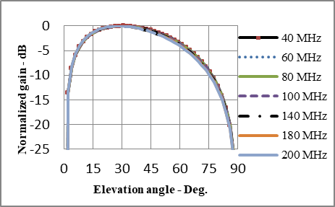
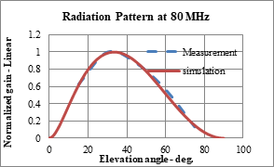
Antennas built at RRI for EoR expt.
87.5-175MHz
40-200MHz
50-100 MHz
Return loss
Radiation pattern

Slide 12
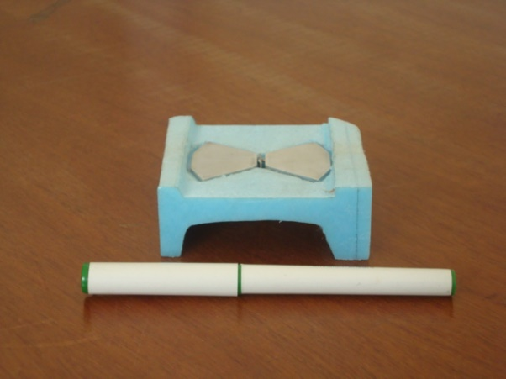
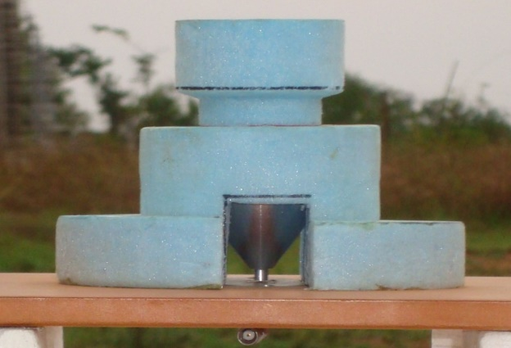
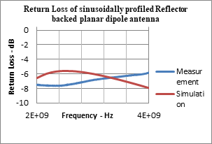
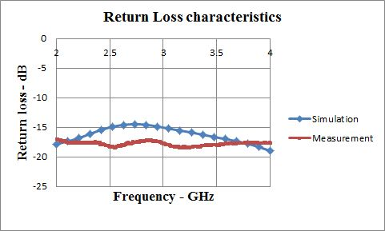
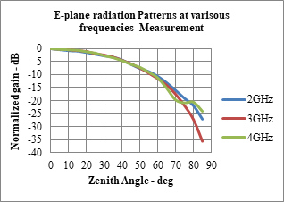
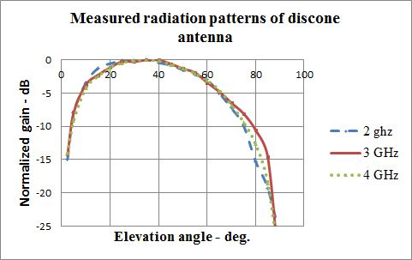
Antennas built for 2-4 GHz
2-4 GHz
2-4 GHz

Slide 13
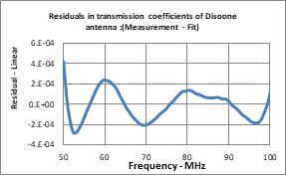
Spectral features due to surface current reflections
Abrupt variation in dimension is minimized in the structure by having
      Smooth feeding point
      Rounding the antenna at its tip
      Reflector dimensions are chosen as small in electrical length to have broad spectral feature due to the reflection at the end
Typical residual obtained after fitting the cone antenna return response with low order polynomial

Slide 14
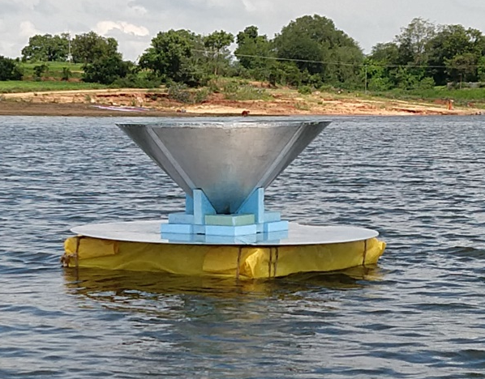
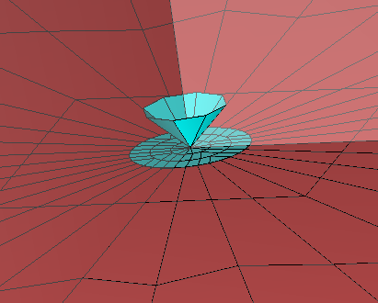
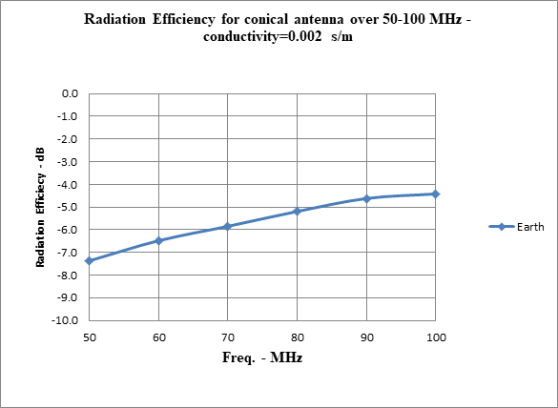
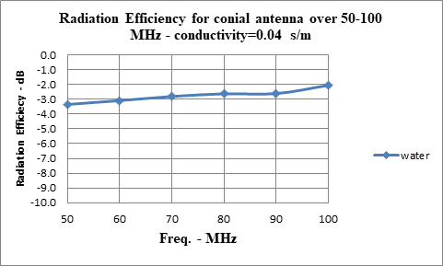
Improvement in Radiation efficiency by going for water medium beneath the antenna
Better electrical conductivity - 0.04 S/m
More uniform medium below the antenna
Higher dielectric constant (80)

Slide 15

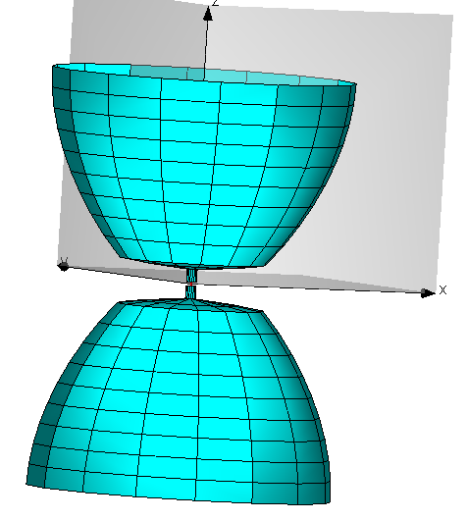
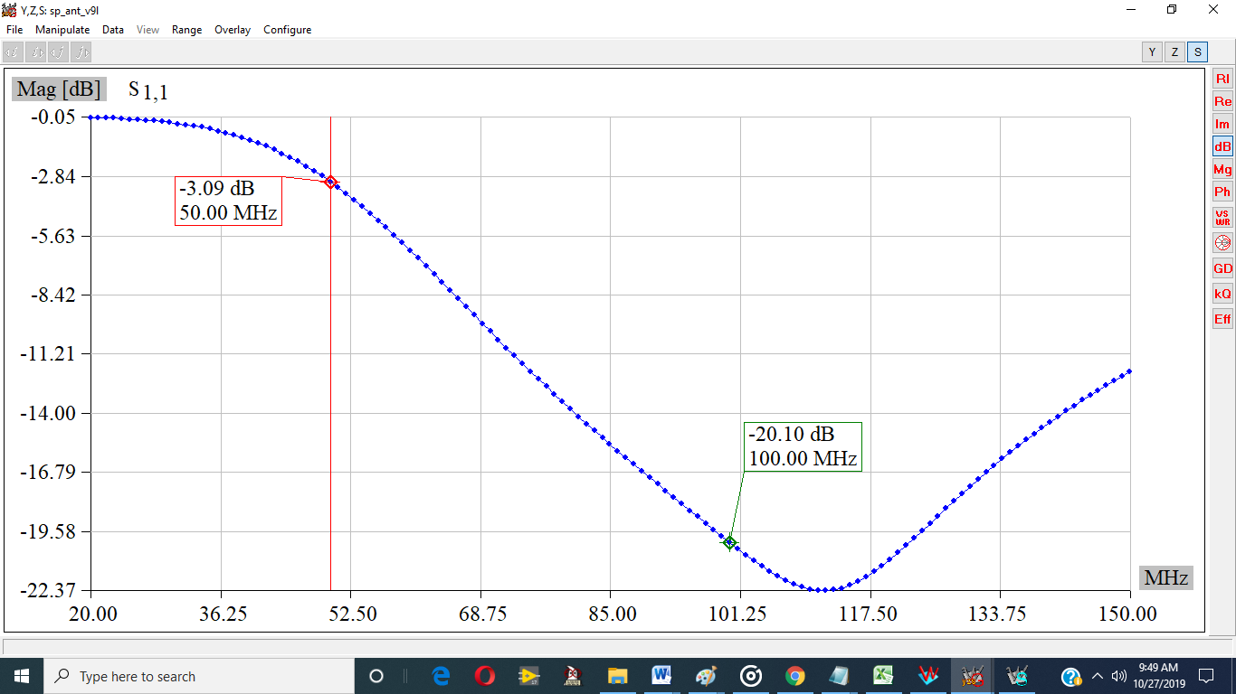
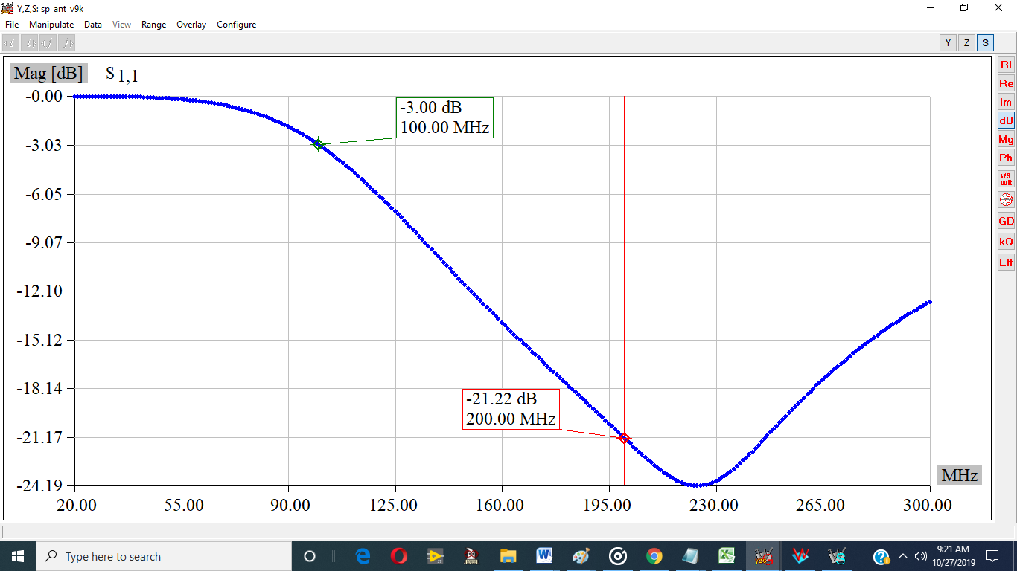
Can we control the variation of return loss characteristics as a function of frequency ?
Dependence of physical parameters of the antenna on the reactive part (Xi) of the antenna impedance is rather complex and non linear, it is rather hard to synthesize the response to our requirement.
(S.A.Schelkunoff 1941)
where G is the radiation resistance, M,N are integrals dependent on the physical parameters
Sinusoidal antenna being designed for space application
50-100 MHz
100-200 MHz

Slide 16
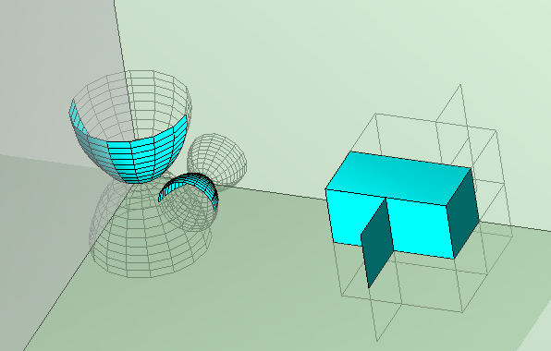
Antenna for space applications
EoR antenna
Bus
Solar panel
Antenna is being designed at present for EoR detection in space.
It is much more challenging in the presence of bus and solar panel of the pay load.

Slide 17
Conclusion
Antenna design for Global EoR detection experiment is challenging
It is required that the antenna’s spectral response be smooth to few parts in 10⁵ so that its features do not confuse the detection process over more than an octave bandwidth
Its radiation efficiency also must be acceptable to get more sky signal.
Antenna design for space application is much more harder than on the ground due to the influence of bus and solar panel.

Slide 18
Thank you

