Slide 1
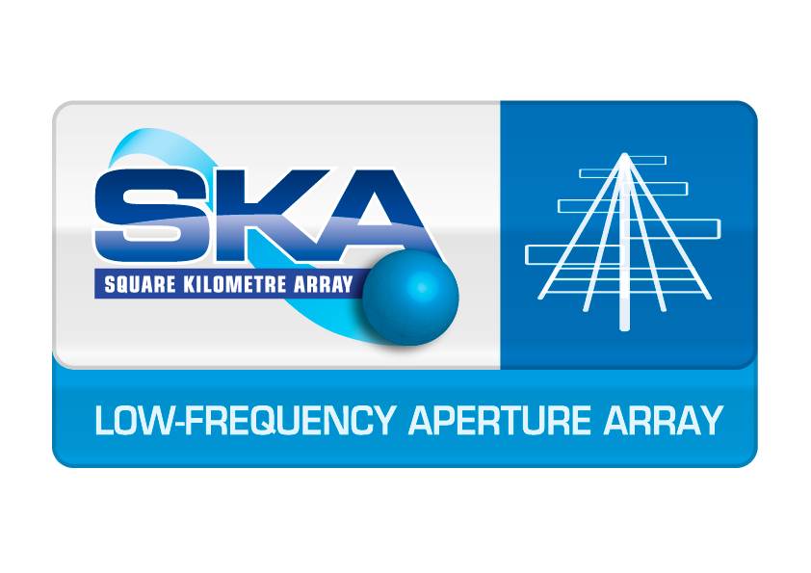
SKA at the MRO
Project Status Update
Raunaq Bhushan
Project Manager - Bridging Phase Construction WP Lead
Curtin University

Slide 2
Partner Institutions
Overview
Origins of the Bridging Phase
Bridging Phase goals and current status
Future activities & opportunities

Slide 3
Partner Institutions
Origins of the Bridging Phase
Motivated by a number of concerns raised during LFAA element-CDR
Primary motivation was to investigate station level calibration
The Bridging Arrays (AAVS and EDA) were commenced at the end of 2018
Affords to opportunity to consistently collect ancillary data such as costs, time-studies and other operational metrics/challenges

Slide 4
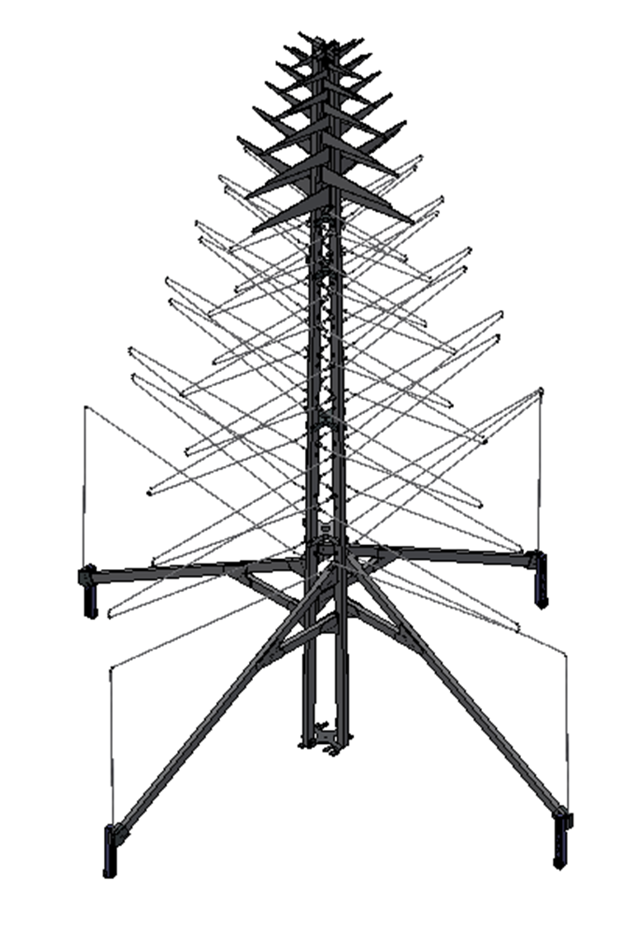
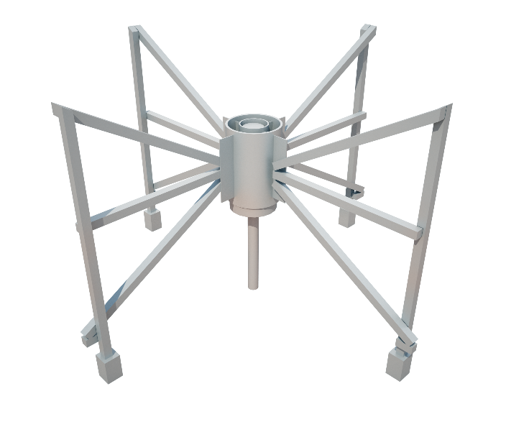
Partner Institutions
Bridging Phase Goals
Two field nodes of 256 antennas each were established
Engineering Development Array 2 (EDA2) – MWA-Style Dipole
Aperture Array Verification System 2 (AAVS2) – SKALA4.1-IT
Arrays needed to be established on a very short time-scale
Several elements deviated from SKA Spec due to time constraints (PaSD etc)
SKA Spec is adopting some Bridging deviations
Future Field Nodes will reconcile all other deviations
Phased rollout was defined executed
at the beginning of 2019

Slide 5
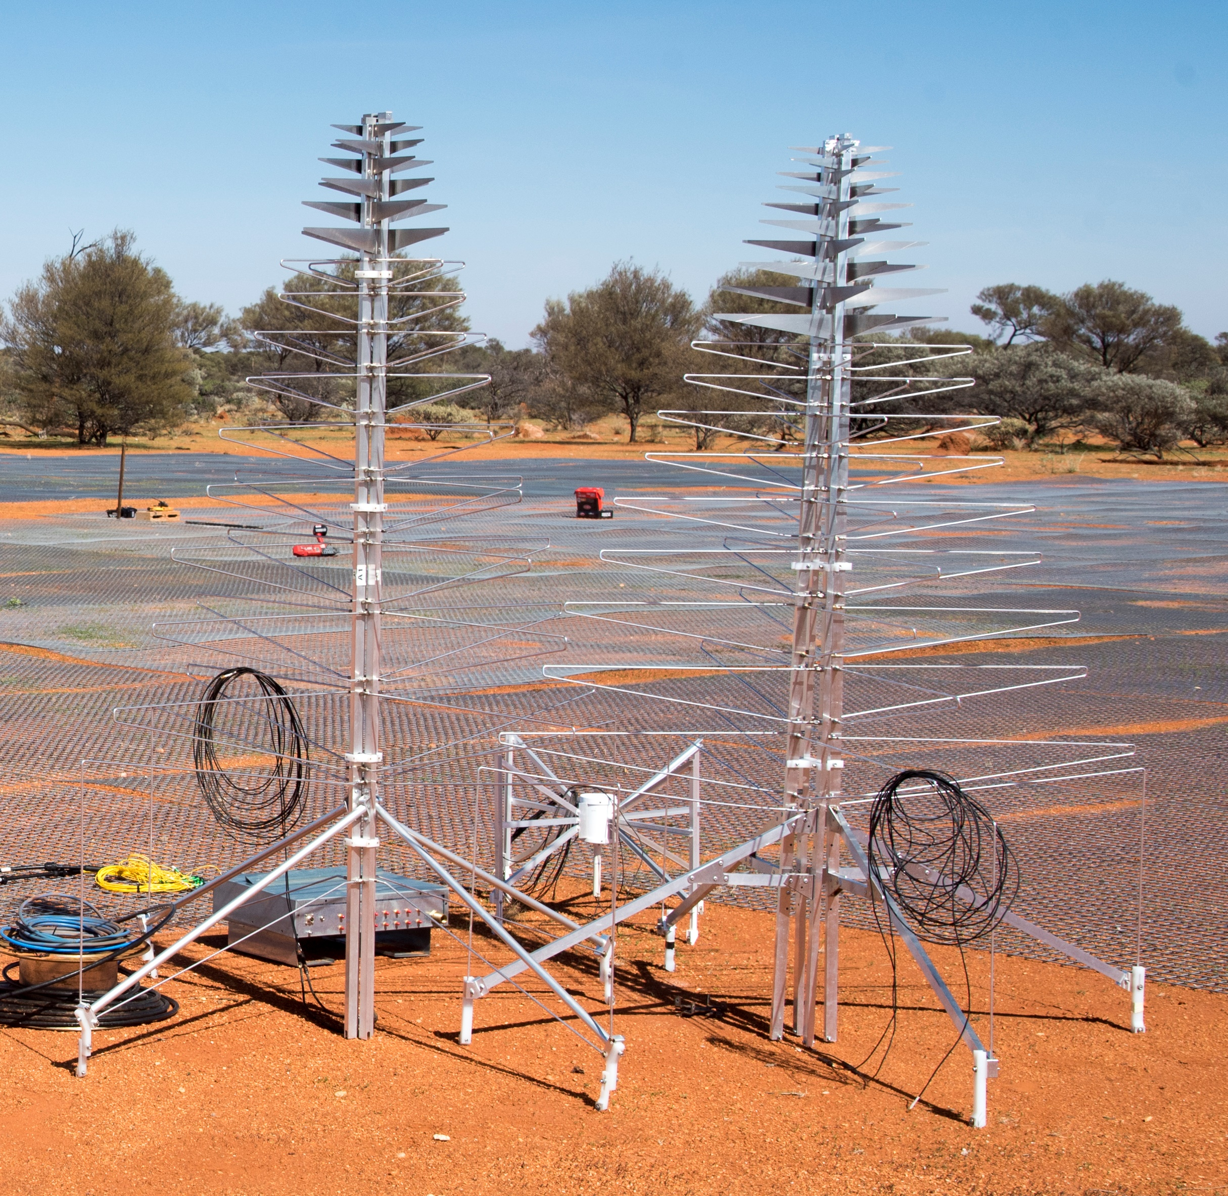
Partner Institutions
Bridging Phases
Phase 0 – Deployment of single antennas each to demonstrate a fully functional signal path.
Made up of a single MWA-Style Dipole, SKALA4.0-IT and SKALA4.1-IT antennas
Commissioned Feb 2018

Slide 6
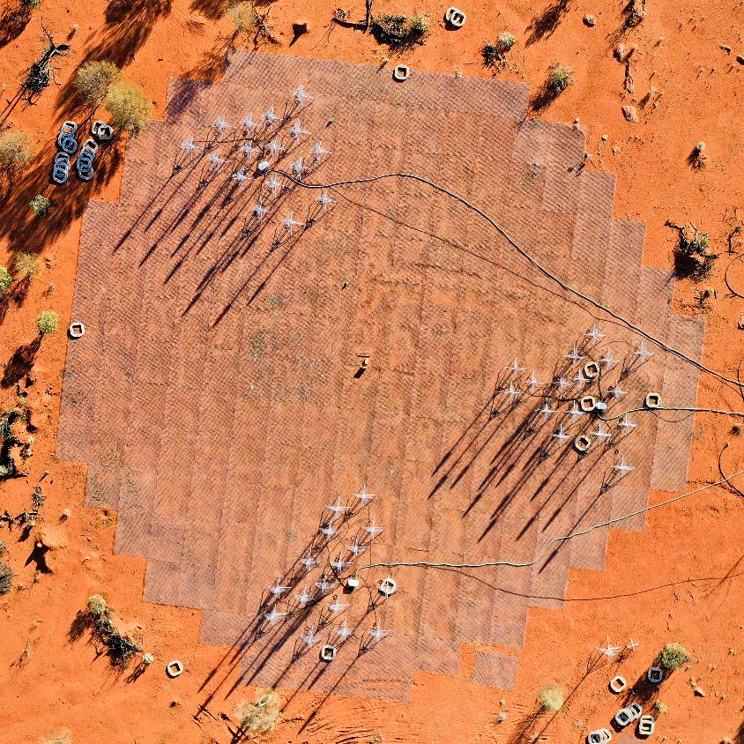
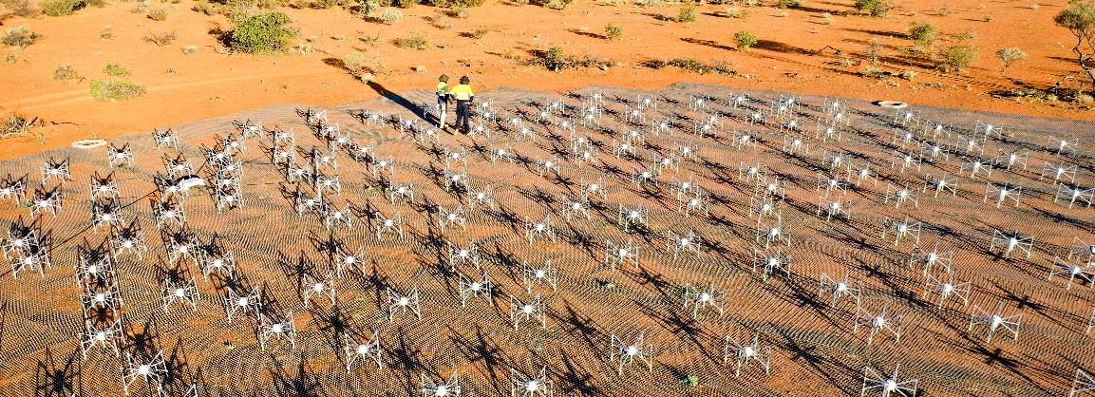
Partner Institutions
Bridging Phases
Phase 1 – Establish 48 SKALA4.1 and MWA-Style dipole antennas in the form of 3 tiles made up of 16 antennas each.
Commissioned May 2018
256 EDA2 antennas installed all at once but only 48 were connected

Slide 7
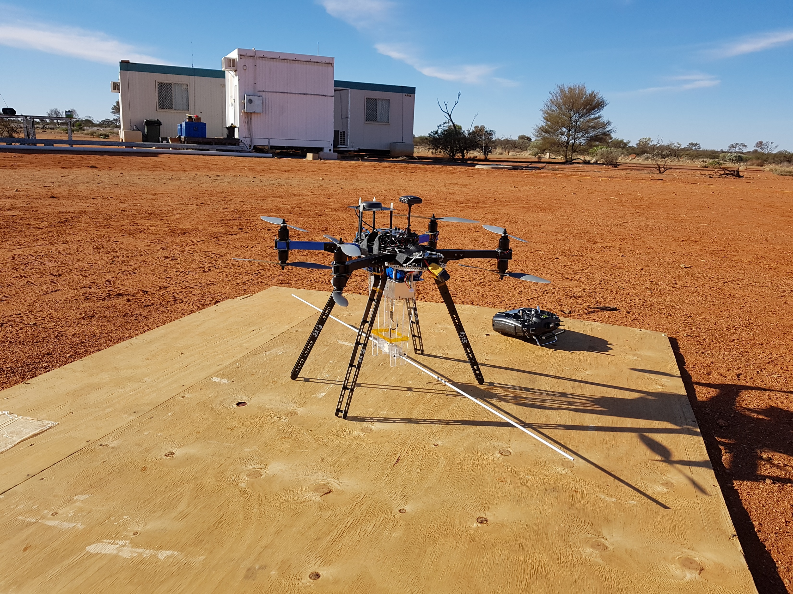
Partner Institutions
Bridging Phases
Drone Campaign conducted June 2019
A drone was flown over both arrays with a transmitter in both the near and far-field
Results have been submitted to SKA (Oct 2019) in the SKA Low Station Calibration Report for System-CDR in December

Slide 8
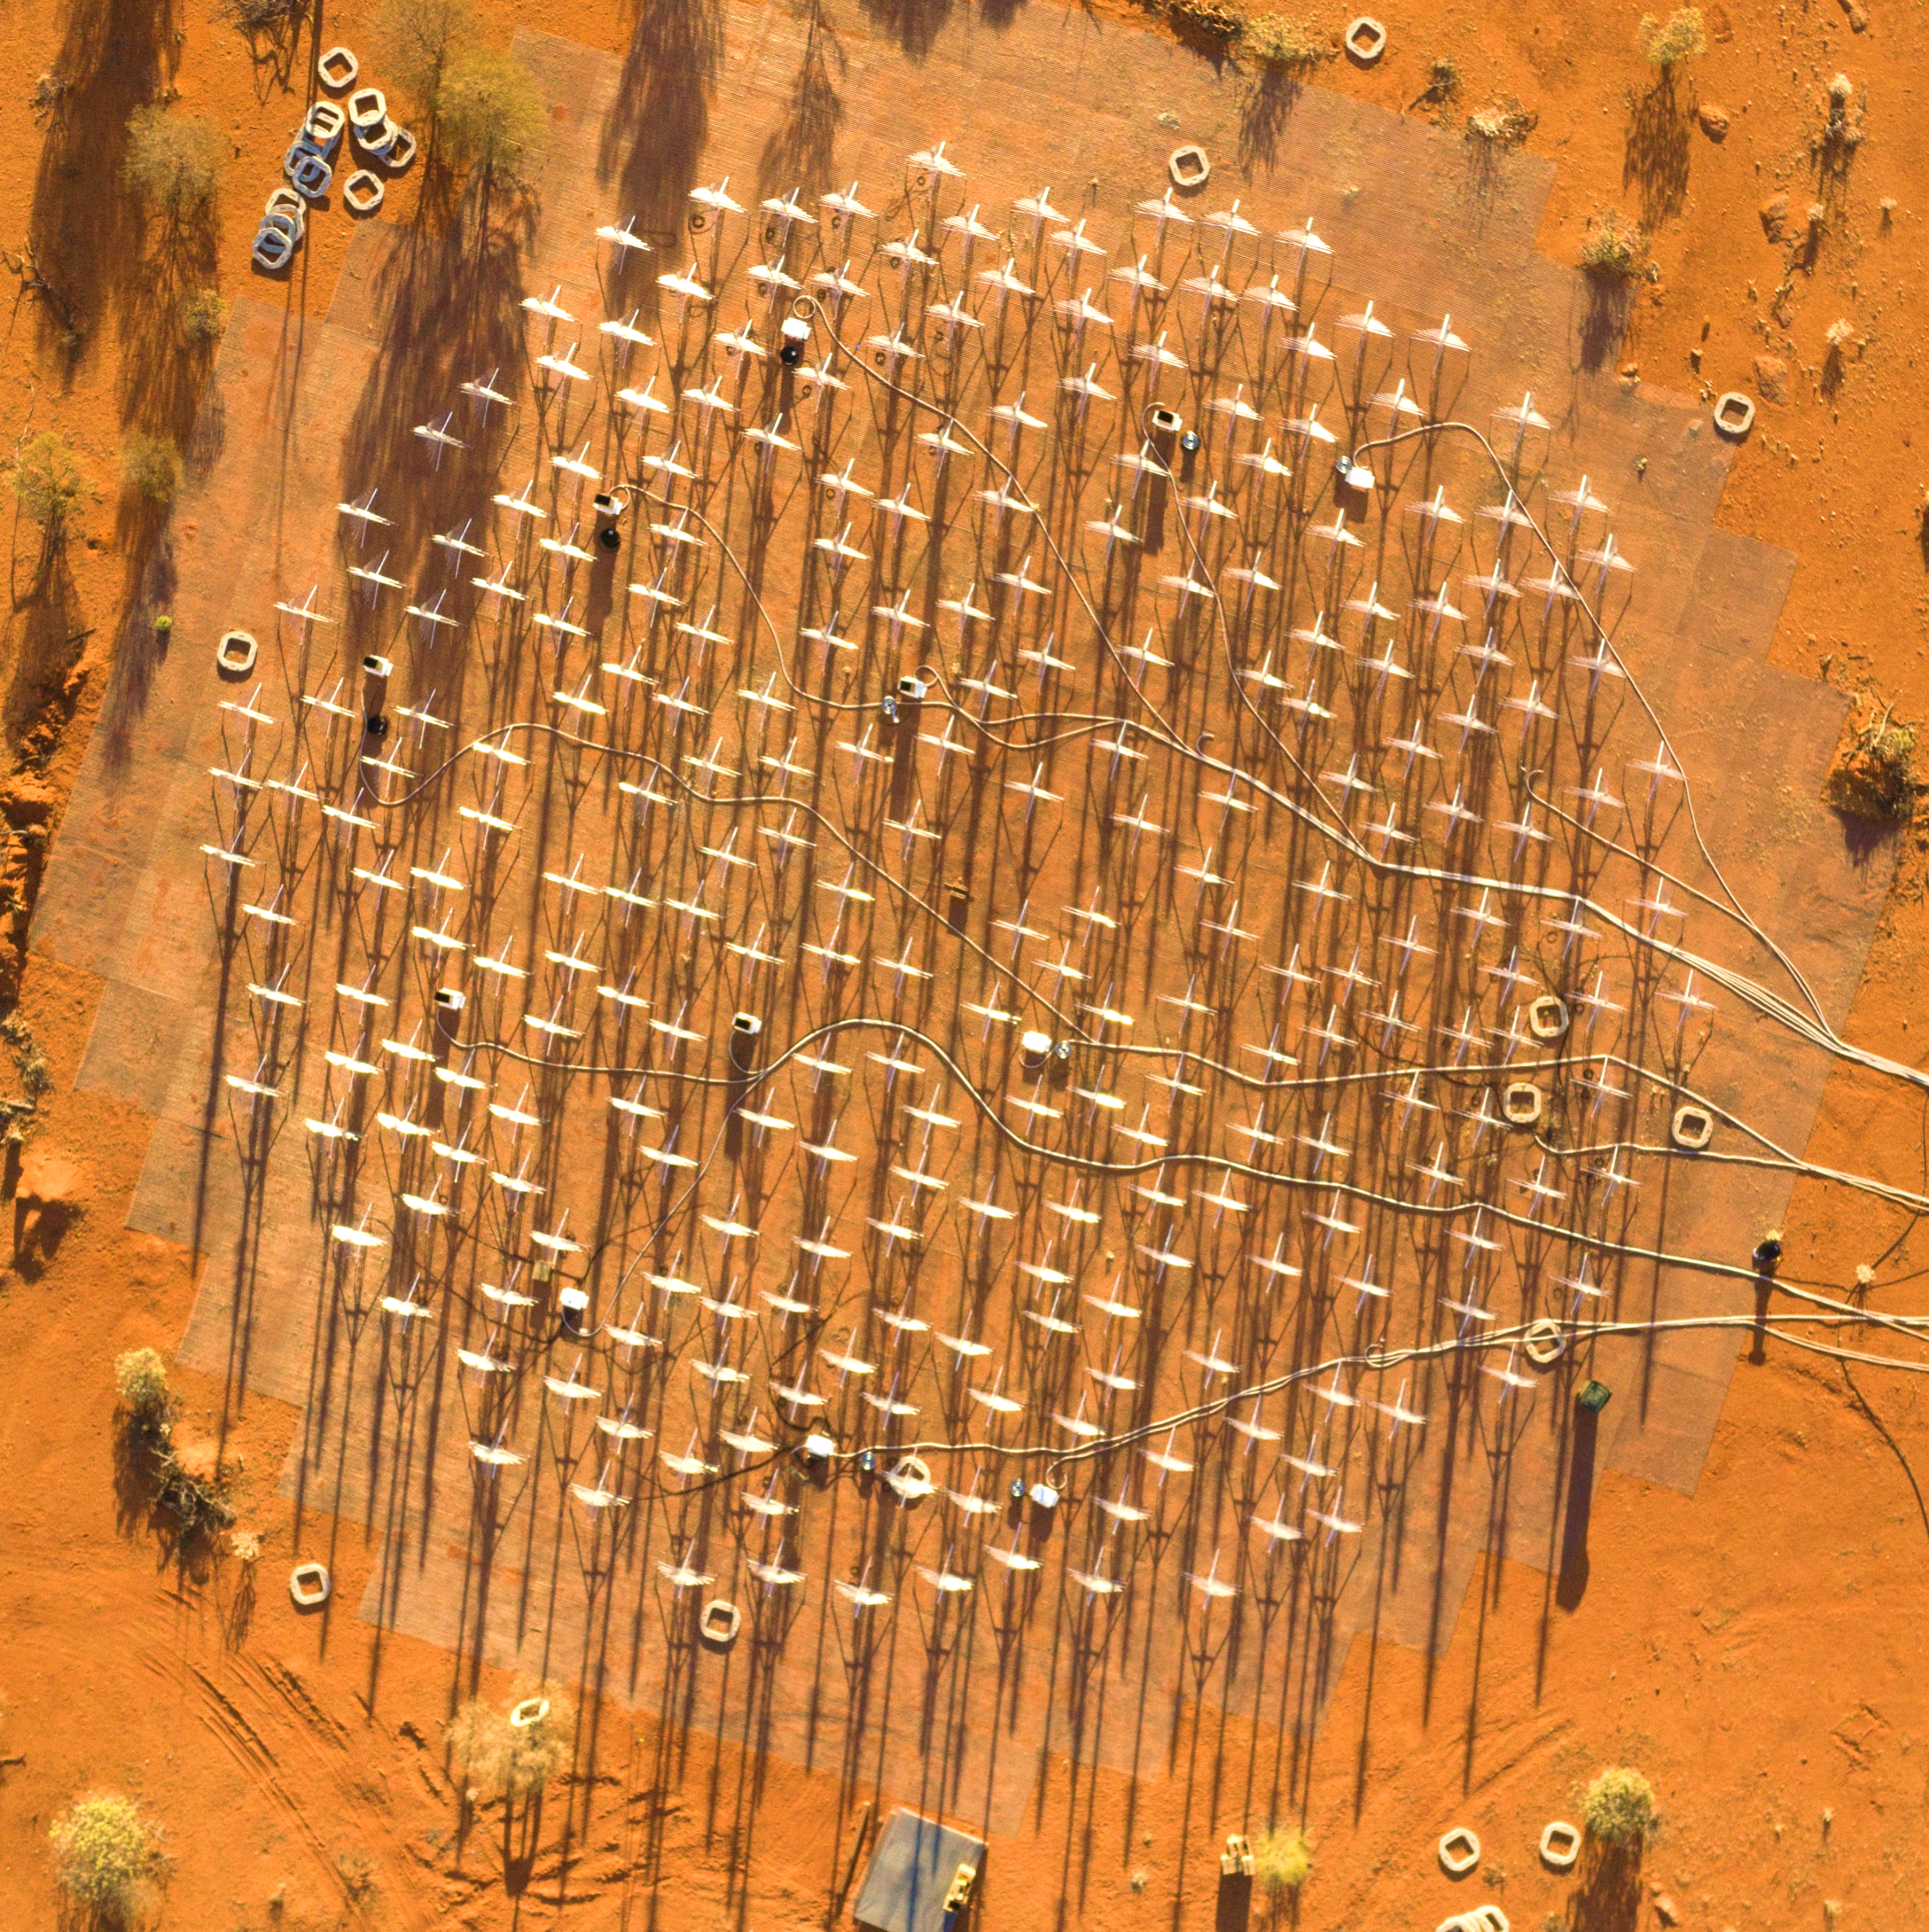
Partner Institutions
Bridging Phases
Phase 2 – Establish 256 antennas of both types of antennas.
All EDA2 antennas were installed in Feb 2019 but Power and Signal Distribution for all 256 was established July 2019
All SKALA4.1 antennas were installed October 2019 and Power and Signal Distribution was fully established November 2019
Phase 2 in place as of 5 days ago changing the SKALA4.1 field node from AAVS1.5 to AAVS2

Slide 9
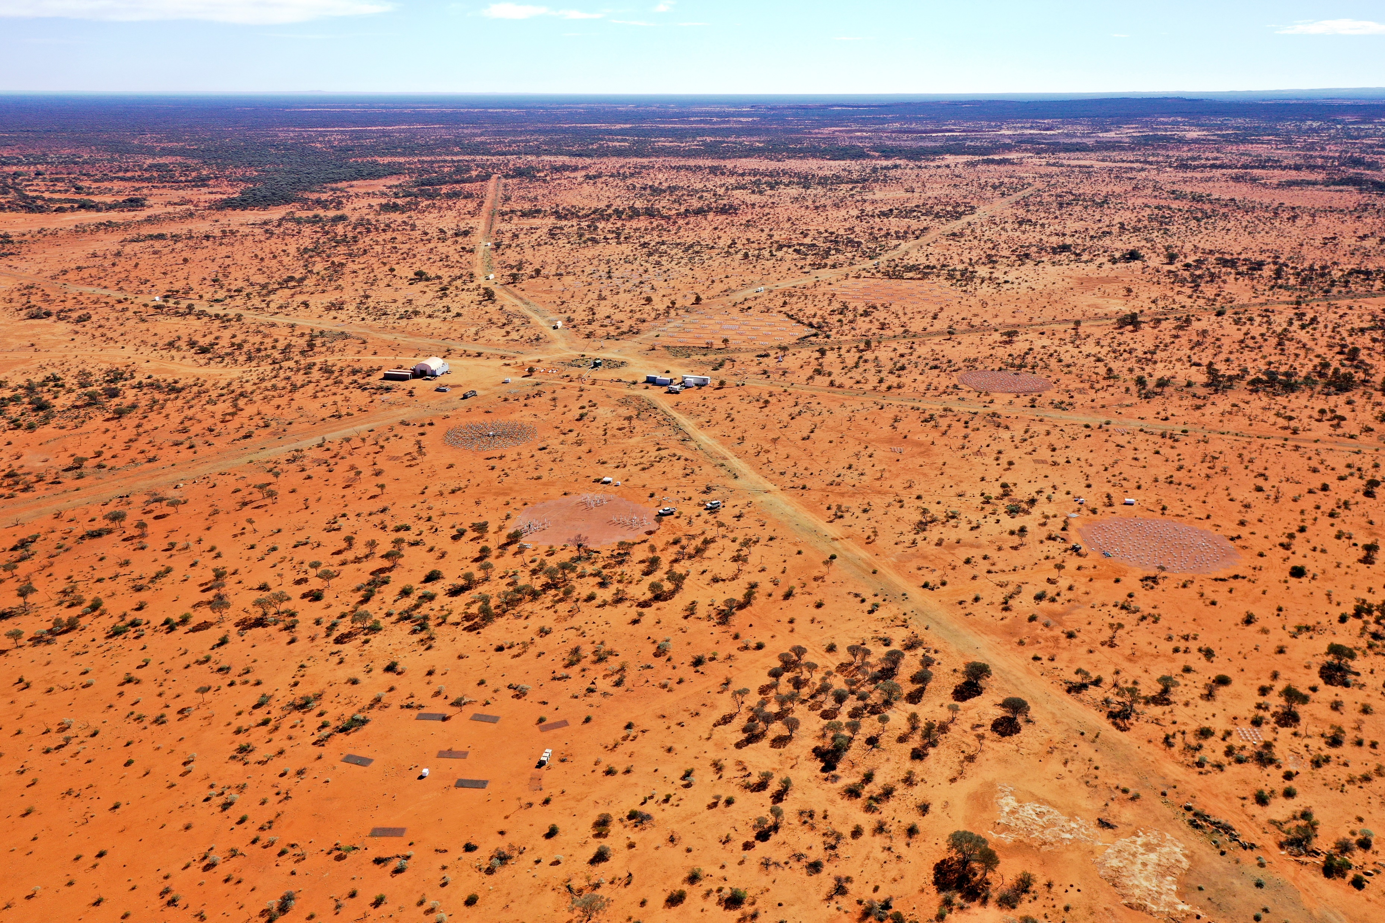
EDA1
(Decommissioned)
AAVS1 (Decommissioned)
AAVS2
EDA2
Unused Site

Slide 10
Partner Institutions
Future Work
Continue observation with both AAVS2 and EDA2 into the March/April timeframe to take advantage of key observation periods
Antenna selection will be made by mid-2020
Phase 3/Pre-production Phase (under proposal)
Establish up to 4 stations of the selected antenna
Configured as close as possible to SKA Spec
Address deviations in Bridging (Mechanical and
Shielding specs, Power and Signal Distribution)
Under proposal at this stage

Slide 11
Future site for selected antenna
Prototype test site
AAVS2
EDA2
Future site for selected antenna

