Slide 1
The Design and Performance of RF Frontend and Signal Transport System of GMRT
S.Sureshkumar
email: skumar@ncra.tifr.res.in
GMRT Observatory, NCRA-TIFR,
Pune University Campus, Pune 411007

Slide 2
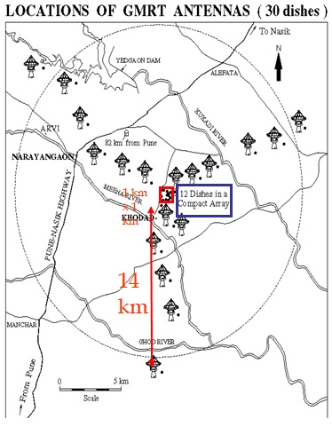
Introduction
Y shaped GMRT array is with 30 antennas of 45 m diameter parabolic dish spread over 14 km radial distance.
All antennas are connected through optical fiber to the central signal processing station located at array center.
uGMRT provide seamless frequency coverage from 120 MHz to 1450 MHz

Slide 3
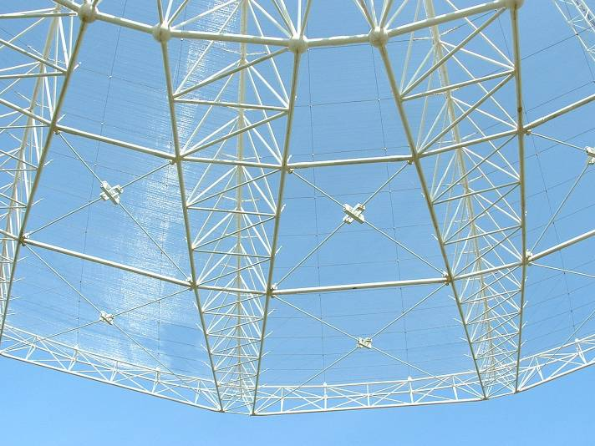
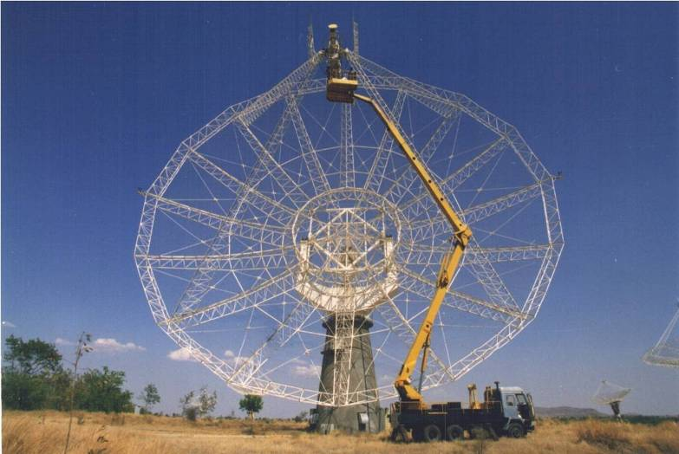
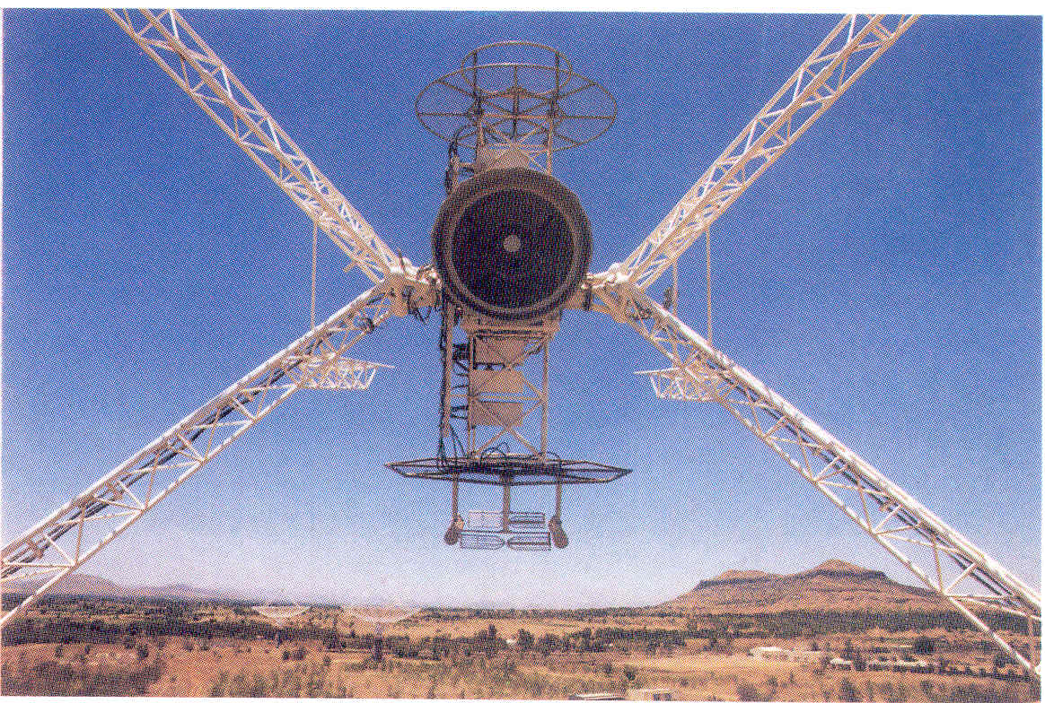
Giant Meterwave Radio Telescope - GMRT

Slide 4
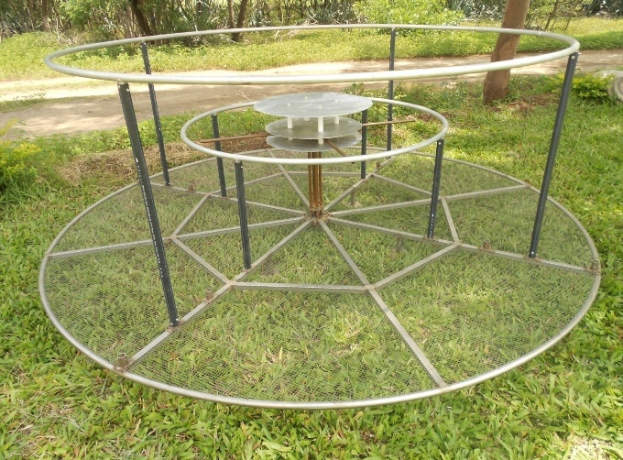
Prime Focus Antenna Feeds of GMRT
Designed By Haumanth Rao

Slide 5
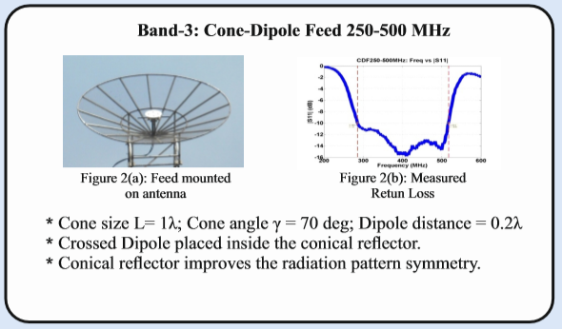
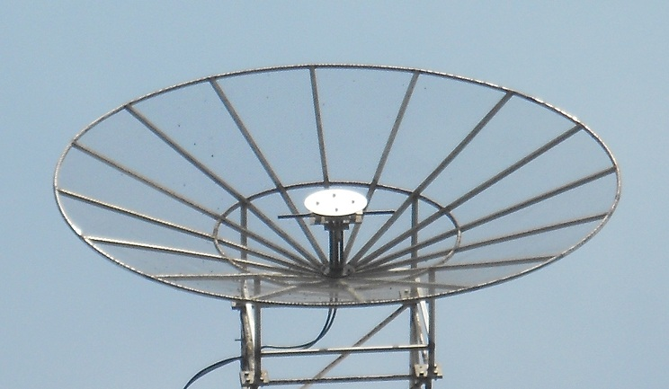
Prime Focus Antenna Feeds of GMRT
Designed By Hanumanth Rao

Slide 6
Prime Focus Antenna Feeds of GMRT
Designed By Hanumanth Rao

Slide 7
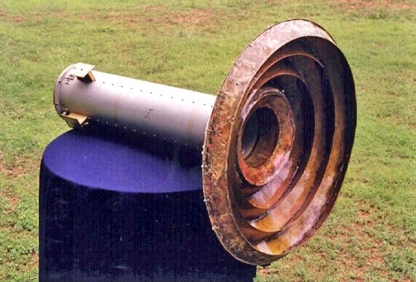
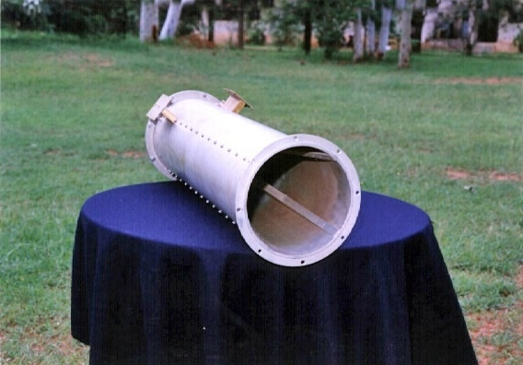
Prime Focus Antenna Feeds of GMRT
Designed By RRI
Corrugated Horn
Quad-Ridged Orthomode Transducer
1000-1450 MHz Band Coverage

Slide 8
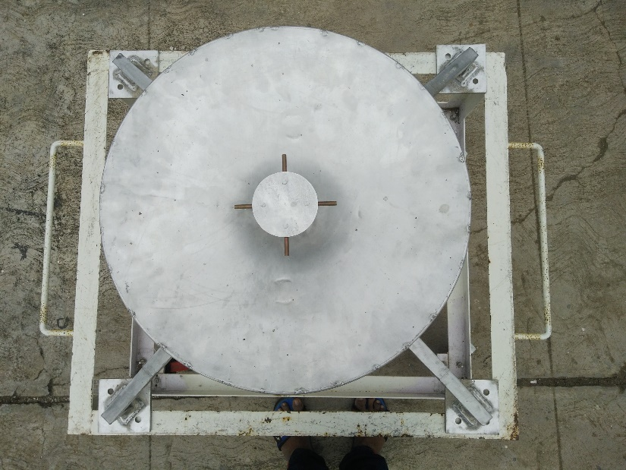
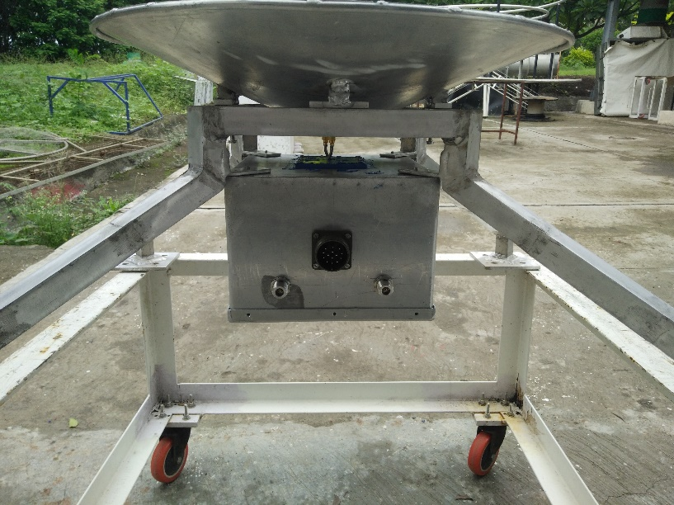
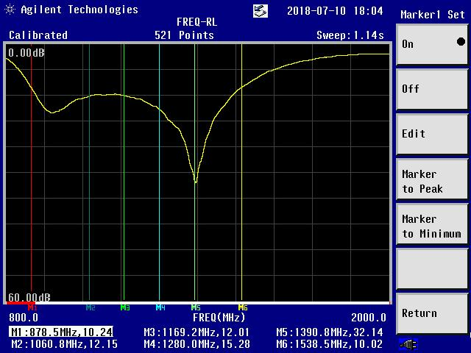
Compact and Light Weight L band feed for GMRT
Designed By Hanumanth Rao

Slide 9
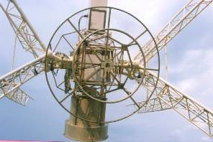
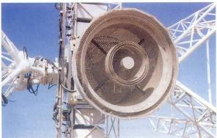
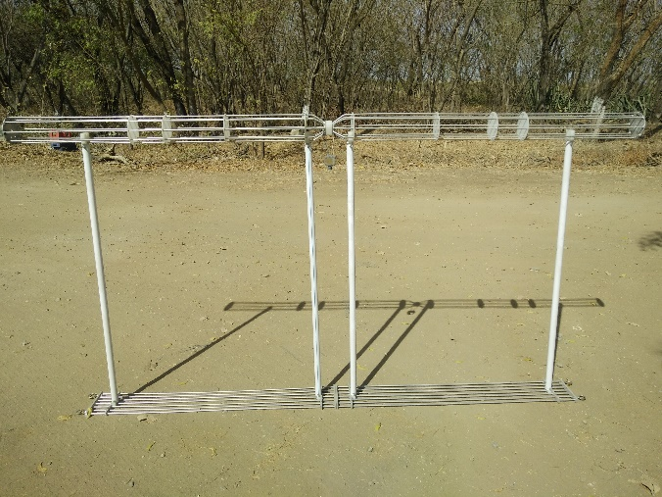
Other Feed designed for GMRT
Designs by G.Shankar
150 MHz folded thick dipole
327 MHz Cross Dipole with Sleeve
610/233 MHz Dual Co-axial Feed
Thick dipole with Line Reflector

Slide 10
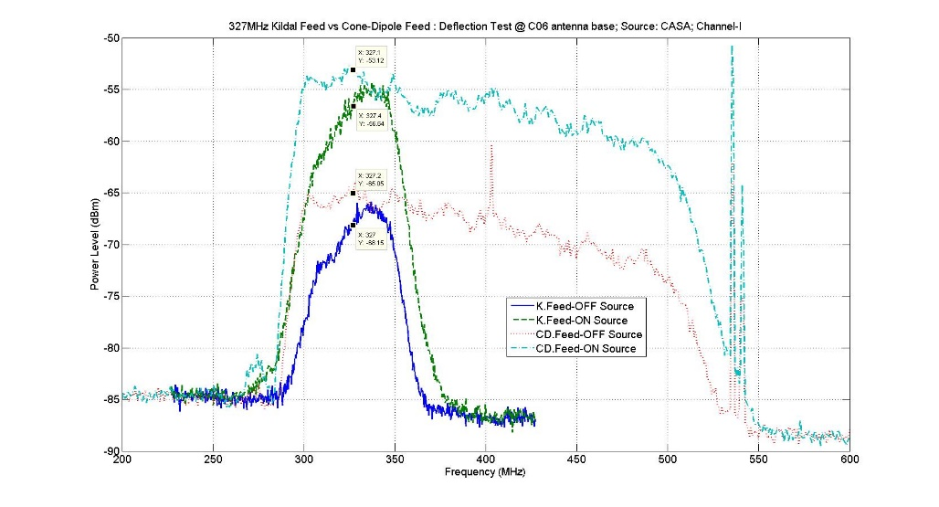
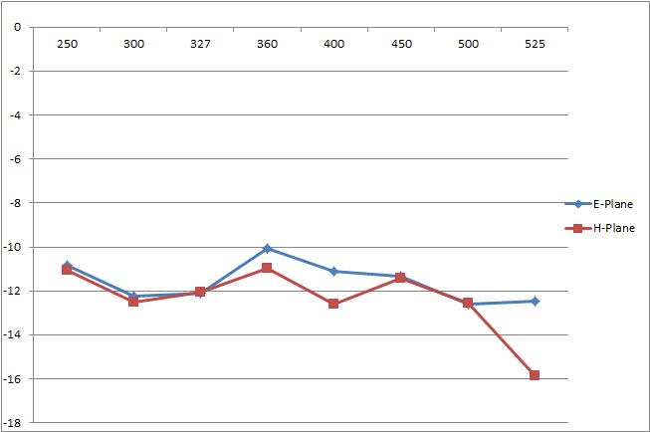
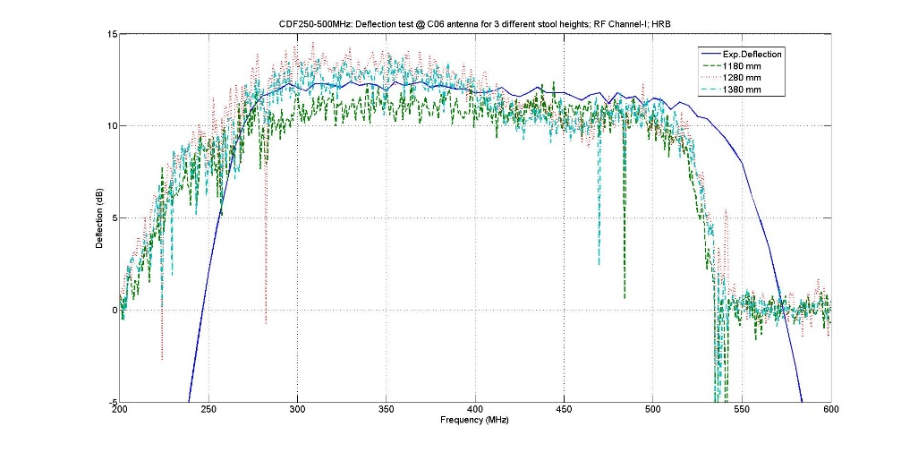
Feed Performance optimization
Impedance Bandwidth
Edge Taper over feed Bandwidth
Sensitivity / Deflection
Phase Center adjustment.

Slide 11
u-GMRT Front-End Block Diagram
CW Cal
Power
Monitor
Noise
Gen
Termi
16 Control
Channels
Power
Monitor
32 Monitor Channels
RFCM
Card
SOLAR
ATTENUATOR
Temp
Sensor
Temp
Sensor
BAND SELECTOR
BYPASS
BroadBand
Amplifier
CH1
BPF
PostAmp
& Phase
Switch
LNA
14dB
30dB
POLARIZER
Switched
Filter Bank
RF ON/OFF
BAND SELECTOR
CH2
Channel
Swap
COMMON BOX
FRONT-END BOX

Slide 12
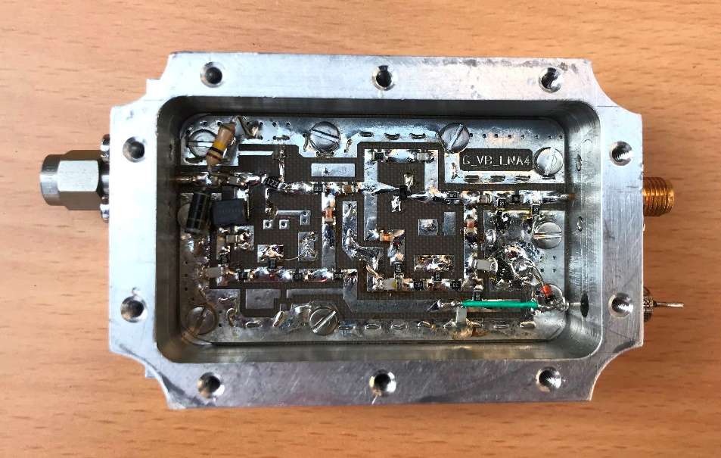
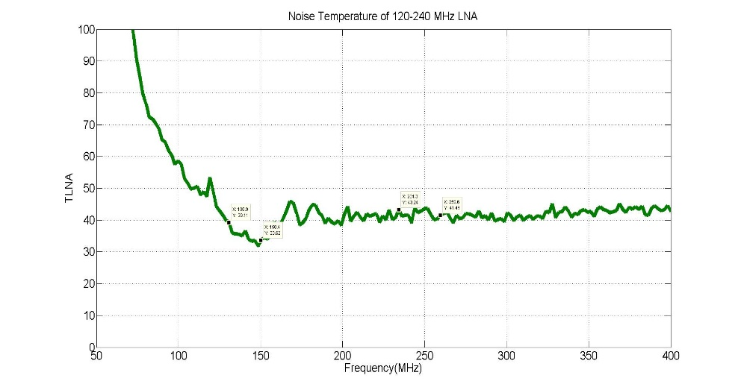
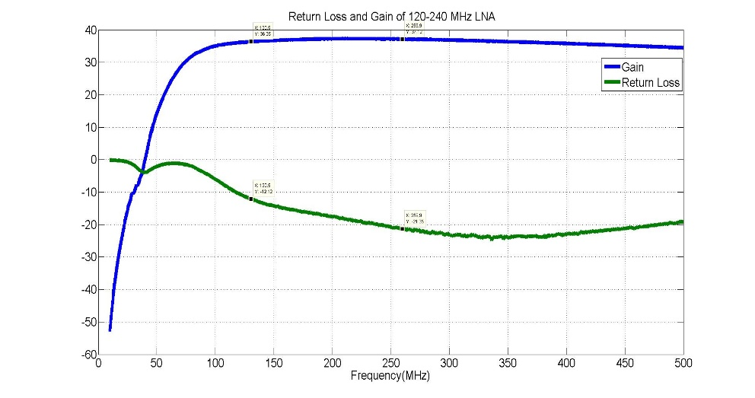
120 – 250 MHz LNA
Bandwidth : 120 - 250 MHz
Gain: > 35 dB
Noise Temp. : 40 Deg. K
Return Loss: Better than -10 dB
OIP3: +20 dBm
Designed By: V. B. Bhalerao

Slide 13
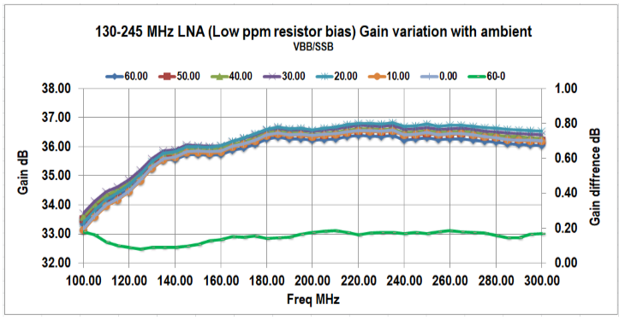

Slide 14
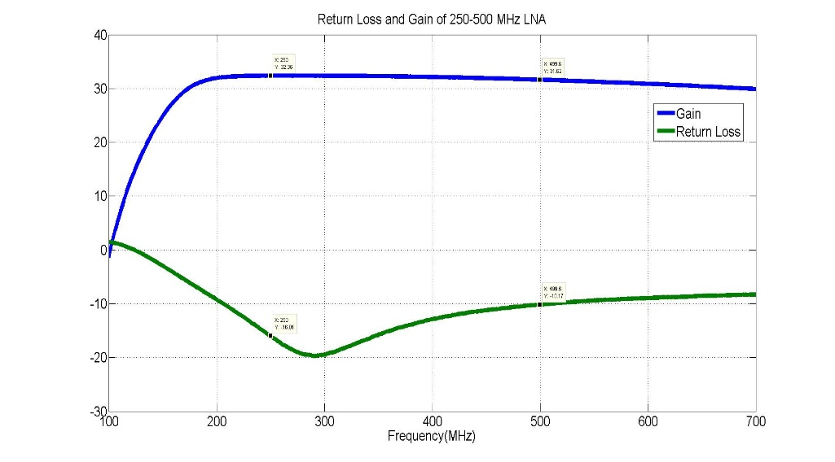
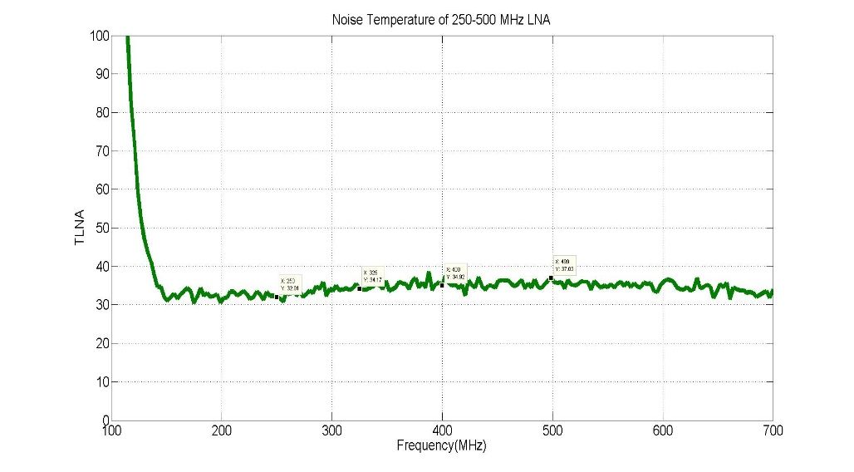
200 – 500 MHz LNA
Bandwidth : 200 - 500 MHz
Gain: 30 dB
Noise Temp. : 35 Deg. K
Return Loss: Better than -10 dB
OIP3: +18 dBm
Designed By: Anil Raut

Slide 15
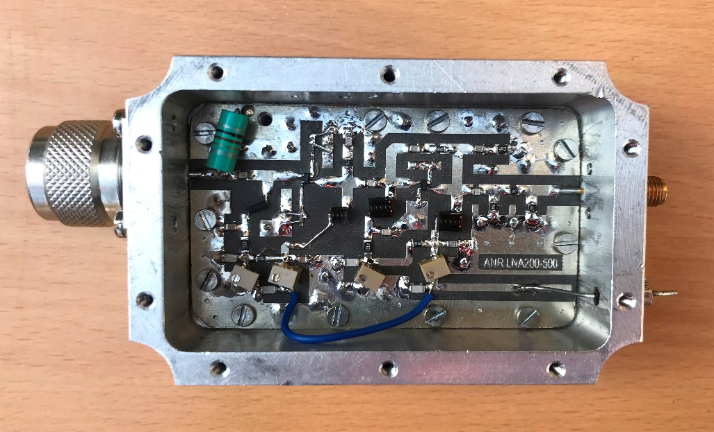
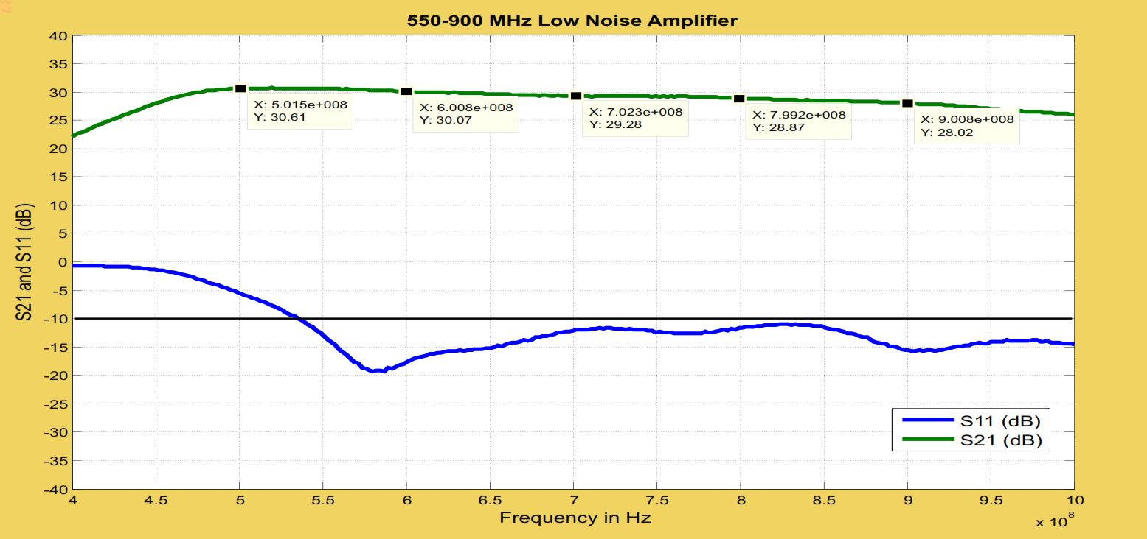
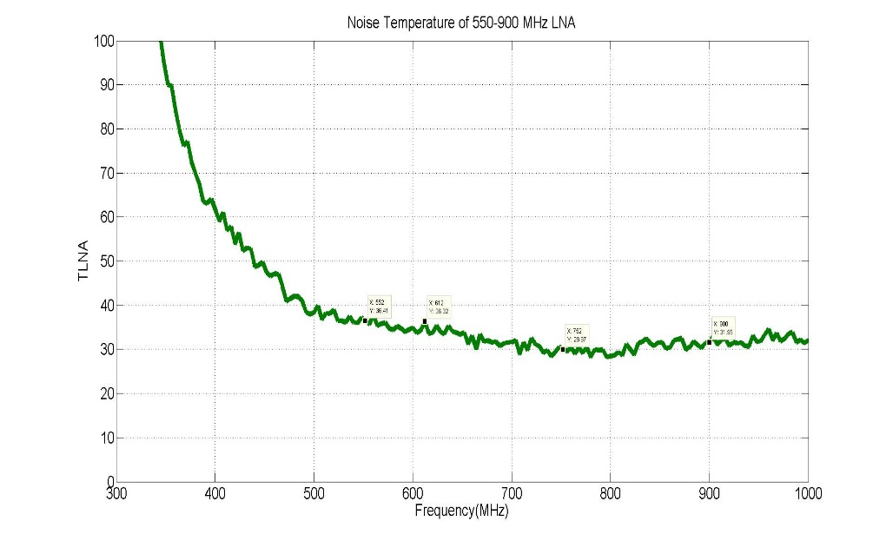
550 – 900 MHz Low Noise Amplifier
Bandwidth : 550 - 900 MHz
Gain: 30 dB
Noise Temp. : 30 - 35 Deg. K
Return Loss: Better than -10 dB
OIP3: +18 dBm
Designed By: Anil Raut

Slide 16
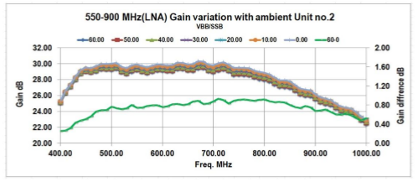

Slide 17
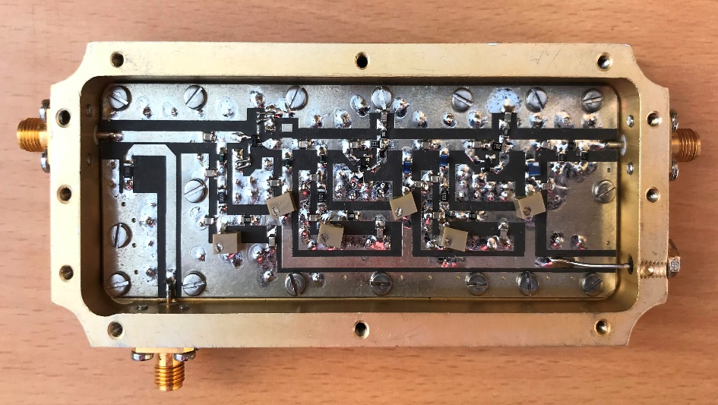
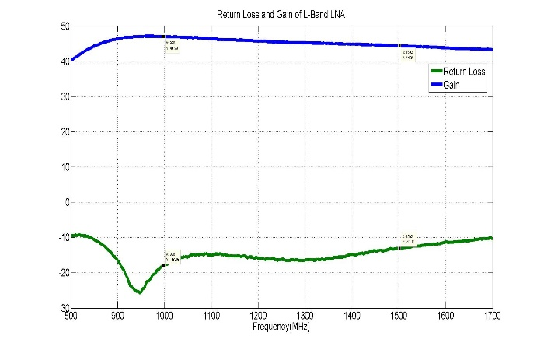
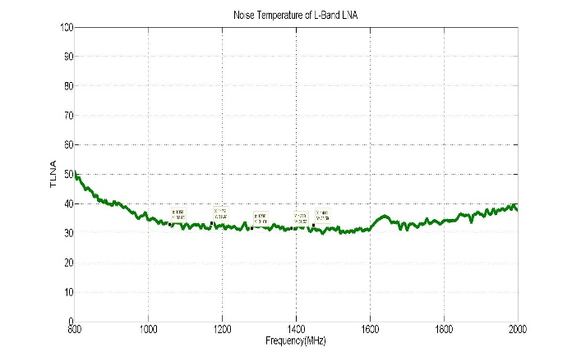
High Gain Low Noise Amplifier
Bandwidth : 1000 - 1500 MHz
Gain: 45 dB
Noise Temp. : 32 Deg. K
Return Loss: Better than -10 dB
OIP3: +14 dBm
Designed By: Anil Raut & Sougata Chatterjee

Slide 18
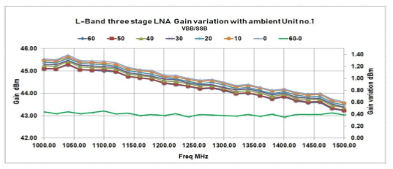

Slide 19
Summary of RF Frontend Performance

Slide 20
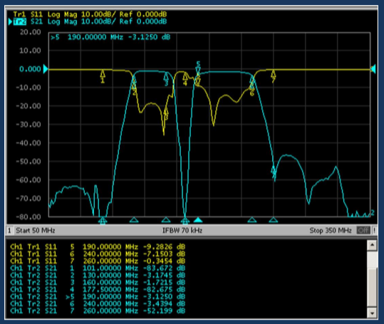
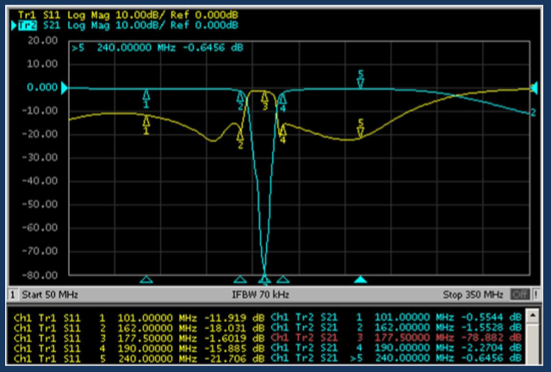
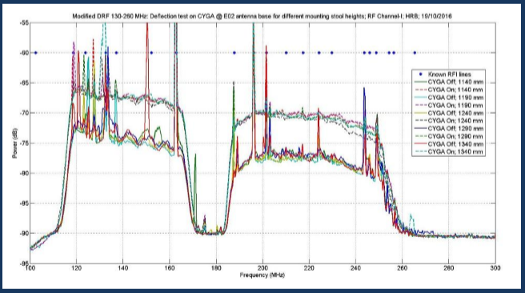
Band 2 ( 120-260 MHz ) Cascaded Bandpass Filter and Band Reject Filter for TV Transmission

Slide 21
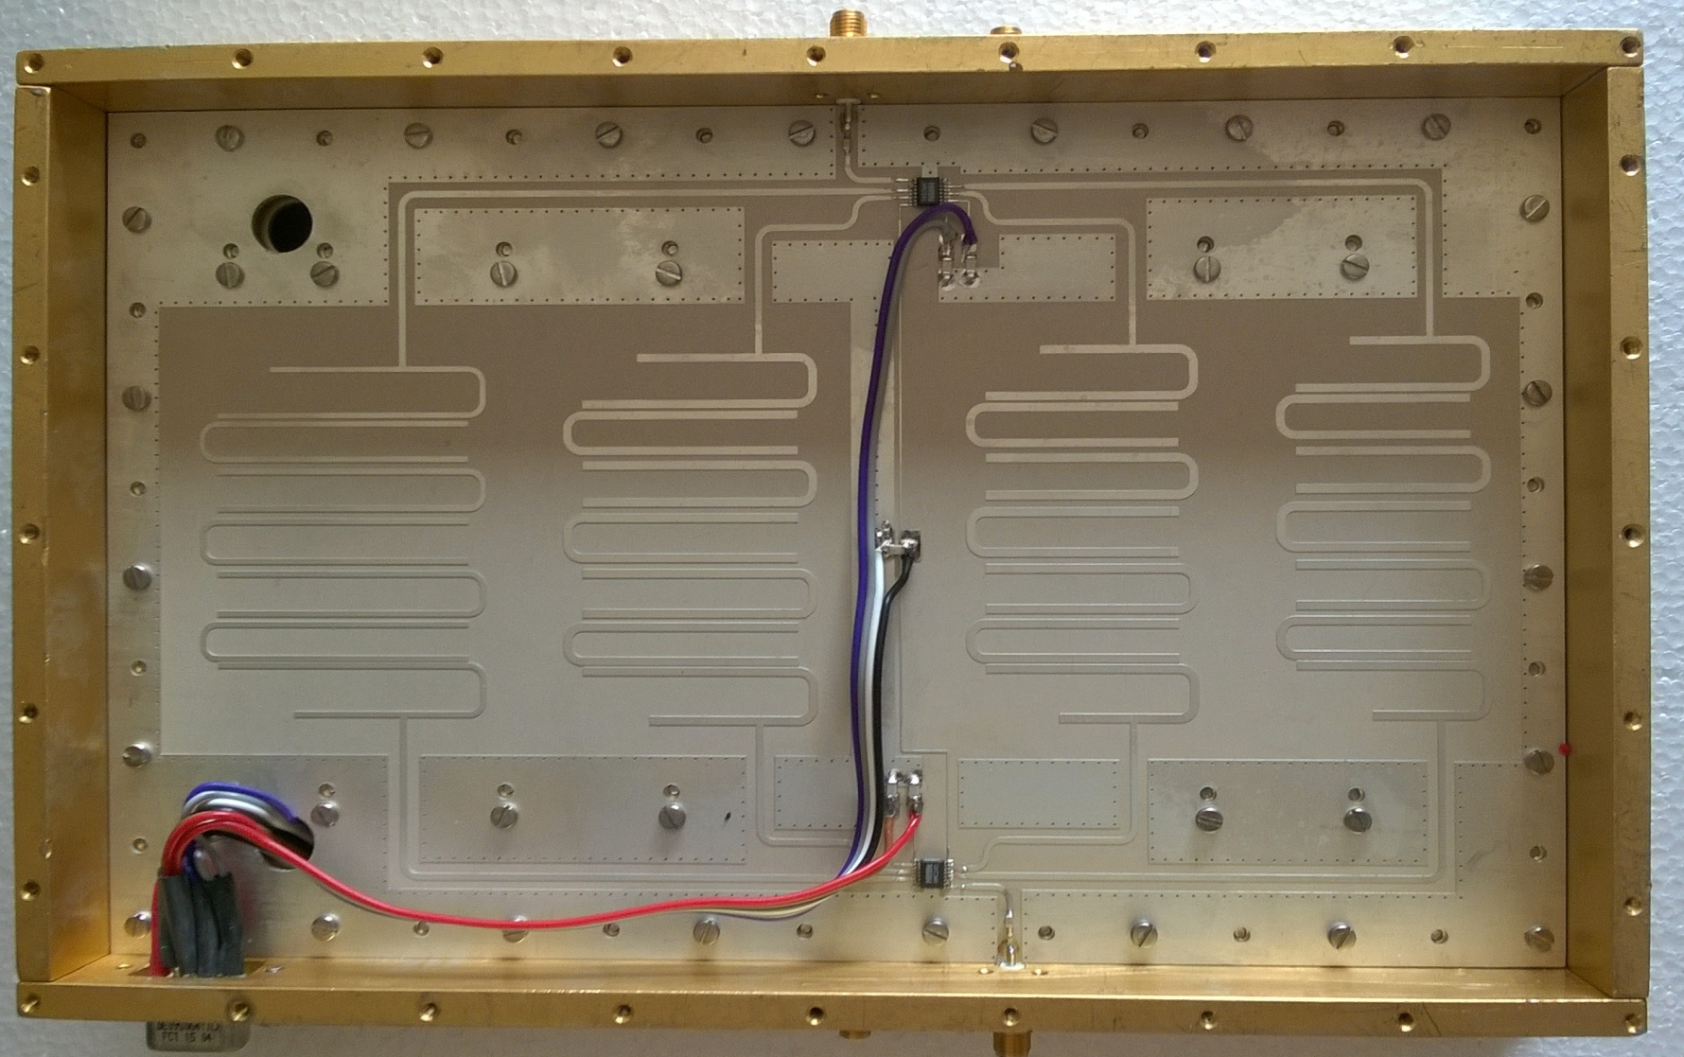
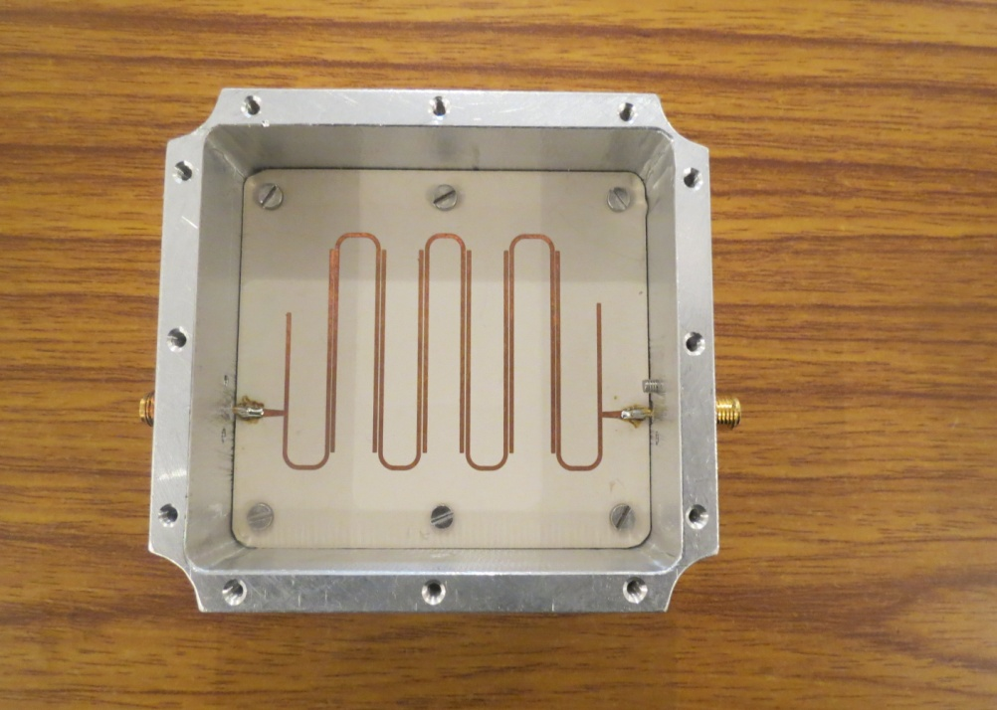
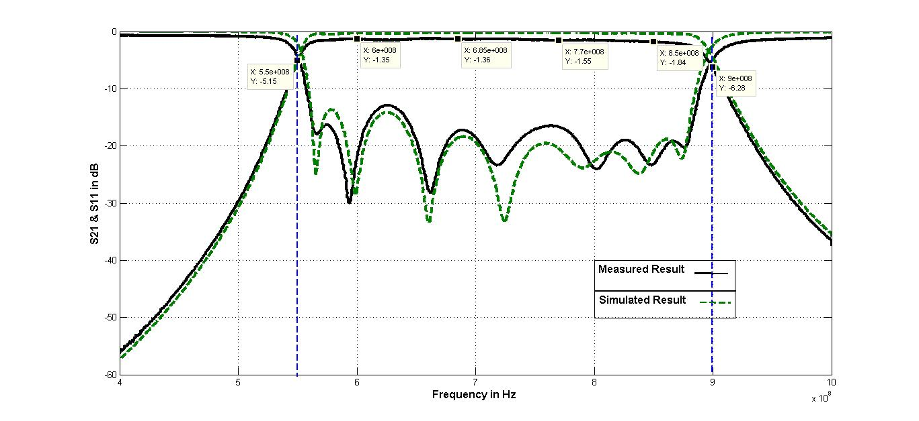
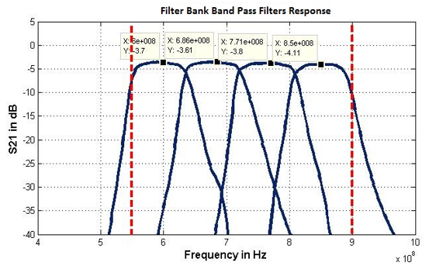
Band 4 ( 550 – 900 MHz ) Bandpass and Switched Filter bank
Designed By Imran Khan

Slide 22
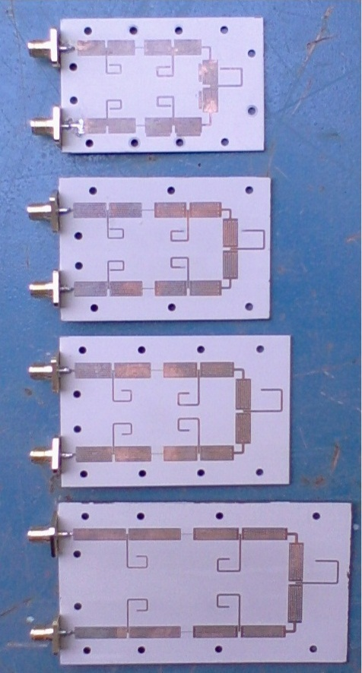
Band 3 ( 250 – 500 MHz ) Switched Filter Bank – A Metamaterial Design to reduce the filter size
Designed By: Sougata Chatterjee

Slide 23
Band Reject Filters
FM Radio Station ( 78 – 118 MHz ), Rejection > 50 dB
Wireless Service (150 – 175 MHz ), Rejection > 40 dB
TV (163-190 MHz), Rejection > 40 dB
TV (500 – 560 MHz), Rejection > 40 dB
Satellite Interference (230 – 280 MHz), Rejection > 40 dB
Mobile Transmission at
GSM-CDMA ( 845 – 1005 MHz ), Rejection > 70 dB
GSM 1800 MHz ( 1705 – 1940 MHz ), Rejection . 40 dB
Low Pass Filter 1650 MHz to reject out of Band signals
Designed By Ankur

Slide 24
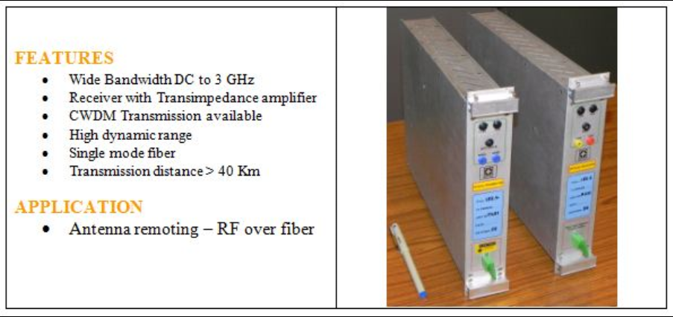
DWDM Based RF Over Fiber Optic System
Features:
Wide Bandwidth DC- 3 GHz
Receiver with Transimpedence Amplifier
DWDM Transmission Available
High Dynamic range
Single mode fiber
Transmission distance > 40 Km
Application:
Antenna remoting - RF over fiber
Cost per Link 1600 USD

Slide 25
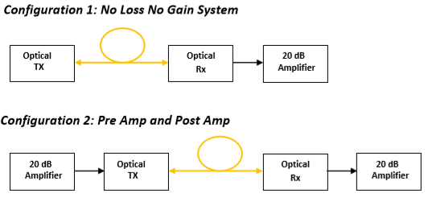

Slide 26
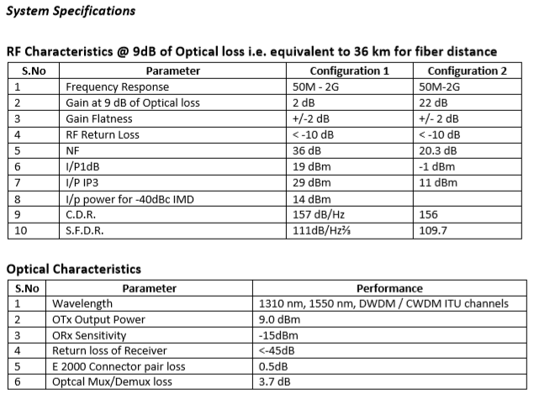

Slide 27
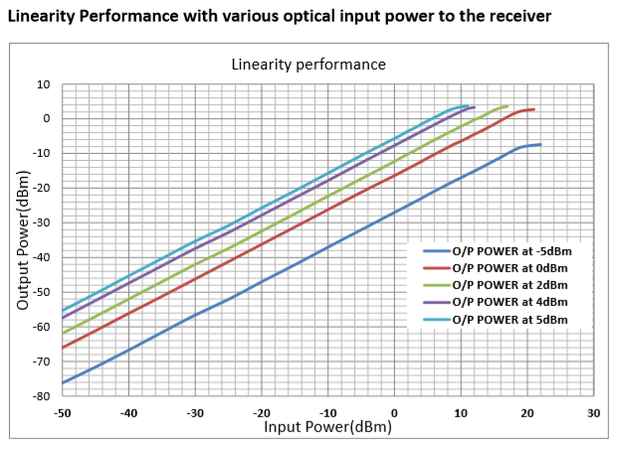

Slide 28
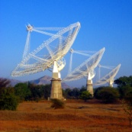
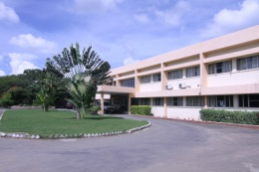
Network Architecture
Using DWDM Multiplexing and Bi-directional Link over Single Fiber
RFCH1
ƛ1
ƛ1
DWDM
Multiplexer
DWDM
De-Multiplexer
RFCH1
RFCH2
ƛ2
ƛ2
RFCH2
ƛ3
ƛ3
IF + control signals
IF + control signal
ƛ4
ƛ4
1550 nm
1550 nm
1310 nm
1310 nm
LO Ref+ control signals
LO Ref+ control signals
Universal 1.3/1.5 um
Coupler
Universal
1.3/1.5 um
Coupler

Slide 29
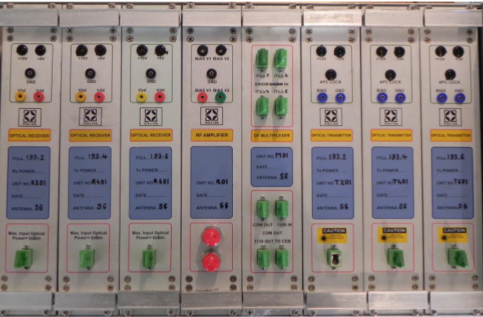
3 Channel DWDM based Rf over Fiber Optic System
Cost per antenna 5600 USD

Slide 30
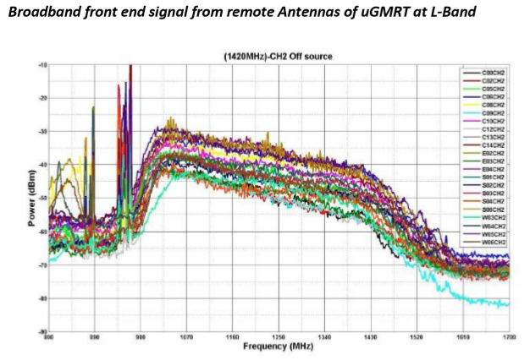

Slide 31
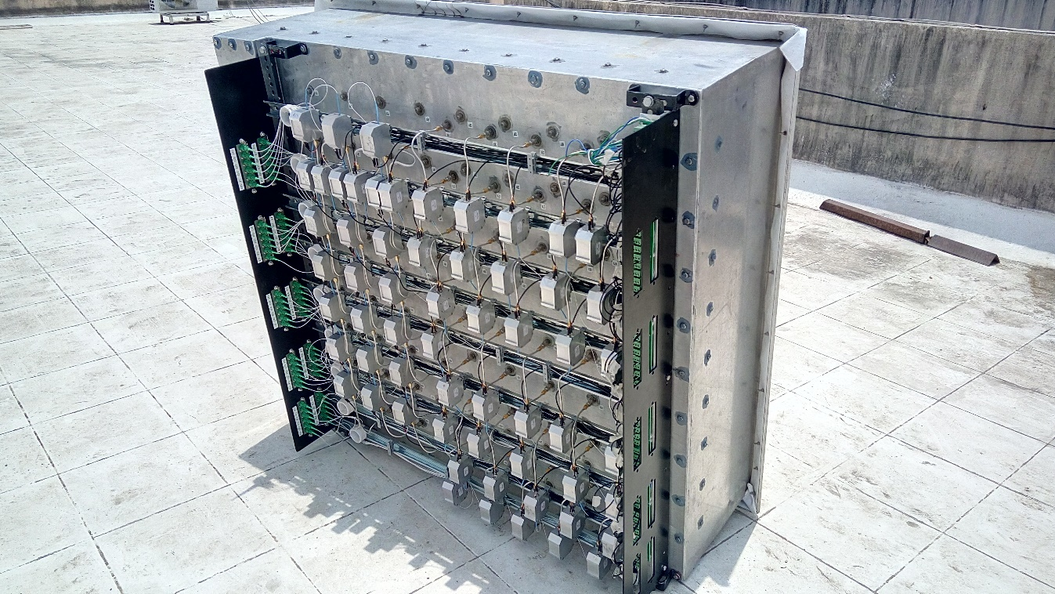
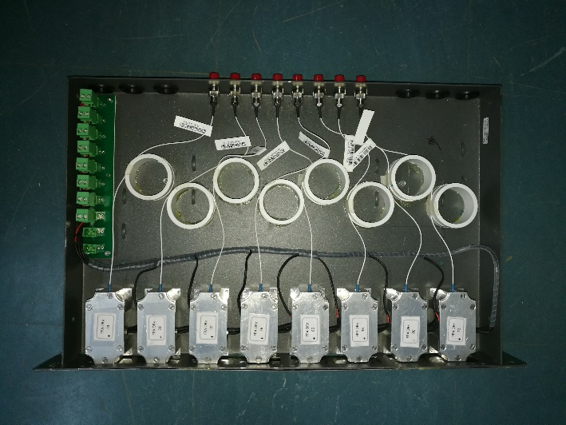
RF over Fiber links for Phased Array Antenna
Cost Per link : 250 USD

Slide 32
60 Element Fiber Routing

Slide 33
Optical Specification
Wavelength: 1310 nm
Laser: Uncooled Fabry Perot Laser
Photodiode: PIN Photodiode
Optical Power Output: + 2 dBm
Optical Margin for no loss no Gain system: 3 dB
RF Specification with Pre and Post Amplifier
RF Bandwidth: 0.6 – 1.7 GHz
Input and Output Impedance: 50 Ohms
RF Gain: 6 dB
Input P1dB: > - 5 dBm
Compression Dynamic Range (CDR):130 dB/Hz
Physical Specification
Transmitter weight:116 grams
Receiver weight : 80 grams
DC Specifications
Optical Transmitter: DC 5 V / 120mA, DC-5V / 90 mA

Slide 34
FPA with Fiber Optic Link - Test Results

Slide 35
RF over Fiber optic link from antenna prime focus

Slide 36
THANK YOU
RF Frontend and Fiber Optics Team

