Slide 1
SKA Low site & infrastructure
Phil Edwards
Slides provided by
Ant Schinckel and Kate Chow
15 November 2019
CSIRO Astronomy and space science
___________
m |u||q oo |

Slide 2
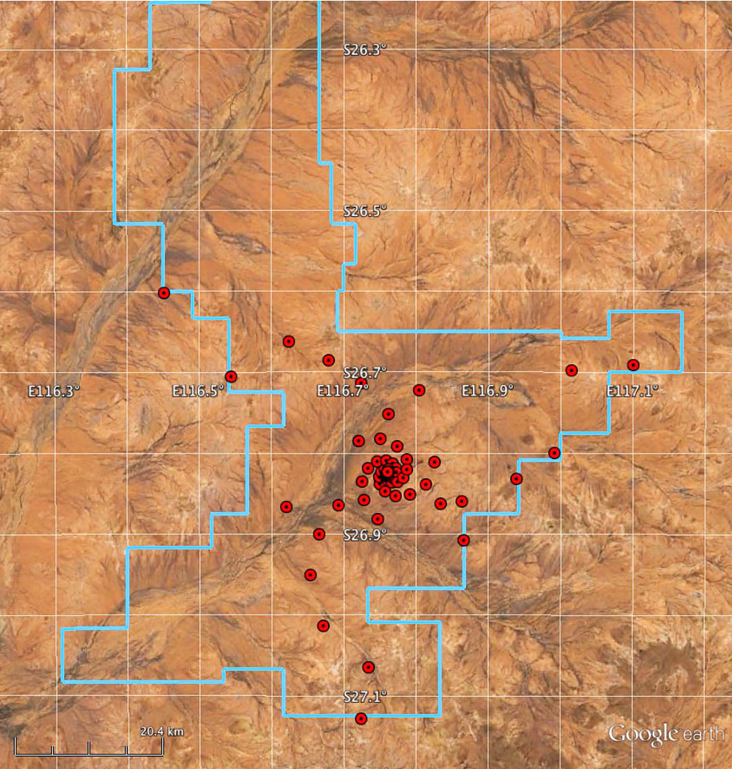
SKA Low
Design baseline:
512 stations
Each 42 metres in diameter
256 antennas in each station
224 stations in 1 km dia core
57,344 antennas!
288 stations in clusters of 6 stations
in 100 x 120 m groups along arms
3 spiral arms
Up to 65 km baselines
Fibres and power to each
Power to end clusters may be local PV
Deployment baseline
Budget constraints
Ensure recoverable - expandable

Slide 3
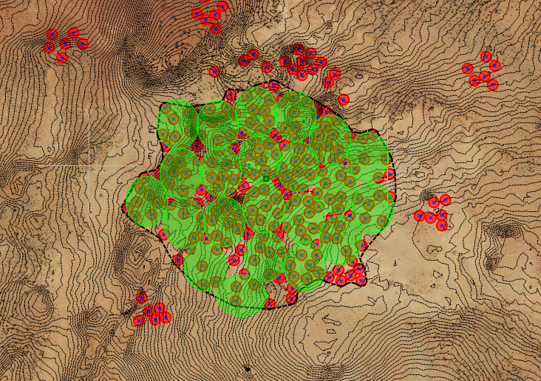
Core scale
= 1 MCG

Slide 4
Why the Murchison Radioastronomy Observatory (MRO)?
Remote location
Nearest town is 145km away (population 320)
Current site of ASKAP (36 dishes, 700 – 1800 MHz)
Current site of MWA (2048 dipoles, 80 – 300 MHz)
Current site of EDGES (50 – 200 MHz)
Will host Australian SKA component:
SKA1-Low Aperture array of dipoles, 50 – 350 MHz
For a virtual tour – https://virtualtours-external.csiro.au/MRO/
Notes:
How – I will go into the current legislation and details of this shortly

Slide 5
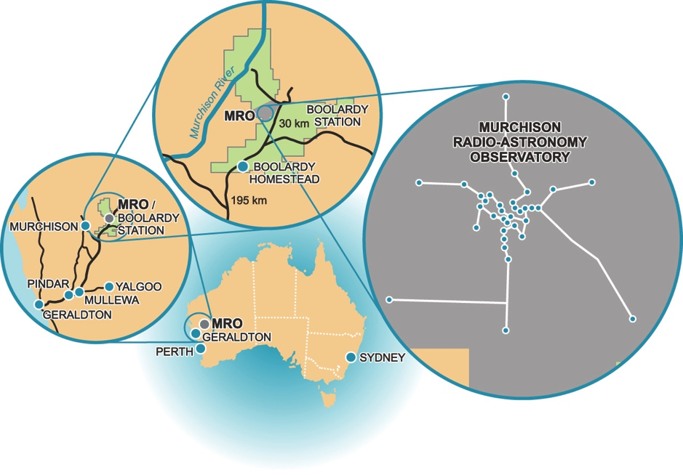
Why the Murchison Radioastronomy Observatory (MRO)?
Notes:
How – I will go into the current legislation and details of this shortly

Slide 6
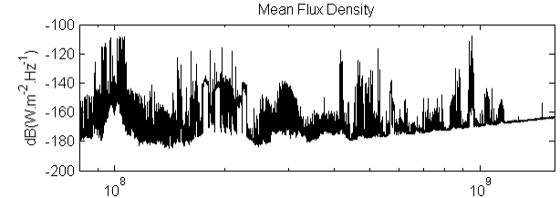
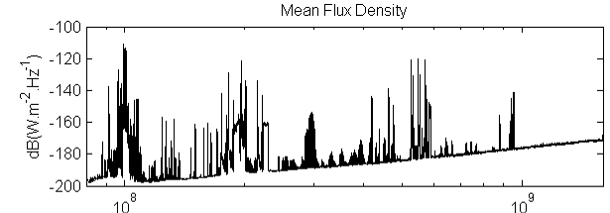
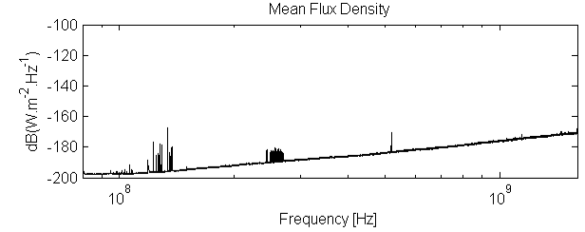
Why the Murchison Radioastronomy Observatory (MRO)?
Sydney
Population 5 million
Narrabri
Population5,000
Murchison
Population50
Notes:
How – I will go into the current legislation and details of this shortly

Slide 7
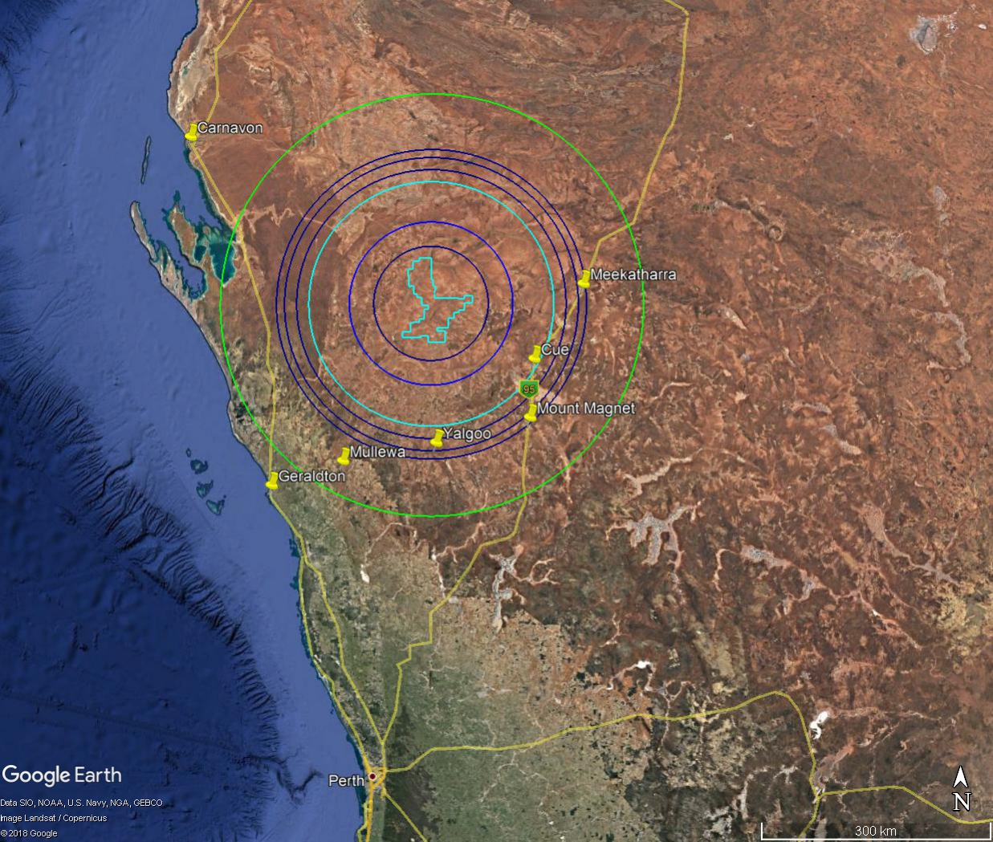
Coordination zones (to 260 km)
Inner zone (70 km)
Australian Radio Quiet Zone WA (ARQZWA) legislation and controls
Notes:
The smallest circle is 70 km, the next is 100 km, the bright turquoise is 150 km (Band Plan outer but that’s probably not immediately relevant to your talk) and the orange one is 260 km. I don’t show the 120 km, 140 km, 145 km zones just because it gets too busy, but if you want you can mention that there are a number of zone sizes depending on frequency. I guess the main point I’m usually making with this slide is that there’s only a few small towns affected and those only at part of the frequency range.

Slide 8
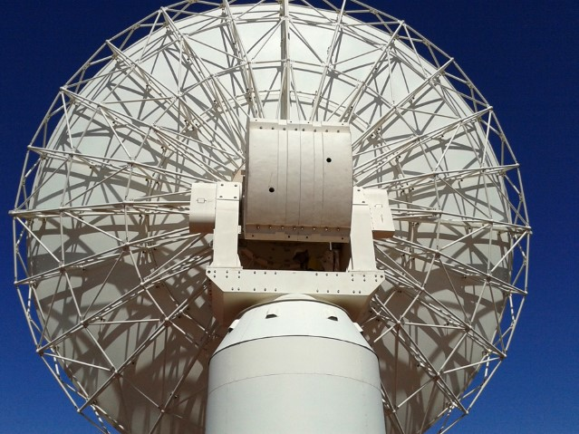
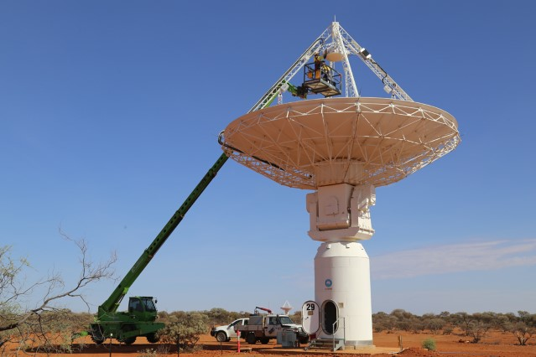
What is not covered by the ARQZWA?
The ARQZWA does not guarantee absence of interference to radioastronomy observations.
Current regulations do not cover:
Frequencies below 70 MHz
Aircraft transmissions
Satellite transmissions
Transmitters beyond 260 km from centre of MRO (which may become more apparent during atmospheric ducting events)
Notes:
(there are no plans to change regulations to cover lower frequencies)
(a modest restricted airspace is being proposed to protect from the most damaging transmissions)
(there is little scope to ever affect international satellite regulation)
We have seen interference from things beyond this, which I’ll show in a few slides that have been extreme or unpredictable occurances. These things have happened not because our protections are inadequate, but because they are unsual or extreme occurrences that we don’t know the cause of, and because we can’t control the atmosphere unfortunately…

Slide 9
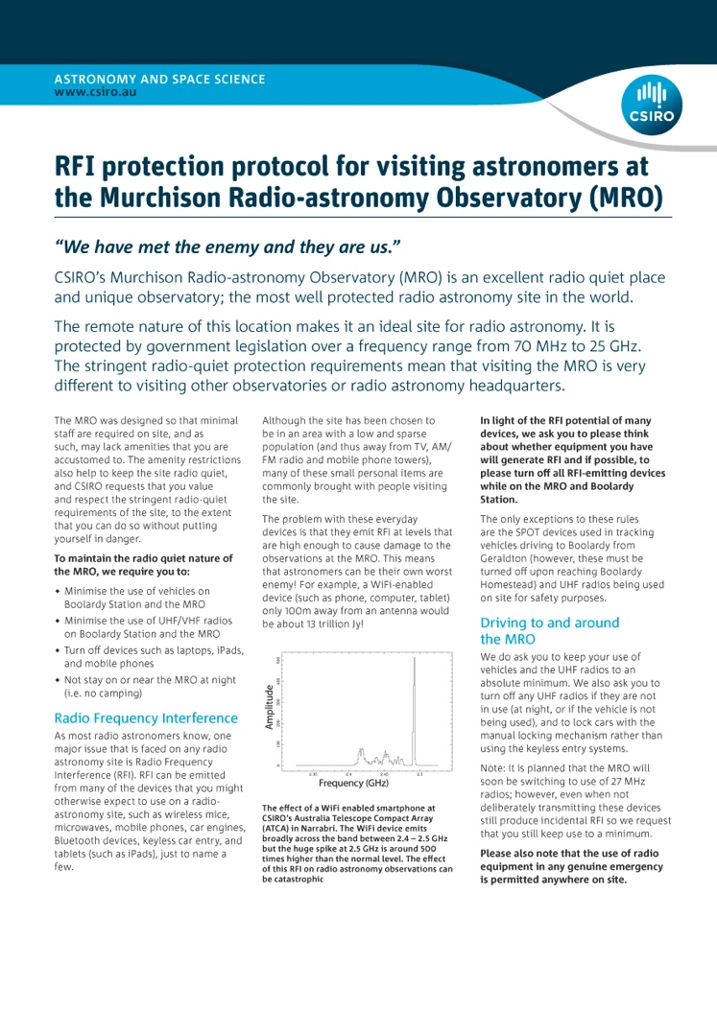
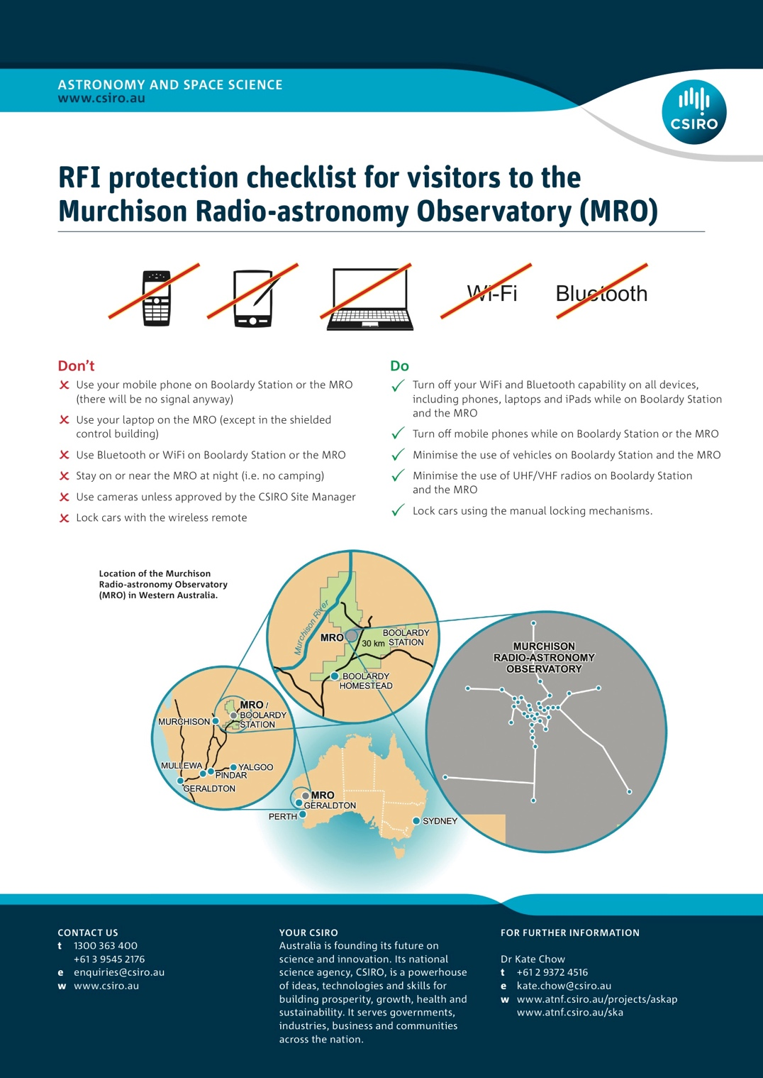
Internal RFI
Notes:
Fact sheets made for visitors, contractors and staff

Slide 10
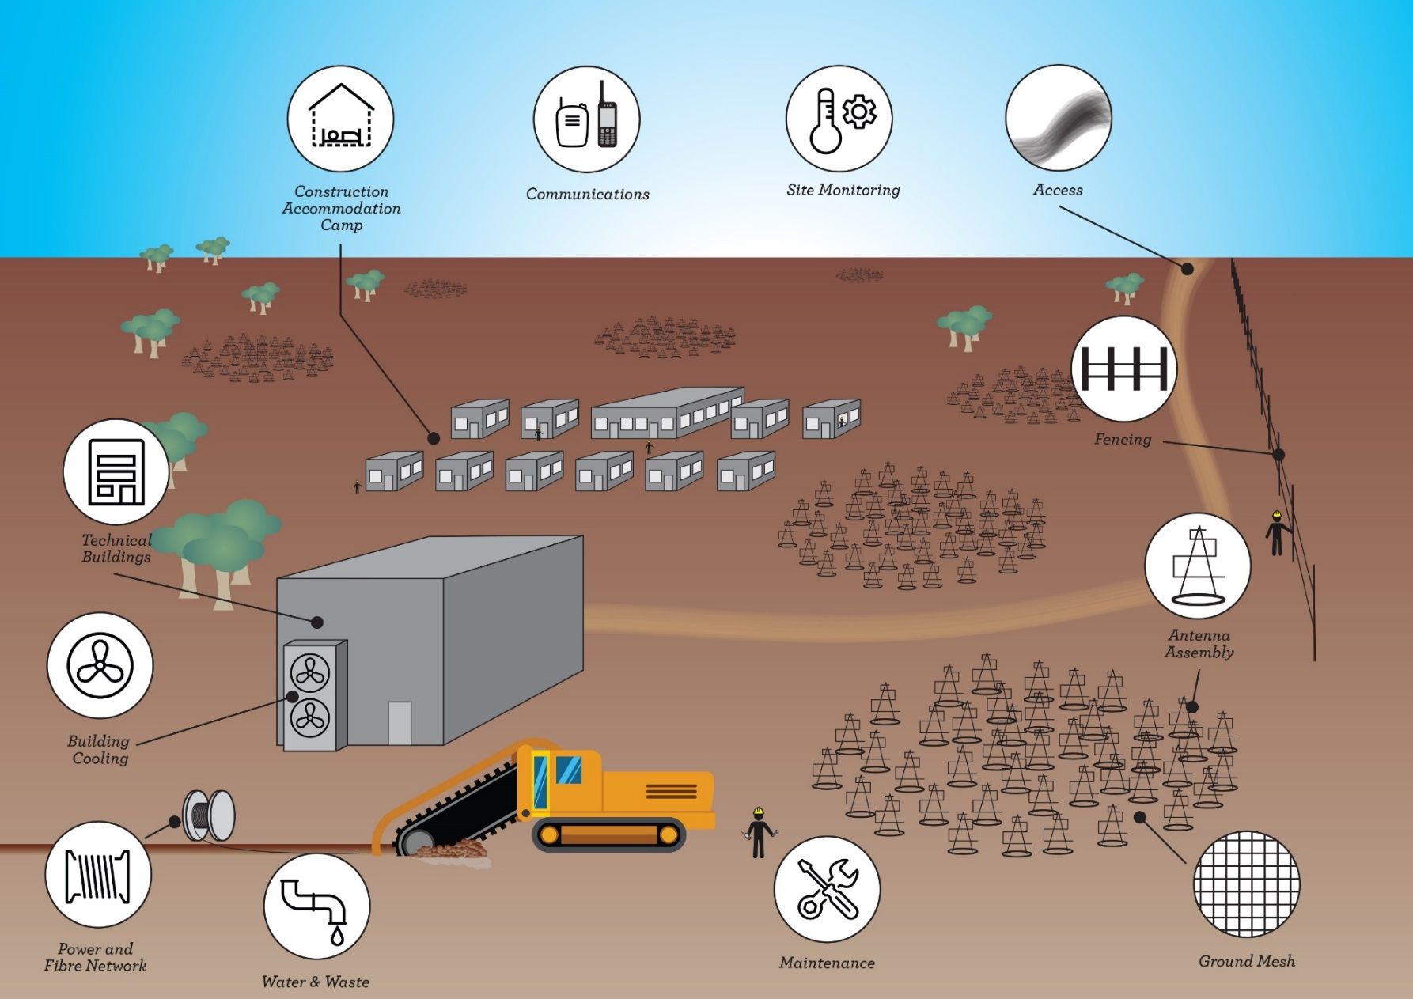
SKA Low Infrastructure Overview

Slide 11
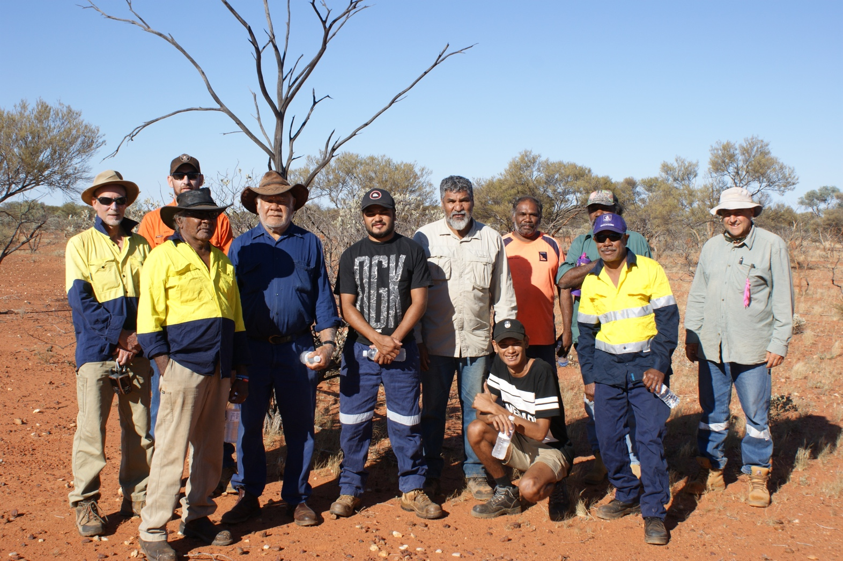
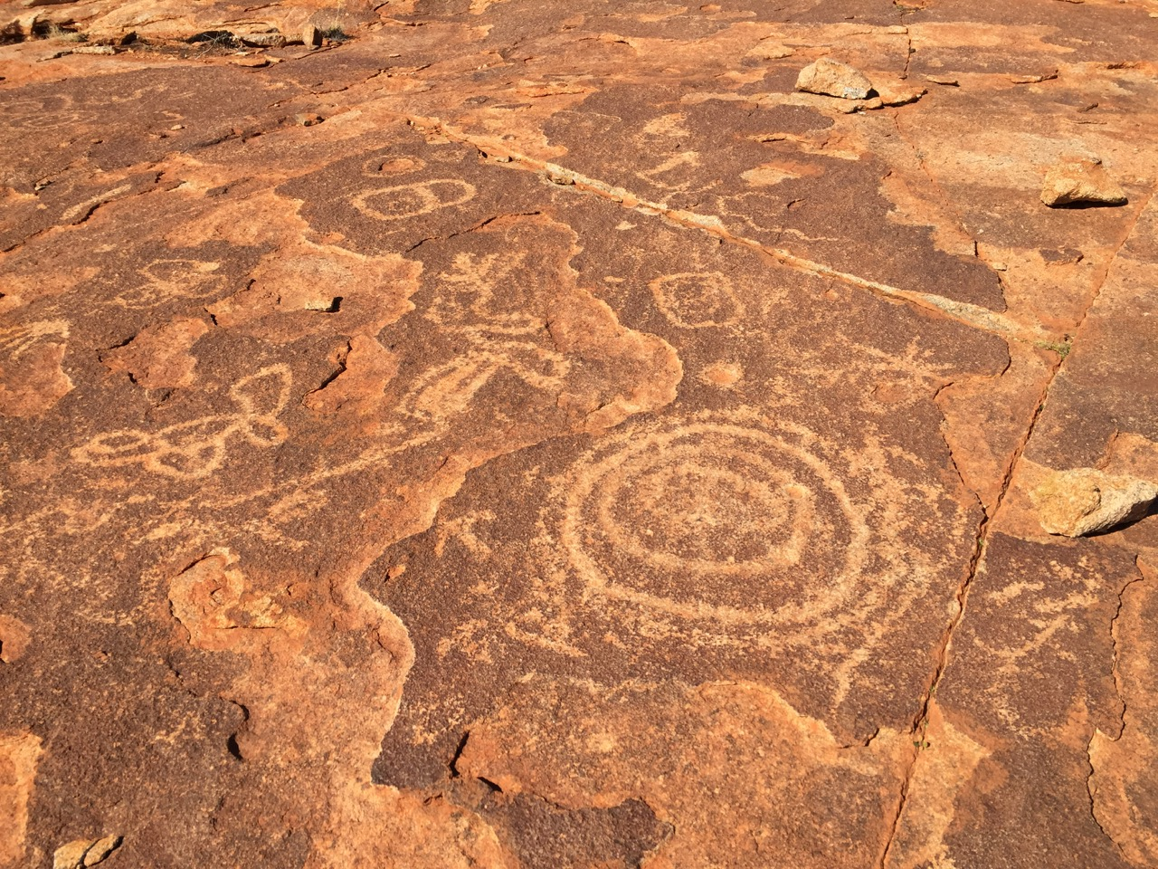
Key boundary conditions
Heritage
Survey (walkover) results
Levels of significance respected
Artefacts managed correctly
Employment and contracting opportunities for Wajarri entities
Sustainability and HSE
RFI
Budget and performance
Site establishment – lease, ILUA, new Site Entity etc

Slide 12
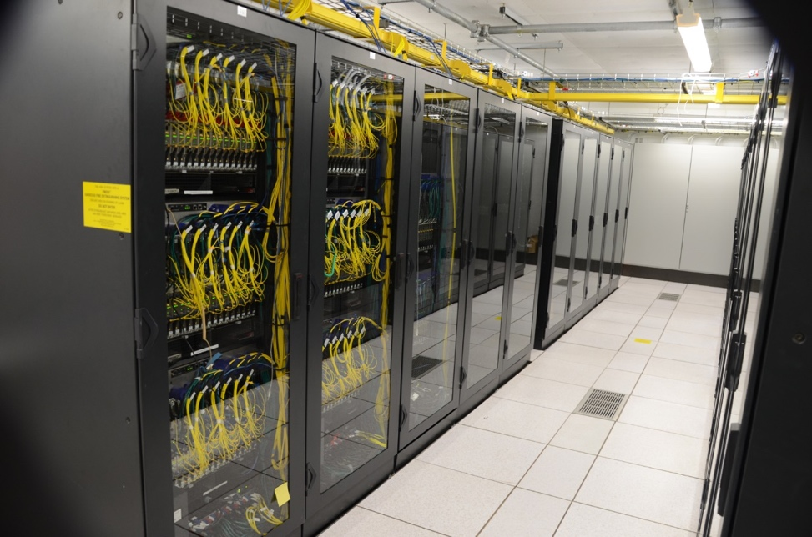
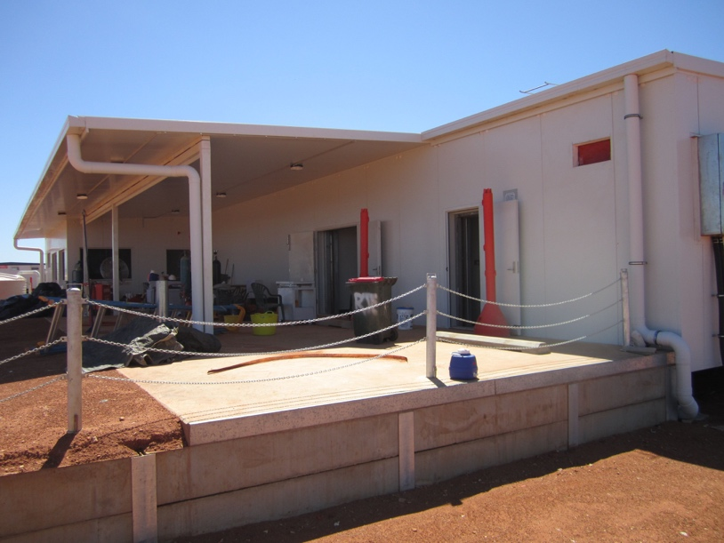
Infrastructure Work Packages
Site Technical Buildings
Build the entire central (CPF) and remote (RPF) processing facility structures (from foundations to roofs), including:
Full construction of the building (possibly done off-site and transported as modules)
Cladding and radiofrequency shielding
Internal walls, ceilings, floors
Fittings, fixtures, furniture and decorations
Power and net cabling, plumbing etc
Cable trenches, cable trays, ductwork
Fully RFI shielded ~ 100+ dB
CPF ~ 1300 sq m
Credit: CSIRO

Slide 13
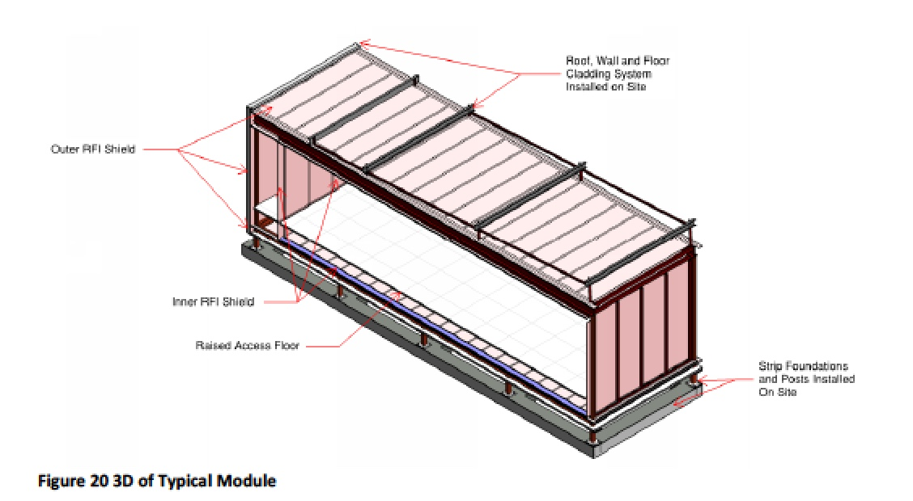
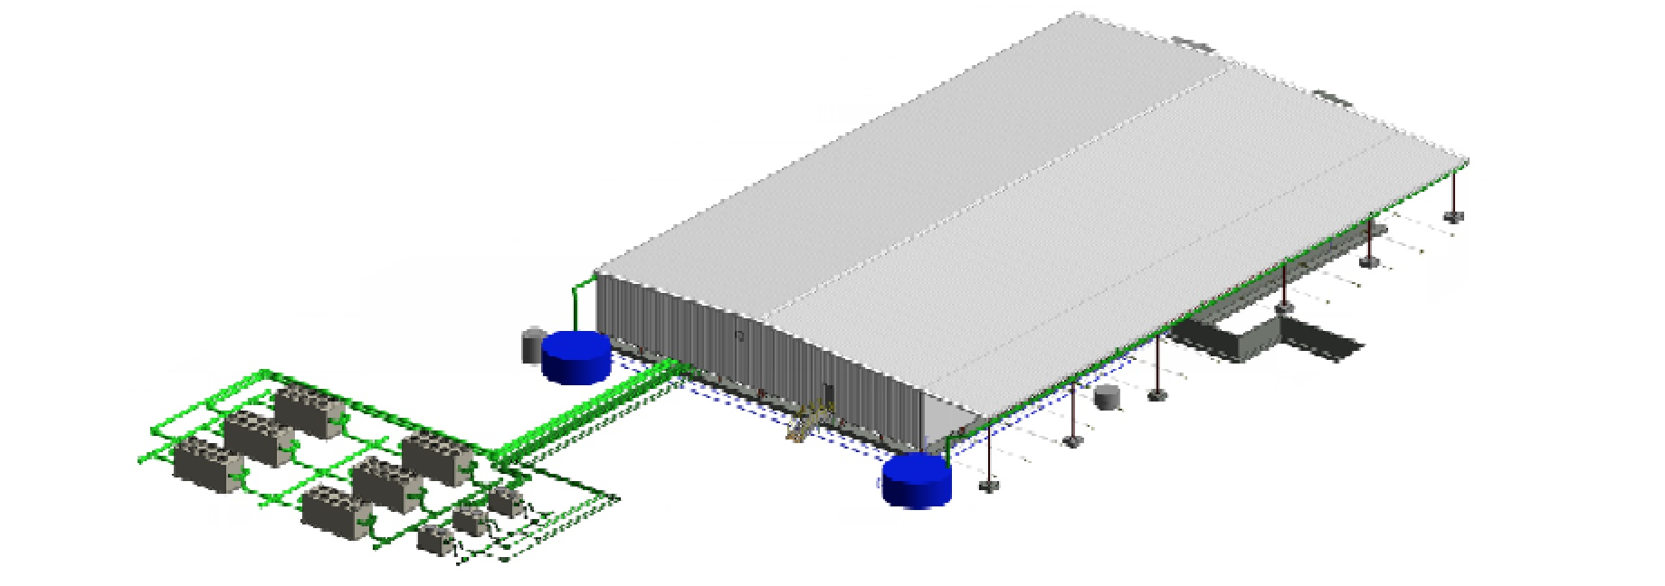
Central Processor Facility (CPF)
Artists impression new SKA CPF
Credit: Aurecon, CSIRO

Slide 14
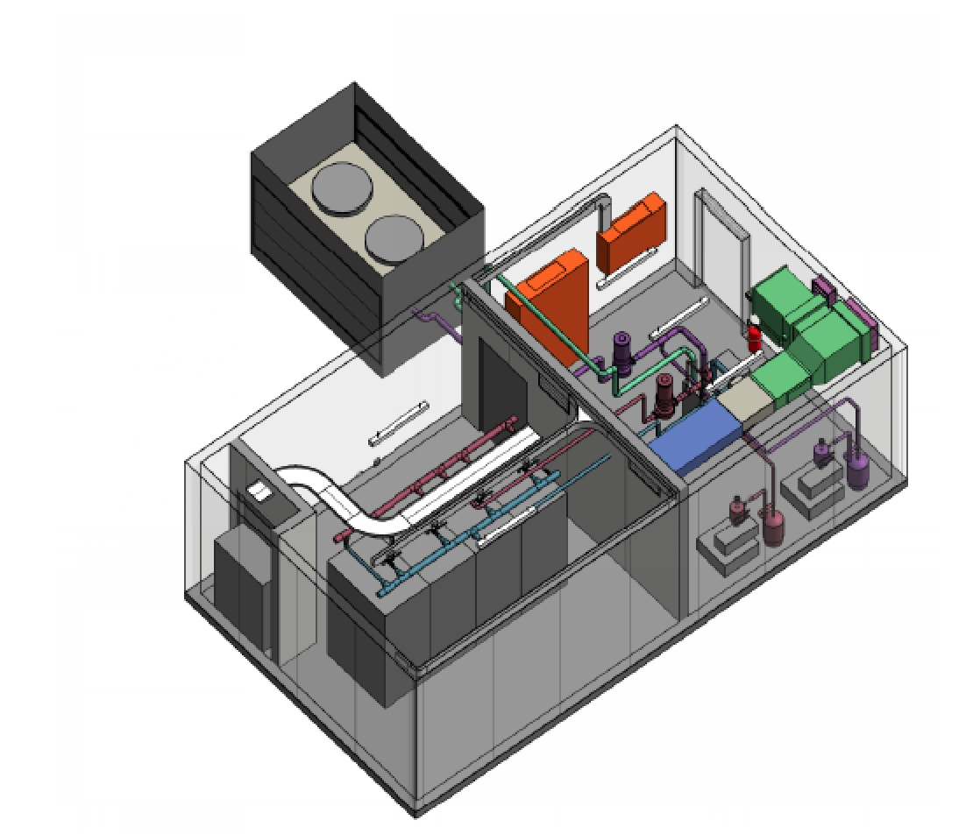
Remote Processor Facility
Credit: Aurecon, CSIRO

Slide 15
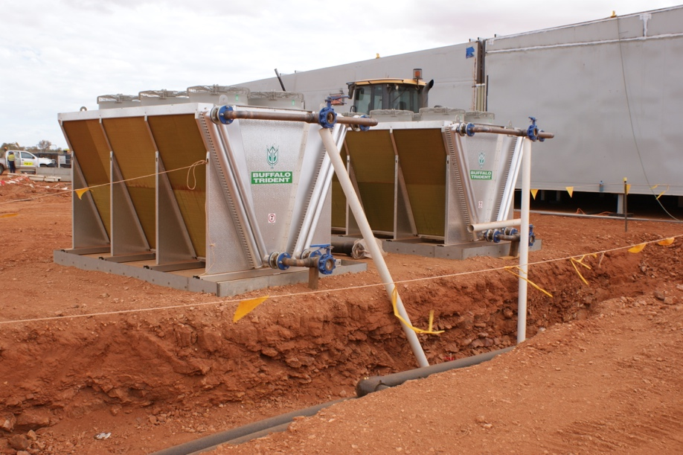
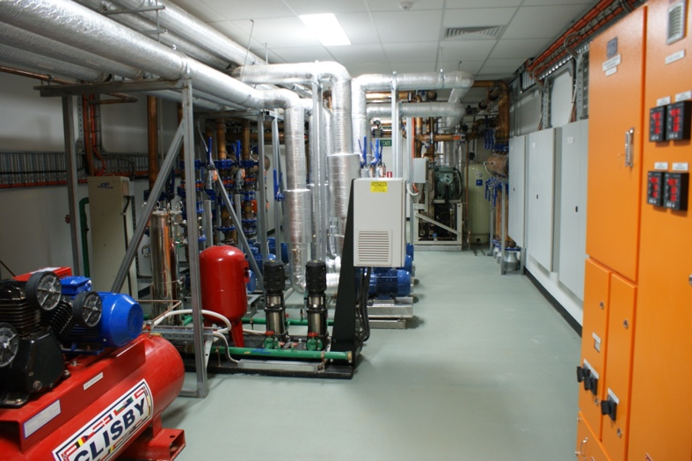
Infrastructure Work Packages
Facility Cooling
Procure, construct, install, verify and maintain cooling systems and components for CPF and RPF as required
Water & Waste
Procure, construct, install, commission, verify and maintain all water and waste disposal components

Slide 16
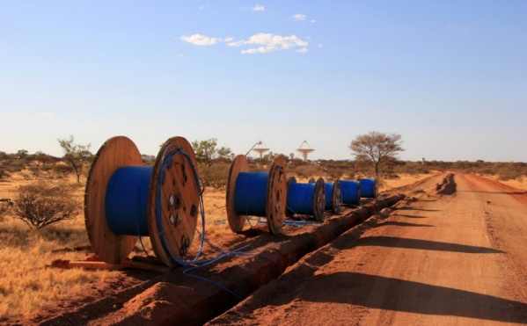
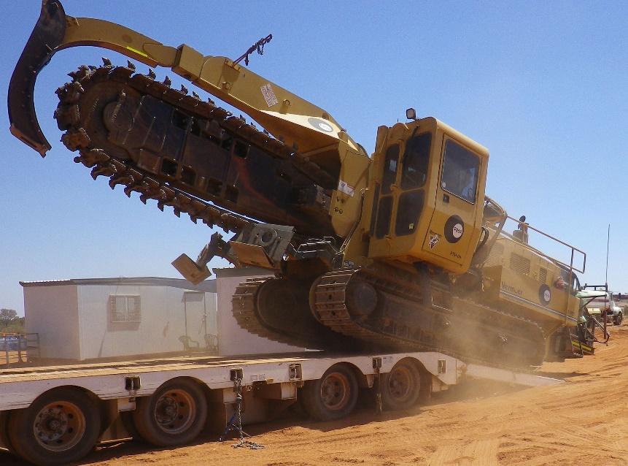
Infrastructure Work Packages
Power and Fibre Networks Infrastructure
Construct, install and maintain analog, digital and long haul fibres, reticulation infrastructure, as well as buried and non-buried power network infrastructure (sharing trench with power as appropriate)
Power
Trench and install buried power supply lines
Provide and install all transformers, switchgear, power controls etc.
Power reticulation (including trays and trenches)
11 kV backbone for efficiency
Credit: SKAO
Credit: Murchison Widefield Array

Slide 17
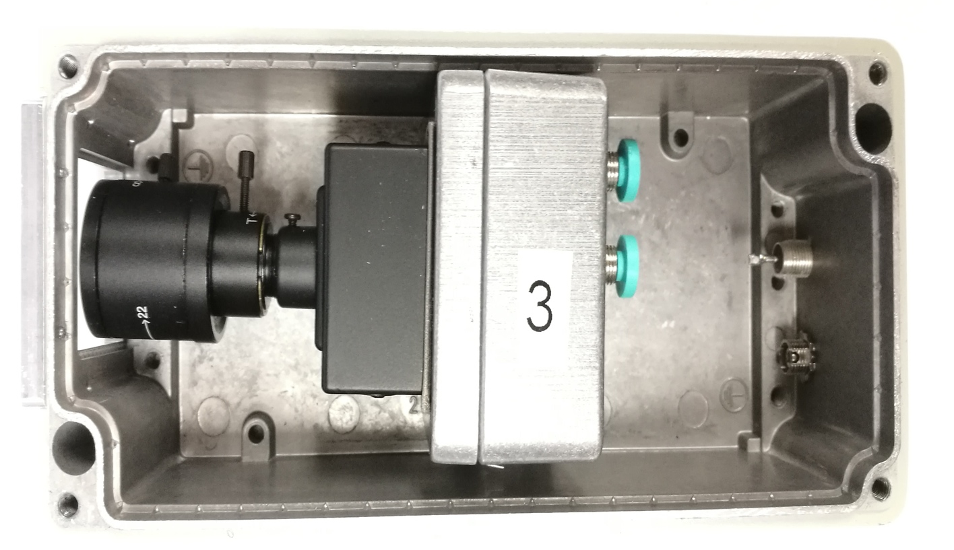
Infrastructure Work Packages
Communications
Detailed design and then expand, upgrade and verify communications for both off-site and on site, routine and emergency use
two-way radios, satellite phones, emergency communications vehicle tracking devices
RFI compliant !
Site Monitoring
Design, build and deliver radio-quiet weather stations, visual monitoring cameras, RFI monitoring, ionosphere, troposphere, etc.
Design, build and connect fibre and power cables to all monitoring equipment

Slide 18
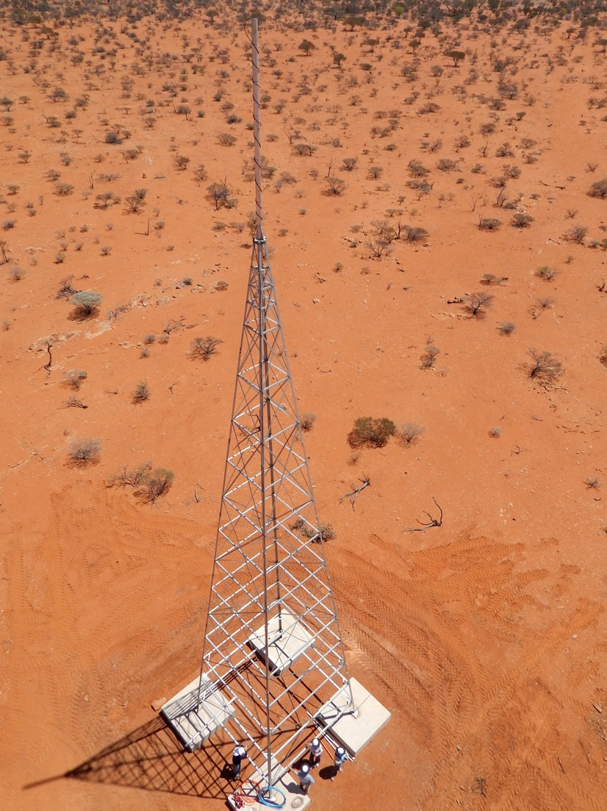
RFI Monitoring system

Slide 19
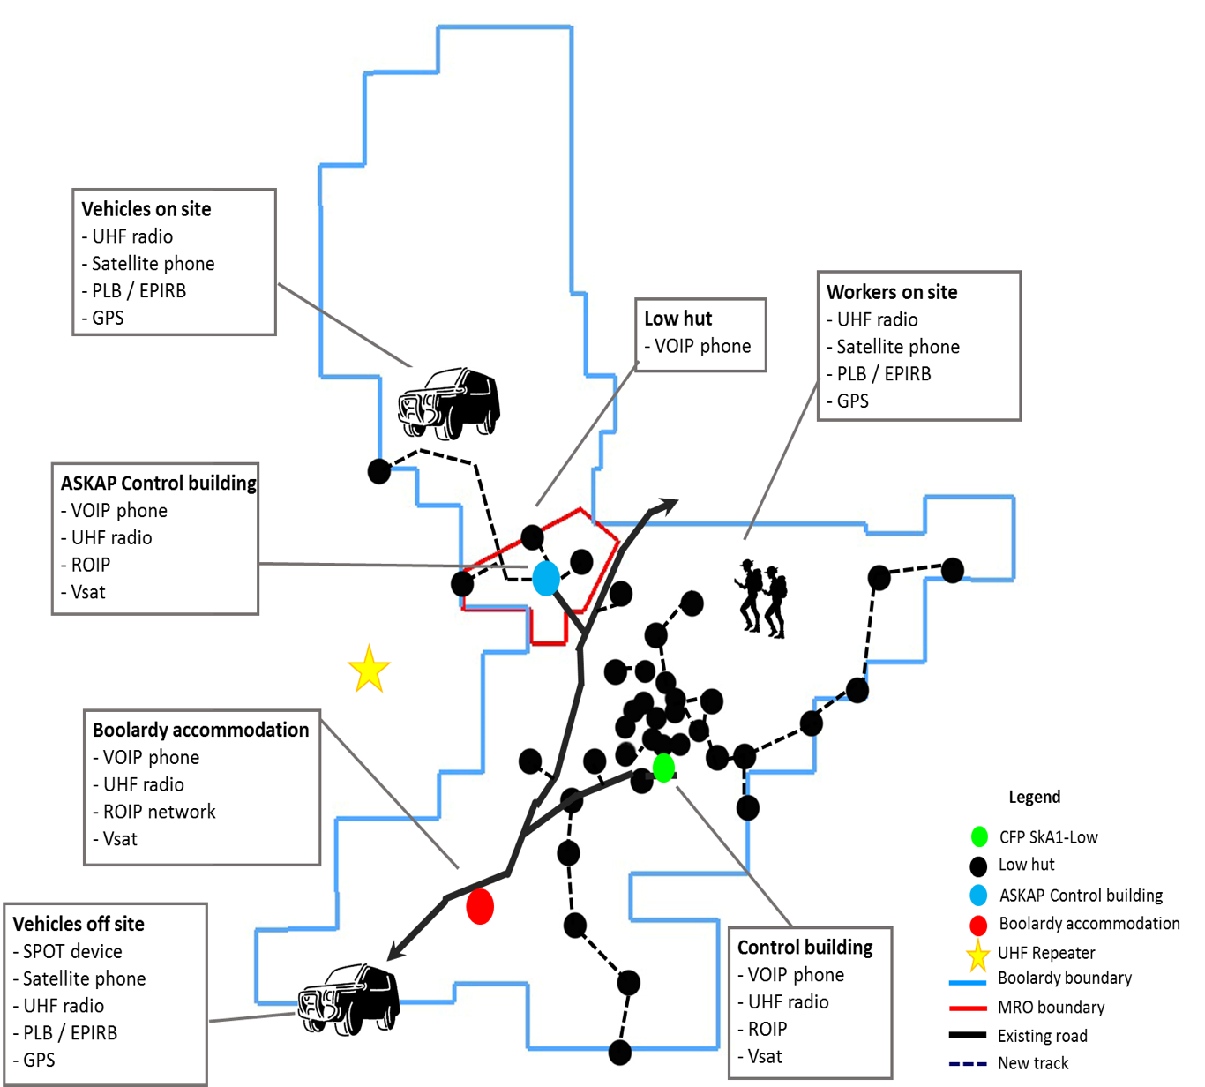
Communications

Slide 20
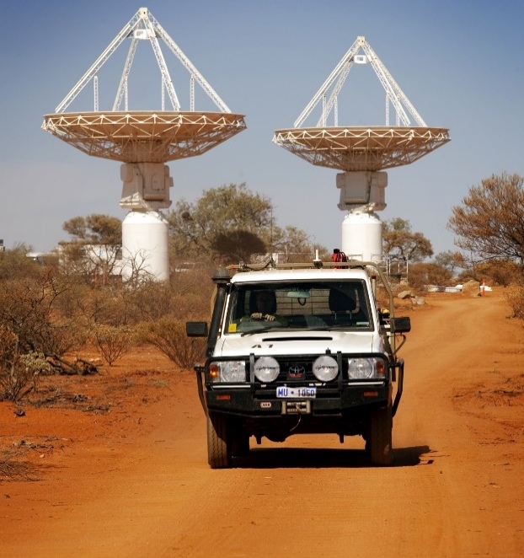
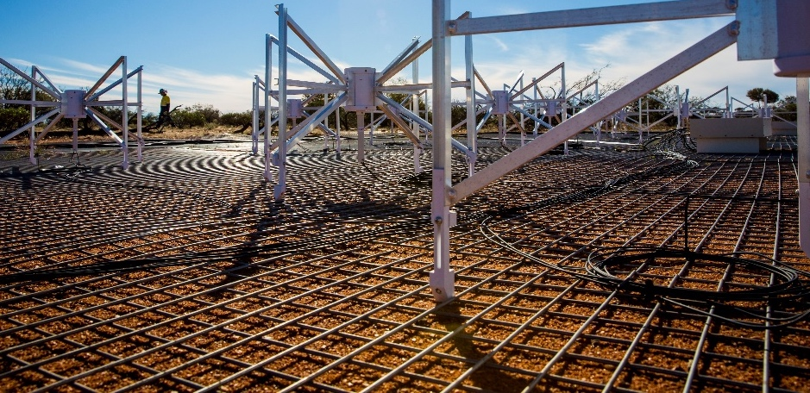
Infrastructure Work Packages
Access, Airstrip and Prepared Ground
build and test an airstrip, on-site roads and tracks,
prepared access for SKA1 LOW antennas,
access tracks to all buildings
approximately 250 km total
Supply & Install Plane Mesh
install ground plane mesh for the array
512 stations of 42m diameter
Credit: WA Dept. Commerce
Credit: Murchison Widefield Array

Slide 21
Access – roads and tracks
Includes:
Design of the main access road and tracks
Optimised road and track alignment design drawings
Including trenching and hand-hole interactions
Preliminary design of a new airstrip
Appropriate construction techniques and routing to
Minimise ground and flora disturbance
Respect heritage aspects
Construction planning and sequencing
Capital and operating cost estimates
Flood study
Design reports and drawings to suit

Slide 22
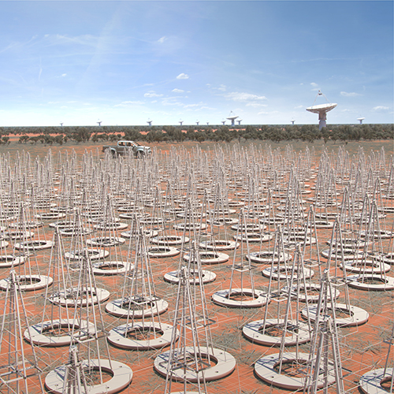
Infrastructure Work Packages
Assembly, Integration and Verification
Inherit and assemble all infrastructure components and products, integrate the components and verify their functionality or quality.
(Field Node Installation)
Assemble, install and test antennas, antenna power interface units, and some aspects of cabling for the array within each of the 512 antenna stations.
Maintenance
Conduct preventative maintenance, and perform any needed corrective actions, for the infrastructural systems until handover.
Credit: SKAO

Slide 23
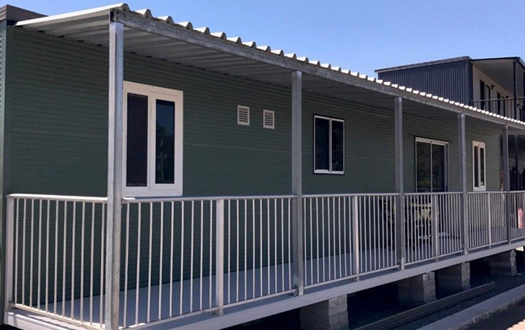
Infrastructure Work Packages
(Temporary Construction Accommodation)
Supply accommodation for up to 250 people
Supply the laundry, kitchen and dining hall
Supply first aid, administration and recreation facilities
Supply water and sewerage treatment plants
Install power, external lighting, and storm water management
Install all loose furniture and equipment
Operate temporary accommodation under contract as required
Credit: ATCO Ltd.

Slide 24
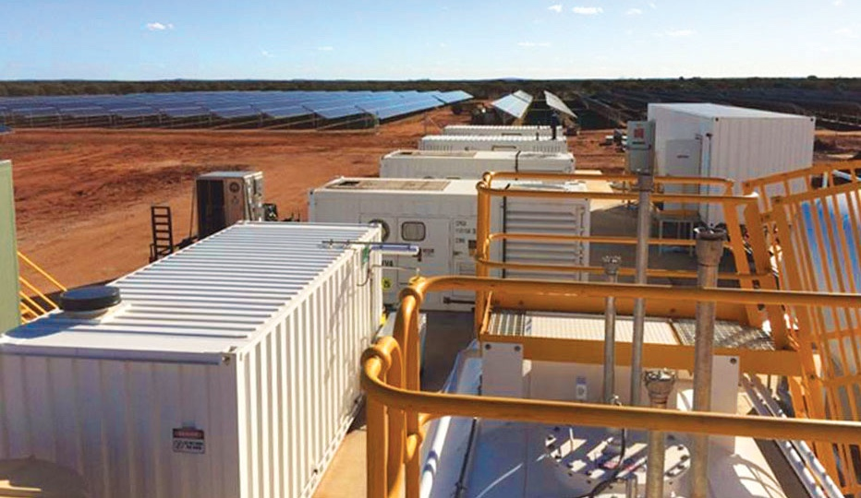
Related facilities (out of Project scope):
Engineering Operations Centre (EOC):
- Geraldton
- home base for SKA Ops, Maintenance
- 1200 - 1500 sq metres
Boolardy Accommodation Facility (BAF):
- new permanent 75 – 90 people facility
- sustainable, sympathetic to enviro, Wajarri
heritage
Power:
- 3 MW off grid
- recent approach to industry for information
- begin procurement 2020
- significant renewable !!!! (current MRO model)
Science Operations Centre (SOC):
- Perth based
- facility for the science operations
Pawsey Centre:
- supercomputer, archive
- 500 sq m of white space
SKA Regional Centre (AusSRC):
- processing, storage and science
support

Slide 25
Infrastructure Status
Design completed for element CDR
Passed in mid 2018
Submitted as part of SKA System CDR (Sept 2019)
full design baseline
December 2019 panel meeting
Next:
Provide input / answers to System CDR questions
Design changes that may arise from CDR
Alterations needed for Deployment baseline
Deployment baseline addresses available funding constraints
Prepare tender documents
…….
Build it!

Slide 26
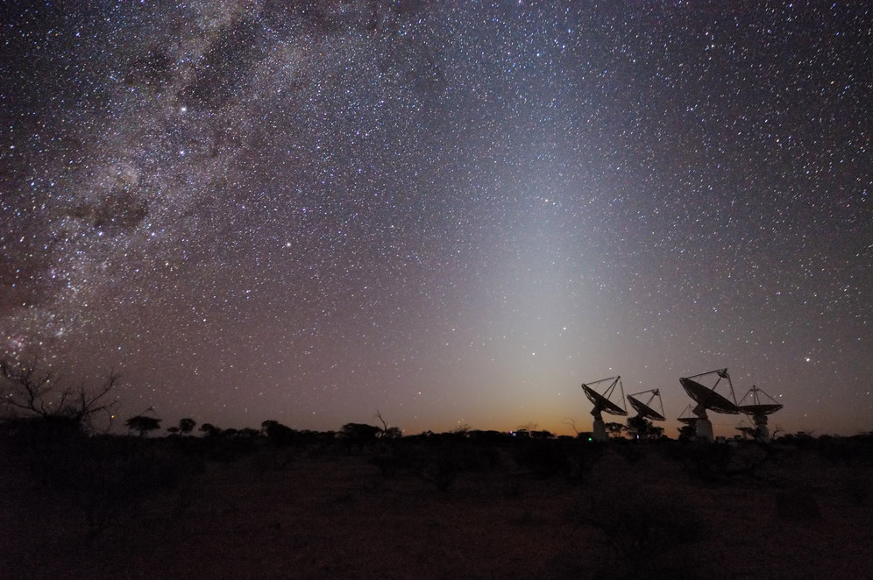
We acknowledge the Wajarri Yamatji as the
traditional owners of the observatory site.
CSIRO Astronomy and Space Science
Phil Edwards
Antony Schinckel Kate Chow
w www.csiro.au/cass
Notes:
I always finish on this slide – and keep a few after this as backup if I think I might get questions

